Slide 1
MODULE 3
3.2 Financial recourses and capital of IT-organizations

Slide 2
The essence of the finances of an organization
The concept of "capital" - one of the main in the theory of the market economy. Considering capital as a factor of production, economists understand it as means of production created by people, including infrastructure (machinery, equipment, buildings, structures, transport, communications, etc.). Capital is a durable resource created for the purpose of producing more goods and services. Capital embodied in the means of production is called real capital. Capital not yet invested in production is the sum of money. Cash capital, or cash, is an investment resource. Cash capital is used to purchase machinery, equipment and other means of production. The process of production and the accumulation of means of production is called investment. Capital is a product of labor and is therefore limited in nature.
The term "finansia" translated from Latin means "cash" or "income".

Slide 3
The essence of the finances of an organization
The finances of an organization are monetary relations arising in the process of formation, distribution and use of decentralized funds of funds intended to ensure social reproduction, to meet the needs of owners, employees, etc.
Depending on the participation of economic entities in the field of material production:
- finance of organizations in sphere of material production;
- finance of organizations in the non-production sphere.
Depending on the industry, the finances of organizations of material production are subdivided into finances of organizations in industry, agriculture, construction, forestry, transport, communications, trade, etc., and the finances of organizations in the non-production sphere include finances of institutions of education, culture, art, health care science, etc.

Slide 4
The main sources of creating of financial resources
The main sources of creating of financial resources are:
1. Equity capital, which includes
a) contributions of founders (in the form of intangible assets, cash or other property);
b) the sources received from the main activity (depreciation charges, profit, budget appropriations provided on a non-repayable basis, targeted financing, etc.).
2. Financial market funds, which are bank loans, commercial loans from other organizations, issue (issue) of securities, budget loans, repo transactions, etc.
A repo transaction is an agreement to sell and repurchase securities at a specified time interval, that is, in essence, these are short-term loans secured by reliable assets.
3. Other funds, which include funds of persons participating in shared construction, charitable contributions, etc.

Slide 5
The main sources of creating of financial resources
The main ways to attract finance investments are:
1. Self-financing (applies to small investment projects and is carried out at their own expense).
2. Equity financing (carried out at the expense of common and preferred shares).
3. State funding (carried out within the framework of targeted state and interstate programs, competitive financing of highly effective projects, etc.).
4. Debt financing (involving the use of borrowed funds in the form of: bank loans; funds accumulated from the issue of debt securities; commercial loans, etc.).
5. Mixed financing is the most common method of financing investments in practice, which involves the use of various financing options.

Slide 6
Financial management
Financial management is a specific area of ​​management activity aimed at optimizing the financial relations and financial flows of the organization and achieving positive final results of management, ensuring the liquidity and solvency of the organization.
Financial management is a system of management measures, techniques, technologies that allow not only to organize financial relations and financial flows, but also to effectively manage them through the use of elements of the financial mechanism (financial methods, levers and instruments, legal support).

Slide 7
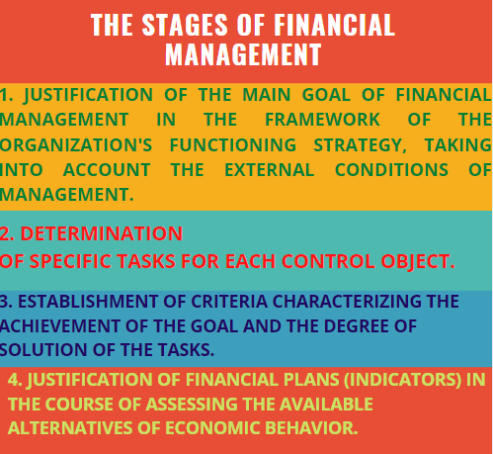
Financial management

Slide 8
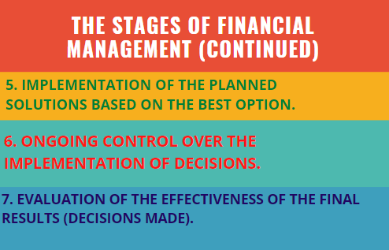
Financial management

Slide 9
Financial management
Within the framework of the economic approach, capital is a self-increasing value, i.e. the value advanced into production for the purpose of making a profit. Capital can be divided into real and financial. The first capital is embodied in material goods as factors of production (buildings, cars, vehicles, raw materials, etc.), the second - in securities and cash. In accordance with this concept, the amount of capital is calculated as the total of the balance sheet for the asset.
Within the framework of the accounting approach, implemented at the level of an economic entity, capital is interpreted as the interest of the owners of this entity in its assets, i.e. the term "capital" in this case is synonymous with net assets, and its value is calculated as the difference between the sum of the assets of the entity and the value of its liabilities. This view is also known as the financial concept of capital.

Slide 10
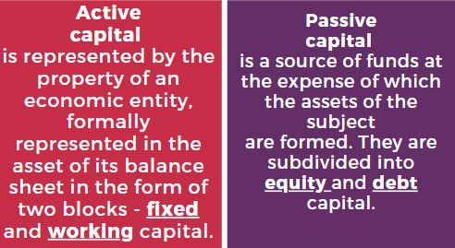
Financial management
The accounting and analytical approach is, in fact, a combination of the two previous approaches. In this case, capital as a set of resources is characterized simultaneously from two sides; a) from the direction of the directions of its investment; b) from the source of origin. Accordingly, there are two interrelated types of capital: active and passive.

Slide 11
Concept and structure of fixed capital
Fixed assets are assets that have a tangible form, and at the same time satisfy the following conditions:
• are intended for use in the activities of the organization, including in the production of products, in the performance of work, in the provision of services, for the managerial needs of the organization, as well as for provision for temporary use (temporary possession and use), except for cases established by law;
• the organization expects to receive economic benefits from the use of assets;
• assets are held for use over a period of more than 12 months;
• the organization does not intend to dispose of assets within 12 months from the date of acquisition;
• the historical cost of assets can be measured reliably.

Slide 12
Concept and structure of fixed capital
Fixed assets are classified.
1. By natural-material composition:
buildings and constructions; transfer devices; cars and equipment; vehicles; tool; perennial plantings, etc.
2. By functional purpose:
• production (machine tools, workshop buildings, vehicles, etc.);
• non-production (housing and communal services, consumer services, etc.).
3. By the degree of use:
in operation; under conservation; in stock; rented.
4. By accessory:
• own (registered on the balance sheet of the organization);
• leased (owned by another organization and temporarily operated for a fee).

Slide 13
Concept and structure of fixed capital
The constituent elements of the structure (types of current assets) are:
1. Stocks, including: materials; unfinished production; implementation costs; finished products and goods; goods shipped (they can be considered in the following areas: the due date of payment has not come; whose payment term is overdue. This element of short-term assets can be characterized negatively when assessing the results of the financial and economic activities of an enterprise, since it arises as a result of a violation of settlement and contractual discipline and is associated with a lack of funds from the buyer or a violation of the assortment, detection of defects); future expenses; other supplies and costs.
2. Long-term assets held for sale.
3. Value added tax on purchased goods, works, services.
4. Short-term receivables.
5. Short-term financial investments.
6. Cash and cash equivalents.
7. Other short-term assets

Slide 14
Concept and structure of working capital
Working capital is funds invested in property that can be converted into cash during one production cycle. Elements of current assets are in two forms: material (inventory, work in progress, finished goods, goods) and financial (accounts receivable, cash, short-term financial investments).
Current assets play an important role in the activities of each business entity, which is explained by the following aspects:
• the availability of these assets is a prerequisite for the start and normal functioning of production and sale of products (works, services);
• their volume, structure and rate of turnover are reflected in the solvency of the organization;
• the efficiency of using current assets has a significant impact on financial results (cost level, profit, profitability, etc.).

Slide 15
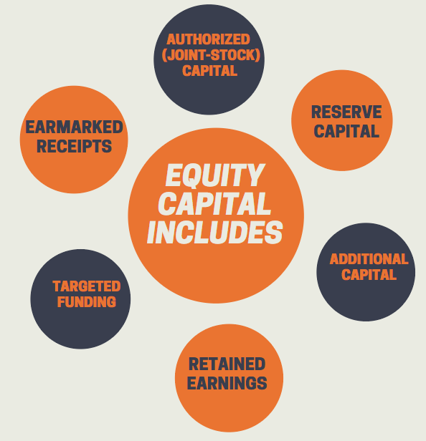
Equity capital
The amount of equity capital reflects the amount of funds and reserves of the organization formed in previous reporting periods, the amount of profit of the reporting year and previous years, receipts for future expenses and expenses.

Slide 16
Equity capital
Authorized capital - the amount of capital registered in the company's charter.
Reserve capital is a portion of equity allocated from net income to cover potential balance sheet losses and other losses.
Additional capital - the value of property contributed by the founders (shareholders) in excess of the registered authorized capital, as well as accruals resulting from the revaluation of property as a result of revaluation, property received free of charge.
Retained earnings - the company's net profit received less losses, dividends or transfers to the amount of paid-in capital.
Targeted financing includes funds that an organization receives from the state in the form of state aid, from other organizations or individuals, intended to finance targeted activities.
Earmarked receipts - funds in cash and in-kind that come to a non-profit organization to carry out the main (statutory) activities.

Slide 17
Debt capital is funds received in the form of a debt obligation. It has a deadline and is subject to return.
The use of borrowed funds to finance current and investment activities is mainly associated with the following reasons:
• absence or insufficient availability of own resources for expansion and modernization of production;
• the presence of a temporary need for funds due to the seasonality of production, interruptions in the flow of funds and other unforeseen circumstances.

Slide 18
Debt capital
The principles of attracting borrowed capital are:
the repayment of resources,
urgency,
payment,
strict regulation of the conditions of attraction.
The forms of raising borrowed capital can be:
banking,
leasing,
mortgage loans,
forfeiting,
factoring, etc.

Slide 19
Debt capital
When choosing the form of attracting borrowed capital, the following are taken into account:
goals of attracting;
the amount of funds needed;
specifics of economic activity and investment project;
the price of the attracted capital;
the complexity of the attraction procedure;
profitability of the operation for which funds are attracted;
creditworthiness and other conditions.

Slide 20
Financing methods:
1) centralized;
2) decentralized.
Centralized method - the federal (state) budget, the budgets of the constituent entities of the Republic (or Federation, etc), centralized off-budget investment funds, etc. act as a source of financing for capital investments.
Decentralized method - sources of organisation and individual developers are the source.
At the organisation, the main sources of financing are: profit remaining at the disposal of the organisation; depreciation deductions; funds received from the issue and sale of shares; loans from commercial banks; sources of parent organizations; funds of foreign investors, etc. But the main sources of financing for capital investments are profit for accumulation and depreciation.

Slide 21
Depreciation
Depreciation is an accounting method of allocating the cost of a tangible or physical asset over its useful life or life expectancy. Depreciation represents how much of an asset's value has been used up. Economists use term ‘amortization’ speaking about intangibles in similar context.
The linear (or straight line) depreciation method is the simplest and the most widely used method to calculate the depreciation for fixed assets. The capital allowance is recorded by equal portions for every time period or interval for the entire service life of the fixed asset.

Slide 22
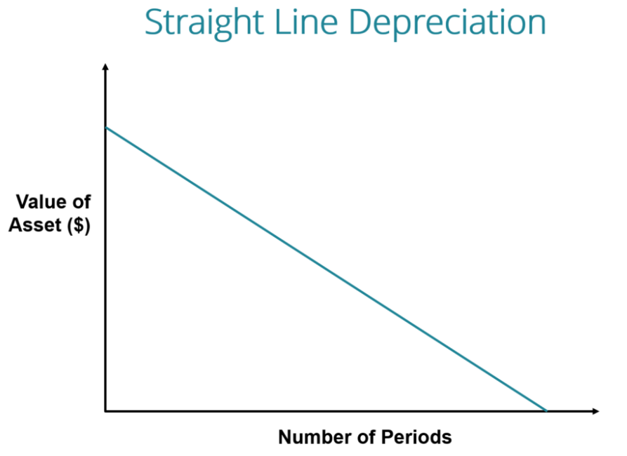
Depreciation

Slide 23
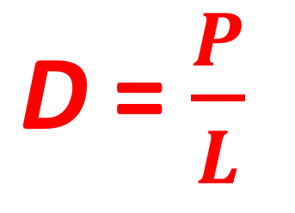
Depreciation
You need the following numbers to calculate annual payments in the case of straight-line depreciation (D) for a fixed asset:
The total purchase price of the asset (the cost of the asset including shipping, taxes, installation fees, etc.) (P)
The useful life of the asset is the number of periods/years in which the asset is expected to be used by the company (L).

Slide 24
Invested capital is a concept that means the total amount of investment that a company has received from its shareholders and creditors.
The funds raised are usually directed to the acquisition of assets that will be used in the course of carrying out activities, such as buildings and structures, industrial equipment, raw materials and materials, goods, etc. efficient use of these assets in the course of business, in turn, will lead to higher profits, which contributes to the improvement of the well-being of shareholders and creditors.

Slide 25
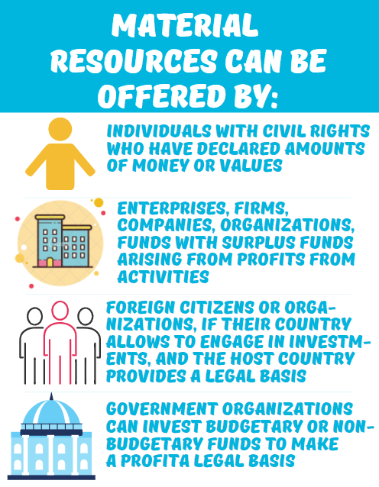
Invested capital

Slide 26
Profit
is understood as a positive financial result of the organization's activities.
The economic legislation of many countries (including the Republic of Belarus) defines profit as the main goal of the functioning of commercial organizations.
The internal content of this category reveals its division into types. The composition of the types of profit differs in managerial accounting and tax accounting.
In accounting, profit is divided by areas of activity into the following perspectives:

Slide 27
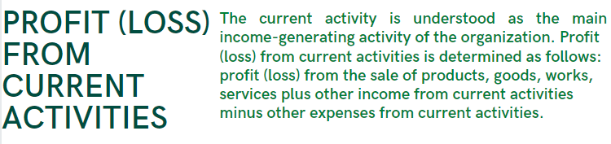
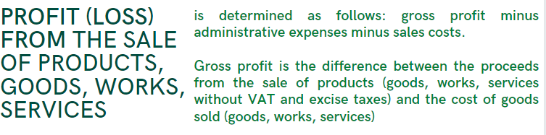
Profit

Slide 28

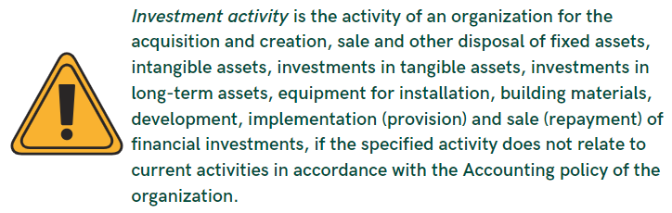
Profit

Slide 29

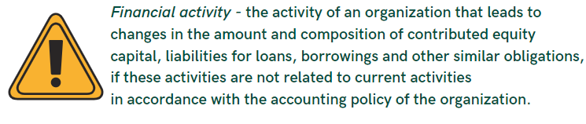
Profit

Slide 30

Profit
Economists often use the term ‘profitability’ when they want to assess the effectiveness of organizations' operations. It is calculated by the formula:
where:
P&S costs – production and sales costs

Slide 31
Profit
The distribution of profits is an integral and inseparable part of the general system of distribution relations and, perhaps, on a par with the distribution of income of individuals, the most important one.
The specific forms and methods of distribution of profits are constantly changing and developing with the growth of social production.
The distribution object is the total (balance sheet) profit of the organisation. The total profit of an organisation synthesizes in itself all the diverse results of its economic and financial activities. When distributing and using it, multiple regulations based on the Law on Income and Profit Tax, the Law on the Joint Stock Company and other regulations must be taken into account.

Slide 32
Profit
Profit distribution is understood as its direction to form state budget revenues and to meet the needs of organisations for funds to expand production and material incentives for employees.
The distribution of profits is legally regulated in the part that goes to budgets of different levels in the form of taxes and other mandatory payments. Determination of the directions of expenses of the profit remaining at the disposal of the enterprise, the structure of the articles of its use is in the competence of the enterprise.

Slide 33
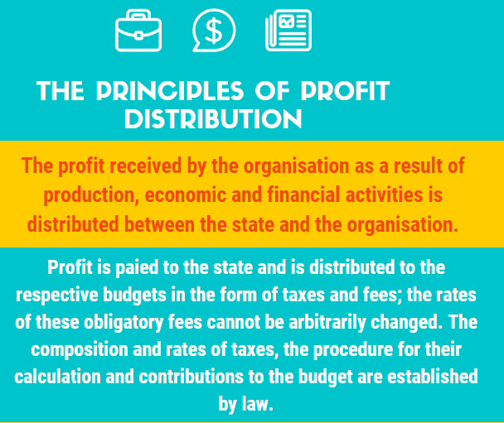
Profit

Slide 34
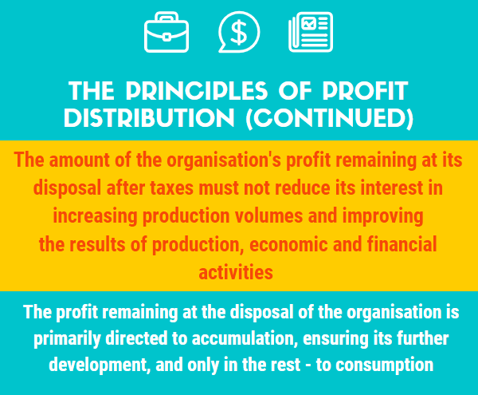
Profit

Slide 35
Profit
From the profit of the organisation they pay income tax and local taxes.
The object of taxation is the taxable profit, calculated on the basis of the amount of profit from the sale of goods (works, services), other values ​​(including fixed assets, inventories, intangible assets), property rights and income from non-sale transactions, reduced by the amount of expenses on these operations.

Slide 36
Profit
The procedure for the distribution and use of the company's profits is fixed and is determined by the regulation, which is developed by the relevant economic services and approved by the governing body of the organisation.

