Slide 1
Organisational development

Slide 2
Organizational development definition
Organizational development is a critical and science-based process that helps organizations build their capacity to change and achieve greater effectiveness by developing, improving, and reinforcing strategies, structures, and processes.
Organization development (OD) is the study of successful organizational change and performance. OD emerged from human relations studies in the 1930s, during which psychologists realized that organizational structures and processes influence worker behavior and motivation. More recently, work on OD has expanded to focus on aligning organizations with their rapidly changing and complex environments through organizational learning, knowledge management and transformation of organizational norms and values. Key concepts of OD theory include: organizational climate (the mood or unique “personality” of an organization, which includes attitudes and beliefs that influence members’ collective behavior), organizational culture (the deeply-seated norms, values and behaviors that members share) and organizational strategies (how an organization identifies problems, plans action, negotiates change and evaluates progress).
Organizational development can be defined as an objective-based methodology used to initiate a change of systems in an entity. Organizational development is achieved through a shift in communication processes or their supporting structure. Studying the behavior of employees enables professionals to examine and observe the work environment and anticipate change, which is then effected to accomplish sound organizational development.

Slide 3
Benefits of Organizational Development
Increasing productivity and efficiency comes with many benefits. One of the best ways to encourage positive results in these metrics is by using a well-thought-out organizational development structure. Organizational development is used to equip an organization with the right tools so that it can adapt and respond positively (profitably!) to changes in the market. The benefits of organizational development include the following:
1. Continuous development
Entities that participate in organizational development continually develop their business models. Organizational development creates a constant pattern of improvement in which strategies are developed, evaluated, implemented, and assessed for results and quality. In essence, the process builds a favorable environment in which a company can embrace change, both internally and externally. The change is leveraged to encourage periodic renewal.
2. Increased horizontal and vertical communication
Of considerable merit to organizational development is effective communication, interaction, and feedback in an organization. An efficient communication system aligns employees with the company’s goals, values, and objectives. An open communication system enables employees to understand the importance of change in an organization. Active organizational development increases communication in an organization, with feedback shared continuously to encourage improvement.

Slide 4
Benefits of Organizational Development
3. Employee growth
Organizational development places significant emphasis on effective communication, which is used to encourage employees to effect necessary changes. Many industry changes require employee development programs. As a result, many organizations are working toward improving the skills of their employees to equip them with more market-relevant skills.
4. Enhancement of products and services
Innovation is one of the main benefits of organizational development and is a key contributing factor to the improvement of products and services. One approach to change is employee development – a critical focal point is a reward for motivation and success. Successful engagement of employees leads to increased innovation and productivity. Through competitive analysis, consumer expectations, and market research, organizational development promotes change.
5. Increased profit margins
Organizational development influences the bottom line in many different ways. As a result of increased productivity and innovation, profits and efficiency increase. Costs come down because the organization can better manage employee turnover and absenteeism. After the alignment of an entity’s objectives, it can focus entirely on development and product and service quality, leading to improvements in customer satisfaction.

Slide 5
Organizational Development Process
A conventional approach in the organizational development process is the action research model. This model is used by many organizations to guide the OD process. It entails what its name describes – research and action. However, there is much more to the OD process than just research and development. There are multiple loops used to transmit feedback, which makes an organization more responsive to change.

Slide 6
Components of the Action Research Model
The action research model comprises six key components:
1. Problem diagnosis
The organization development process begins by recognizing problems. The method of diagnosis usually takes the form of data gathering, assessment of cause, as well as an initial investigation to ascertain options.
2. Feedback and assessment
The feedback and assessment step often involves proper investigation of identified problems so that there is a deep understanding of the challenge at hand. This can include an appraisal of documents, focus groups, customer or employee surveys, hiring consultants, and interviewing current employees. Information gathered is used to re-evaluate the challenges in the first step.
3. Planning
Once an organization defines and understands its challenge, an action plan is put together. The plan lays down all the intervention measures that are considered appropriate for the problem at hand. Usually, the measures include such things as training seminars, workshops, team building, and changing the makeup or structure of teams. Additionally, measurable objectives, which define the expected results, form an integral part of the overall plan.

Slide 7
Components of the Action Research Model
4. Intervention and implementation
Once a plan is in place, the intervention phase commences. Since the organizational development process is complicated, implementation processes are a key element of the model. As an example, if training classes are preferred over other methods, test results will form the basis upon which the training process is evaluated. The objective at this point is to ensure the required changes take place. If that is not the case, feedback is assessed and used to bring about the required change.
5. Evaluation
As soon as the intervention plan is complete, the outcome of the change in the organization is assessed. If the required change does not take place, the organization looks for the cause. Adjustments are made to ensure the obstacle is eliminated.
6. Success
Success denotes that the desired change took place. A proper plan and efficiency standards are put in place to ensure that the new switch is sustainable. Ongoing monitoring is needed to ensure that implemented changes last. Furthermore, as markets and organizations change, new problems can arise, leading to the push for further development. Great organizations evolve continuously.

Slide 8
Organizational development patterns
Organizational development is based on some patterns described by the concept of the organization's life cycle.
A life cycle is defined as the developmental stages that occur during an system lifetime.
The organizational life cycle is the life cycle of an organization from its creation to its termination. It also refers to the expected sequence of advancements experienced by an organization, as opposed to a randomized occurrence of events. The relevance of a biological life cycle relating to the growth of an organization, was discovered by organizational researchers many years ago. This was apparent as organizations had a distinct conception, periods of expansion and eventually, termination.
Most models, however, hold to a view that the organizational life cycle is comprised of four or five stages that can be summarized simply as startup, growth, maturity, decline, and death (or revival).
There are several approaches to describing the life cycle:

Slide 9
Generally, there are several stages to an organization's life cycle
Stage 1: Idea
Stage 1: Existence : Commonly known as the birth or entrepreneurial stage, “existence” signifies the start of an organization's expansion. The main importance is centered around the acknowledgement of having an adequate number of customers to keep the organization or business active.
Stage 2: Survival : At this stage, organizations look to pursue growth, establish a framework and develop their capabilities. There is a focus on regularly setting targets for the organization, with the main aim being to generate sufficient revenue for survival and expansion. Some organizations enjoy adequate growth to be able to enter the next stage, whilst others are unsuccessful in achieving this and consequently fail to survive.
Stage 3: Maturity : This stage signifies the organization entering a more formal hierarchy of management (hierarchical organization). A frequent problem encountered at this stage would be those associated with “Red Tape”. Organizations look to safeguard their growth as opposed to focusing on expansion. Top and middle-level management specialize in different tasks, such as planning and routine work respectively.
Stage 4: Renewal : Organizations experience a renewal in their structure of management, from a hierarchical to a matrix style, which encourages creativity and flexibility.
Stage 5: Decline : This stage initiates the death of an organization. The decline is identified by the focus on political agenda and authority within an organization, whereby individuals start to become preoccupied with personal objectives, instead of focusing on the objectives of the organization itself. This slowly destroys the functionality and feasibility of the entire organization.
Stage: Crisis

Slide 10
Crisis and organizational crisis from a general point of view
Crisis
any event that is going (or is expected) to lead to an unstable and dangerous situation affecting an individual, group, community, or whole society.
the turning point for better or worse
a situation that has reached a critical phase
organizational crisis is the turning point for better or worse organization development according to lifecycle stage
organizational crisis could:
Threaten a major product line, business unit
Damage an organization's financial performance
Harm the health and well being of consumers, employees, surrounding communities, or the environment
Destroy the public's trust in an organization, its reputation and image

Slide 11
Theories of the organizational life cycle
There are two most elaborated theories of the life cycle of an organization, which focus on specific aspects of its development. They named according to author names:
Greiner's Growth Model
Adizes Model.

Slide 12
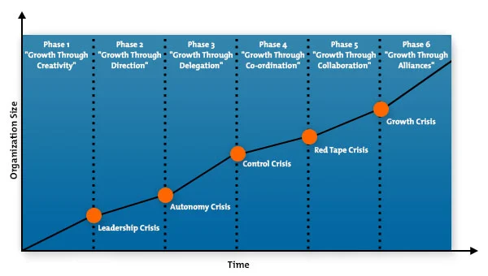
Greiner's Growth Model
Greiner's Growth Model describes phases that organizations go through as they grow. ... Each growth phase is made up of a period of relatively stable growth, followed by a "crisis" when major organizational change is needed if the company is to carry on growing.
Larry E. Greiner originally proposed this model in 1972 with five phases of growth. In 1998, he added a sixth phase in an updated version of his original article. The six growth phases are described below:

Slide 13
Greiner's Growth Model: stages explanations
Phase 1: Growth Through Creativity
Here, the entrepreneurs who founded the firm are busy creating products and opening up markets. There aren't many staff, so informal communication works fine, and rewards for long hours are probably through profit share or stock options. However, as more staff join, production expands and capital is injected, there's a need for more formal communication. This phase ends with a Leadership Crisis, where professional management is needed. The founders may change their style and take on this role, but often someone new will be brought in.
Phase 2: Growth Through Direction
Growth continues in an environment of more formal communications, budgets and focus on separate activities like marketing and production. Incentive schemes replace stock as a financial reward. However, there comes a point when the products and processes become so numerous that there are not enough hours in the day for one person to manage them all, and he or she can't possibly know as much about all these products or services as those lower down the hierarchy. This phase ends with an Autonomy Crisis: new structures based on delegation are called for.
Phase 3: Growth Through Delegation
With mid-level managers freed up to react fast to opportunities for new products or in new markets, the organization continues to grow, with top management just monitoring and dealing with the big issues (perhaps starting to look at merger or acquisition opportunities). Many businesses flounder at this stage, as the manager whose directive approach solved the problems at the end of Phase 1 finds it hard to let go, yet the mid-level managers struggle with their new roles as leaders. This phase ends with a Control Crisis: a much more sophisticated head office function is required, and the separate parts of the business need to work together.

Slide 14
Greiner's Growth Model: stages explanations
Phase 4: Growth Through Coordination and Monitoring
Growth continues with the previously isolated business units re-organized into product groups or service practices. Investment finance is allocated centrally and managed according to Return on Investment (ROI) and not just profits. Incentives are shared through company-wide profit share schemes aligned to corporate goals. Eventually, though, work becomes submerged under increasing amounts of bureaucracy, and growth may become stifled. This phase ends on a Red-Tape Crisis: a new culture and structure must be introduced.
Phase 5: Growth Through Collaboration
The formal controls of phases 2-4 are replaced by professional good sense as staff group and re-group flexibly in teams to deliver projects in a matrix structure supported by sophisticated information systems and team-based financial rewards. This phase ends with a crisis of Internal Growth: further growth can only come by developing partnerships with complementary organizations.
Phase 6: Growth Through Extra-Organizational Solutions
Greiner's recently added sixth phase suggests that growth may continue through merger, outsourcing, networks and other solutions involving other companies. Growth rates will vary between and even within phases. The duration of each phase depends almost totally on the rate of growth of the market in which the organization operates. The longer a phase lasts, though, the harder it will be to implement a transition.

Slide 15
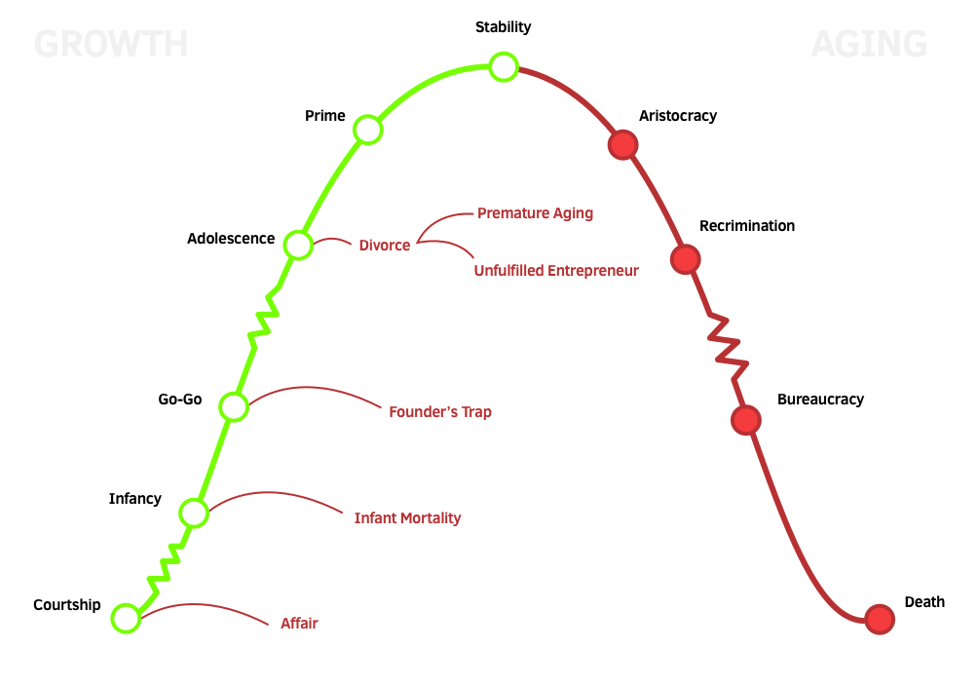
Adizes lifecycle model
According to Adizes , companies go through the following stages: Courtship, Infancy, Go-Go, Adolescence, Prime, Stability, Aristocracy, Recrimination (or Early Bureaucracy), Bureaucracy and Death. The following is a brief description of each stage of the life cycle of organizations.

Slide 16
The 10 Stages of organizational Life Cycles
Courtship. Would-be founders focus on ideas and future possibilities, making and talking about ambitious plans. Courtship ends and infancy begins when the founders assume risk.
Infancy. The founders' attention shifts from ideas and possibilities to results. The need to make sales drives this action-oriented, opportunity-driven stage. Nobody pays much attention to paperwork, controls, systems, or procedures. Founders work 16-hour days, six to seven days a week, trying to do everything by themselves.
Go-Go. This is a rapid-growth stage. Sales are still king. The founders believe they can do no wrong. Because they see everything as an opportunity, t heir arrogance leaves their businesses vulnerable to flagrant mistakes. They organize their companies around people rather than functions; capable employees can--and do--wear many hats, but to their staff's consternation, the founders continue to make every decision.
Adolescence. During this stage, companies take a new form. The founder shire chief operating officers but find it difficult to hand over the reins. An attitude of us (the old-timers) versus them (the COO and his or her supporters)hampers operations. There are so many internal conflicts, people have little time left to serve customers. Companies suffer a temporary loss of vision.
Prime. With a renewed clarity of vision, companies establish an even balance between control and flexibility. Everything comes together. Disciplined yet innovative, companies consistently meet their customers' needs. New businesses sprout up within the organization, and they are decentralized to provide new life-cycle opportunities.
Stability. Companies are still strong, but without the eagerness of their earlier stages. They welcome new ideas but with less excitement than they did during the growing stages. The financial people begin to impose controls for short-term results in ways that curtail long-term innovation. The emphasis on marketing and research and development wanes.
Aristocracy. Not making waves becomes a way of life. Outward signs of respectability--dress, office decor, and titles--take on enormous importance. Companies acquire businesses rather than incubate start-ups. Their culture emphasizes how things are done over what's being done and why people are doing it. Company leaders rely on the past to carry them into the future.
Recrimination. In this stage of decay, companies conduct witch-hunts to find out who did wrong rather than try to discover what went wrong and how to fix it. Cost reductions take precedence over efforts that could increase revenues. Backstabbing and corporate infighting rule. Executives fight to protect their turf, isolating themselves from their fellow executives. Petty jealousies reign supreme.
Bureaucracy. If companies do not die in the previous stage--maybe they are in a regulated environment where the critical factor for success is not how they satisfy customers but whether they are politically an asset or amiability--they become bureaucratic. Procedure manuals thicken, paperwork abounds, and rules and policies choke innovation and creativity. Even customers--forsaken and forgotten--find they need to devise elaborate strategies to get anybody's attention.
Death. This final stage may creep up over several years, or it may arrive suddenly, with one massive blow. Companies crumble when they cannot generate the cash they need; the outflow finally exhausts any inflow.

Slide 17
IT-startup The lifecycle of startups
However, startups are diversified and complex in nature, these entities have their lifecycle. Hopefully, research on startups’ lifecycle is well-developed in last few years (see Salamzadeh, 2015a,b). Since the sequence of activities and stages might vary among different startups, a holistic perspective is presented in this paper to offer a better understanding of the lifecycle of startups. The stages are as follows (Figure 1):
(i) Bootstrapping stage:
In this very early stage, the entrepreneur himself/herself initiates a set of activities to turn his/her idea into a profitable business. However, he/she considers a higher risk or even uncertainty level, continues working on the new venture idea, makes a team, uses personal funds, and asks family members and friends for their investment in the idea. Bootstrapping, which is sometimes defined as highly creative ways of acquiring the use of resources without borrowing (Freear et al., 2002), is considered to be one of the areas of entrepreneurship research that most need to be addressed (Ebben& Johnson, 2006). The purposeo f this stage is to position the venture for growth by demonstrating product feasibility, cashmanagement capability, team building and management, and customer acceptance (Brush et. al., 2006). Moreover, angel investors are more likely to invest in this stage. In sum, as Harrison et al. (2004) argue: “bootstrapping is a way of life in entrepreneurial companies”. This argument reveals the reason why most of the theories of startups are borrowed from entrepreneurship theories (see, Entrepreneurship theories focusing on startups).

Slide 18
IT-startup The lifecycle of startups
(ii) Seed stage:
After the bootstrapping stage, the founder enters into a new stage, which is the seed stage. This stage is characterized by team work, prototype development, entry into market, valuation of the venture, seeking for support mechanisms such as accelerators and incubators, and average investments to grow the startup. Frankly speaking, for most startups the seed stage is a mess and is construed as highly uncertain (Salamzadeh, 2015 a). The seed stage is characterized by the initial capital that is used to do product and/or service (Manchanda & Muralidharan, 2014). Thus, founder seeks for support mechanisms such as accelerators, incubators, small business development centers, and hatcheries to accelerate the process. A great number of startups fail in this stage. Since they could not find support mechanisms and in best case they would turn to a low profit company with a low rate of success. On the other hand, those who succeed in receiving support would have a higher chance of becoming profitable companies. It goes without saying that valuation is normally done at the end of this stage.

Slide 19
IT-startup The lifecycle of startups
(iii) Creation stage:
Creation stage occurs when the company sells its products, enters into market, and hires first employees (Salamzadeh, 2015). Some scholars believe that entrepreneurshipstops when the creation stage is ended (Ogorelc, 1999). This supports the argument that most of the theories which cover startups are borrowed from entrepreneurship theories and not management and organization theories (see Entrepreneurship theories focusing on startups). At the end of this stage, organization/firm is formed and corporate finance is considered as the main choice for financing the firm. Venture capitals could facilitate the creation stage, by funding the venture.

Slide 20
Startup Funding Stages
Pre-Seed Funding: The bootstrapping stage
Seed Funding: Product development stage
Series A Funding: First round of VC
Series B Funding: Second round of VC
Series C Funding: Third round of VC
Series D Funding: Special round of funding
IPO: Stock market launch

Slide 21
1. The Pre-seed Funding Stage
This prime stage of seed funding falls so early that it’s not even considered as a startup funding. The pre-seed funding stage generally refers to the time period in which a startup is getting their operations off the ground.
It’s likely that investors won’t make an investment in exchange for equity in the startup during the pre-series stage. This stage can last for a long time or you can get pre-series funding in quick time. It depends on the nature of your startup and the initial costs that you must consider while developing the business model.
The pre-seed funding stage is commonly known as bootstrapping. In simple terms, it means using your own existing resources in order to scale your startup. Startup owners invest from their own pocket and try to grow themselves in the most resourceful manner.
During the development stage of the startup, entrepreneurs may have to work overtime or get a second job so that they can invest their additional income into their new startup.
Adding to what Jonathan said, the pre-seed funding stage allows a budding startup to build and distribute their product(s) or service(s) effectively. In the research or development phase, the entrepreneurs tend to assess the viability of their idea. They might have a working prototype of their product and are in search of appropriate funding that allows them to scale their startup full-time.
During this stage, many entrepreneurs also seek guidance from founders who have been there and have gone through a similar experience as them. It allows them to determine the incurring costs of their idea or project, develop a winning business model, and garner ideas on how to grow their plan into an operating business.
Entrepreneurs should also work out any necessary partnership agreements, copyrights, or other legal issues during the pre-series stage as similar issues are best resolved during this stage. Later on, they might become expensive and even insurmountable. Also, no investor will provide funds to a startup having legal issues prior to their launch.

Slide 22
1. The Pre-seed Funding Stage
Potential Investors of Pre-Seed Stage. The most common pre-series investors are:
Startup Owners
Friends and Family
Early Stage Venture Funds (Micro VCs)
“Ask people who know you already. Friends, past co-workers, family, etc. That is your best and almost only chance. Failing that ask people who are from the industry and have a lot of money. They might be able to recognize something at the pre-seed stage.” said Kamal Hassan, Partner at Loyal VC.
Startup Valuation in Pre-Seed Stage
During the pre-seed funding stage, startups value anywhere between $10,000 to $100,000.
Active Pre-Seed Stage Funds
Seedcamp
K9 Ventures
First Round

Slide 23
2. Seed Funding Stage
After the pre-seeding stage, it’s time to actually plant the seed. The first in the startup funding stages is “Seed funding”. Almost 29 percent of startups fail because they run out of capital while bootstrapping, which makes seed capital critical to get a business up and running. You can consider the seed funding stage as an analogy of planting a tree. Ideally, the initial funding is the “seed” which allows any startup to flourish. When you provide appropriate water i.e. a successful business strategy, alongside the dedication of the entrepreneur, the startup will eventually grow into a “tree”. Because the investors are taking a huge risk by investing in the business, startups must provide them equity against seed fundings. The stakes are even higher because, at this stage, startups cannot guarantee a successful business model. Seed funding allows a startup to fund costs of product launch, get early traction through marketing, initiate important hiring and further market research for developing product-market-fit. Many startups consider the seed funding round is all that is necessary to successfully get their startup off the ground.
Potential Investors of Seed Stage
The common types of investors who participate in seed funding are:
Friends and Family
Angel Investors
Early Stage Venture Funds (Micro VCs)
Crowdfunding

Slide 24
2. Seed Funding Stage
Startup Valuation & Fundraising in Seed Stage
Startups that are eligible for seed funding have a business that values anywhere between $3 million to $6 million. The seed funding stage will facilitate funding from $50,000 up to $3 million for a promising startup.
Active Seed Stage Funds
500 Startups
Y Combinator
AngelPad
Techstars
Speedinvest

Slide 25
3. Series A Funding Stage
Series A stage is the first round of venture capital financing.
By now, the startup must have a developed product and a customer base with consistent revenue flow. Now it’s time for them to opt for series A funding and optimize their value offerings. This is an ideal opportunity that allows startups to scale themselves across different markets.
In the Series A funding round, it’s significant to have a plan that will generate long-term profits. Many times, startups come up with great ideas that can generate a substantial amount of enthusiastic users, however, they do not know how to monetize it in the long run.
This is the stage where you must start learning how fundraising works and start making early connections with angel investors and VCs. Following the 30-10-2 rule, you must identify investors who would want to invest in your startup. According to this rule, you must find 30 investors who are willing to invest in your business. 10 out of those 30 investors might show interest in your proposal, 2 of which will really pass on funds to you.
Mark Suster said, “Meet your potential investors early. Tell them you’re not raising money yet but that you will be in the next 6 months or so. Tell them you really like them so you want them to have an early view (which is what all investors want).”
Series A funding mostly comes from angel investors and traditional venture capital firms. They are not looking for “great ideas”, instead, they are looking for startups with a solid business strategy that can turn their great idea into a successful, money-making organization, allowing the investors to reap the benefits of their investment.
A single investor may serve as an “anchor” but once a startup has secured its first investor, it’s easier to attract additional investors. Although angel investors prefer to invest during this stage, they tend to have much less influence than VC firms in this stage.

Slide 26
3. Series A Funding Stage
Potential Investors for Series A
Accelerators
Super Angel Investors
Venture Capitalists
Company Valuation & Fundraising in Series A
Startups with a good business plan valuing up to $10 million to $30 million are able to raise approximately $15 million during the Series A funding stage.
Active Series A Investors
IDG Capital
New Enterprise Associates
Plug and Play
SOSV

Slide 27
Series B Funding Stage
Startups that go through the previous startup funding stages (seed funding and Series A) have already developed a substantial user base alongside a steady stream of revenue. They have proven themselves in front of their investors that they are can achieve success at a larger scale.
Investors assist startups to expand their horizons by funding their market reach activities, increasing their market share, form operational teams such as marketing, business development, and customer success. The series B funding stage allows startups to grow so that they can meet the various demands of their customers and also compete in tight markets in terms of competition.
Series B funding stage may appear to be similar to the former funding stage in terms of processes and key players, however, series B funding is often led by same characters, including a key anchor investor that helps you to attract other investors. The major difference is the addition of a new wave of VCs that specialize in investing in well-established startups so that they can further exceed expectations.
“The dilemma is that while your Series A investors were extremely important to you during that round, they may not be the investors you need going forward. If you are in a position where going public is a real possibility, then you need the crossover investors who will be there for you today and when you go public,” suggests Praveen Tipirneni, MD & CEO of Morphic Therapeutic Inc.

Slide 28
Series B Funding Stage
Potential Investors for Series B
Venture Capitalists
Late stage VCs
Company Valuation & Fundraising in Series B
Startups with a revenue-generating model, valuing up to $30 million to $60 million are able to raise approximately $30 million during the Series B funding stage.
Active Series B Investors
Khosla Ventures
GV
StartX (Stanford-StartX Fund)

Slide 29
Series C Funding Stage
Startups that make it to the series C funding stage should be on their growth path. These startups search for more funding that could help them build new products, reach new markets, even acquire other under-performing startups of the similar industry.
In the series C funding stage, investors happily fund successful startups. They are hopeful to receive a profit that is more than the money they invest. The Series C funding stage focuses on scaling the startup as rapidly as possible.
To scale your startup significantly, you can acquire different startups with the Series C funding. By now, your startup operations have become less risky whereas more investors are coming in to play. Many hedge funds, investment banks, private equity firms etc. will happily invest in your startup during the Series C stage.
The reason behind this is that the startup has already proven itself to be an operating success. New investors join the game by investing a significant amount of money into thriving startups to secure their own position as leading investors.
Do remember that startups that engage in Series C Funding are well-established, hold a strong customer base, have procured stable revenue streams alongside proven histories of their growth, and want to expand their operations on a global scale. If you haven’t accomplished any of the above, then you’re not ready for the Series C funding yet.
“Now is a better time than ever for emerging businesses to apply for the funding they need to accelerate their growth,” said Marz Ayyad, EMEA Lead at NetSuite PE & VC Practice.

Slide 30
Series B Funding Stage
Potential Investors for Series C
Late stage VCs
Private Equity Firms
Hedge Funds
Banks
Company Valuation & Fundraising in Series C
Startups with a good business growth valuing up to $100 million to $120 million are able to raise approximately $50 million during the Series C funding stage.

Slide 31
Series D Funding Stage and Beyond
Not many startups find a need to go to this stage. The Series D funding stage allows entrepreneurs to raise funds for a special situation. For instance, a merger and also if it has not yet hit its growth goal.
A startup may consider series D funding if it hasn’t gone public yet, but is contemplating a merger with a competitor on agreeable terms. The Series D funding offers startups the most viable solutions allowing them to negotiate issues head-on by acquiring another startup as a merger.
Also, If a startup was unable to achieve its growth landmark with series C funds, then it will find a need to get more funds through series D funding to keep afloat.

Slide 32
Series D Funding Stage and Beyond
Potential Investors for Series D
Late stage VCs
Private Equity Firms
Hedge Funds
Banks
Company Valuation & Fundraising in Series D
Startups in this stage may value around $150 million to $300 million are able to raise approximately $100 million during this startup funding stage.
Active Series C & D Investors
Accel
Sequoia Capital
Founders Fund
Lightspeed Venture Partners

Slide 33
Initial Public Offering (IPO)
IPO is the process of offering corporate shares to the general public for the first time. Growing startups that need funding often use this process to generate funds, whereas established organizations use it to allow startup owners to exit some or all of their ownership by selling the shares to the general public. When a startup decides to go public, a specific set of events occur during the IPO process. They include:
Formation of an external public offering team comprising of underwriters, lawyers, certified public accountants, and SEC experts.
Compilation of the startup’s Information including its financial performance as well as its expected future operations.
Audit of the startup’s financial statements takes place which generates an opinion about its public offering.
The startup files its prospectus with the SEC and determines a specific date for going public.
Benefits of IPO
Raising funds for the startup is not the only benefit that entrepreneurs enjoy in case of a public offering. Some other advantages are:
A public organization is able to generate additional funds through secondary offerings as it already has access to public markets.
Many public organizations compensate executives through stock. The stocks of a public organization are more attractive to employees as the stocks can be sold easily. Also, being public allows an organization to recruit better talent as well.
Mergers are easier for a public organization as it can utilize its public shares to acquire another startup.

