Slide 1
Marketing

Slide 2
Definition of marketing
According to the American Marketing Association, «Marketing is the activity, set of institutions, and processes for creating, communicating, delivering, and exchanging offerings that have value for customers, clients, partners, and society at large».
Philip Kotler’s definition of Marketing is – “Marketing is a social and managerial process by which individuals and groups obtain what they need and want through creating and exchanging products and value with other”.

Slide 3
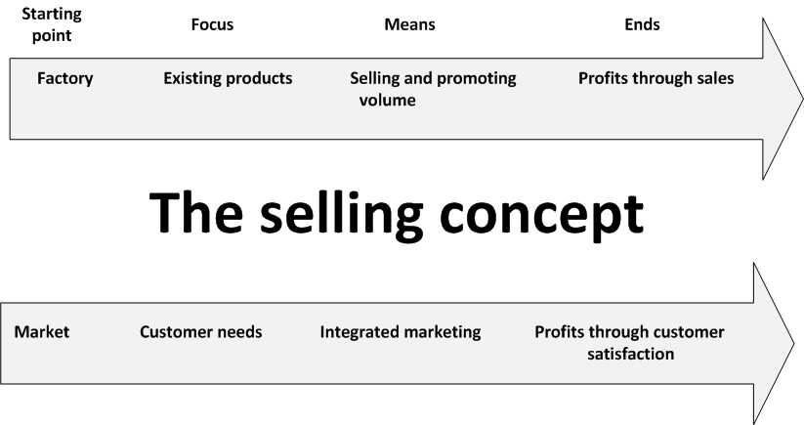
The selling and marketing concepts contrasted

Slide 4
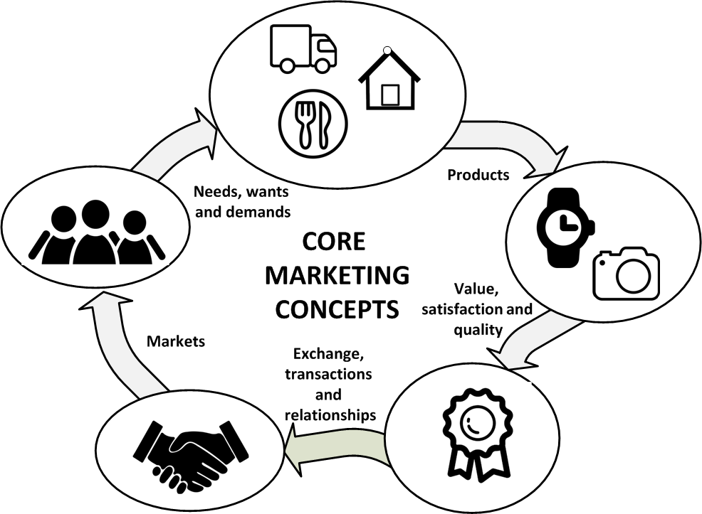
Essence of marketing

Slide 5
Essence of marketing: core definitions
human need
A state of felt deprivation.
Human wants
The form that a human need takes as shaped by culture and individual Personality
demands
Human wants that are backed by buying power.
customer satisfaction
It is a measure of how products and services supplied by a company meet or surpass customer expectation. Customer satisfaction is defined as "the number of customers, or percentage of total customers, whose reported experience with a firm, its products, or its services (ratings) exceeds specified satisfaction goals." Customers play an important role and are essential in keeping a product or service relevant so it is in the best interest of the business to ensure customer satisfaction, and build customer loyalty.
market
The set of all actual potential buyers of a product or service.
is a place where two parties can gather to facilitate the exchange of goods and services.

Slide 6
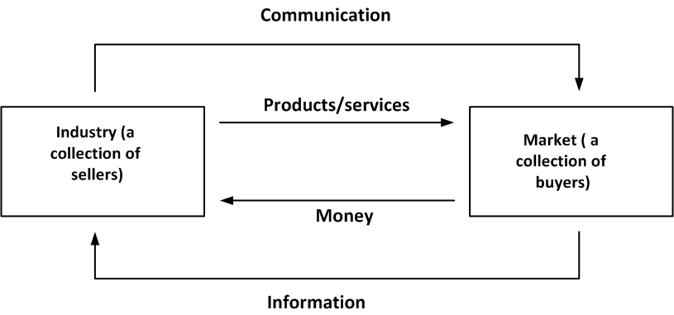
A simple marketing system

Slide 7
Marketing includes everything that organizations do to satisfy customer needs:
Coming up with a product and defining its features and benefits
Setting its price
Identifying its target market
Making potential customers aware of it
Getting people to buy it
Delivering it to people who buy it
Managing relationships with customers after it has been delivered

Slide 8
to achieve company profitability goals, you need to start with three things:
1. Find out what customers or potential customers need.
2. Develop products to meet those needs.
3. Engage the entire organization in efforts to satisfy customers.

Slide 9
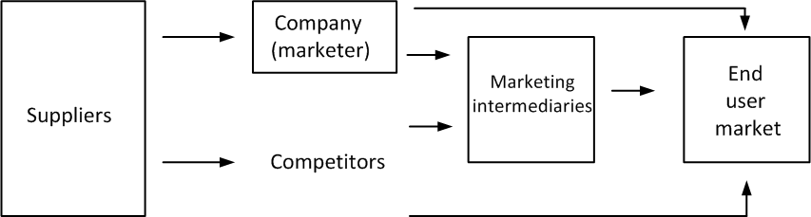
Main actors and forces in a modern marketing system

Slide 10
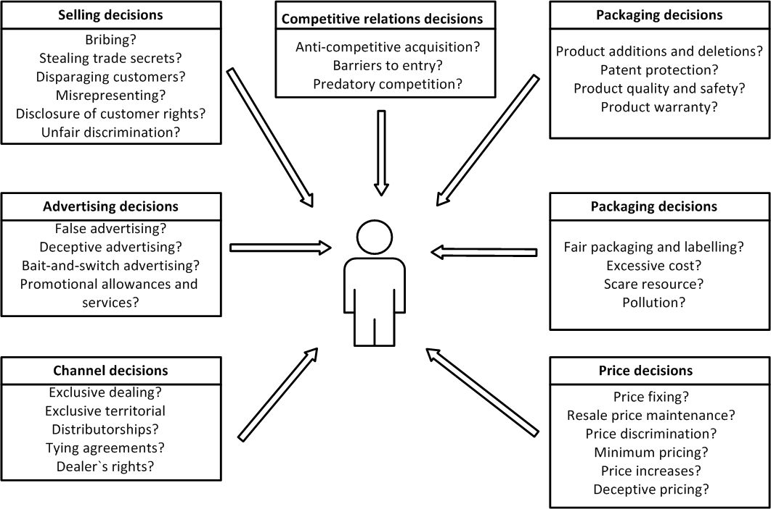
Legal issues and marketing

Slide 11
The Marketing Process
Strategy
Target Consumers
The Competitive Environment
Demand Measurement and Forecasting
Market Segmentation
Positioning
Tactics
Developing the Marketing Mix

Slide 12
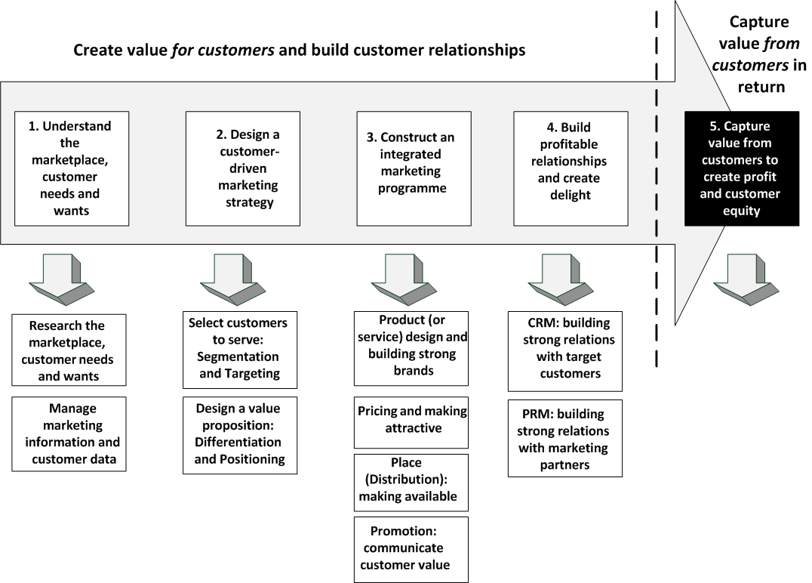

Slide 13
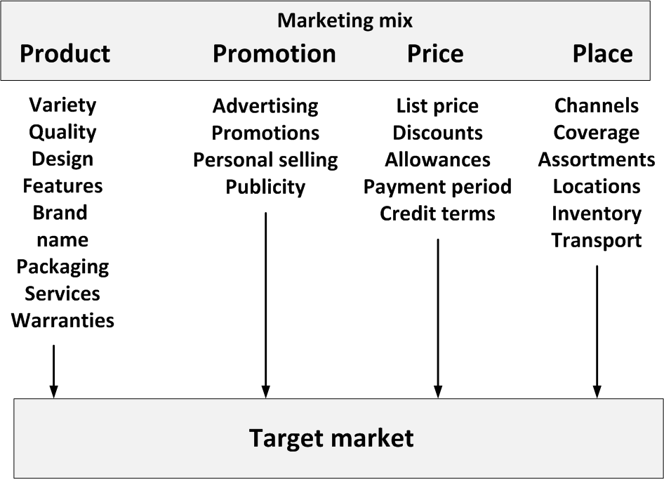
Structure of marketing activity

Slide 14
References

