Slide 1
business environment

Slide 2
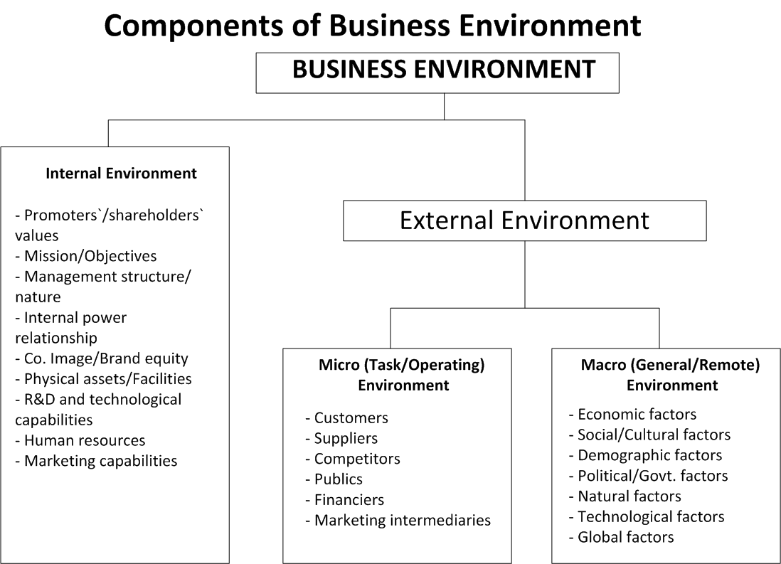
business environment
The definition of business environment means all of the internal and external factors that affect how the company functions including employees, customers, management, supply and demand and business regulations.

Slide 3
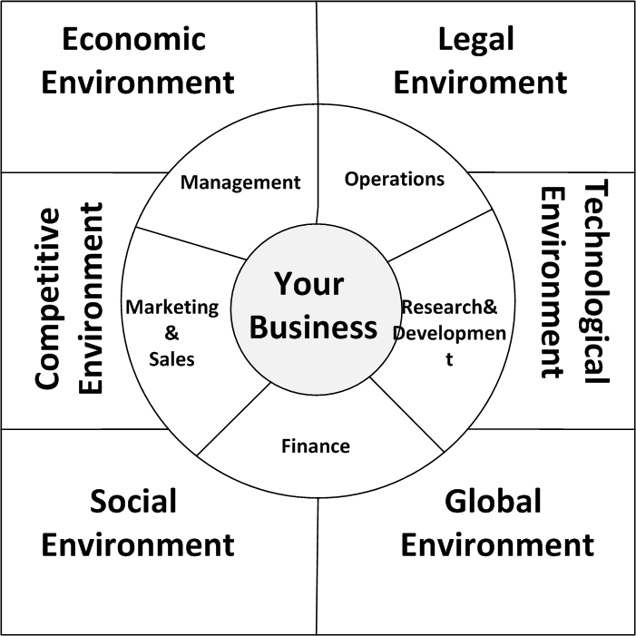
External business environment: elements
Micro environment
The factors are inside organization and under the control of the organization
Management
Operations
Research and development
Marketing and sales
Finance
Macro environment
The factors are outside the control of the organization but have some form impact on the organisation
Technology
Globalisation
Social
Competiors
Economy
legal

Slide 4
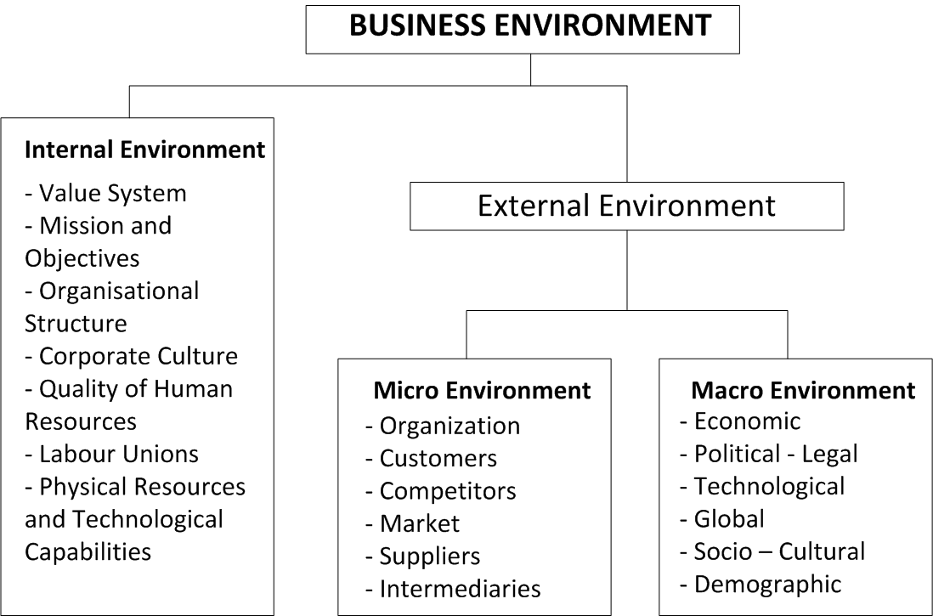
External business environment: subelements

Slide 6
What is PESTLE Analysis
PESTLE Analysis is a technique used for analysing the external environment surrounding an organisation when investigating business change. PESTLE is an acronym which stands for Political, Economic, Sociological, Technological, Legal, Environmental. The factors identified could be items that help the organisation or hinder it. The technique is used to help identify factors involved in change rather than solutions to any of the factors.
There are several variations on PESTLE Analysis:
PEST: Political, Economic, Sociological, Technological
PESTLIED: Political, economic, sociological, technological, environmental, legal, international, environmental, demographic
STEEPLE: Sociological, technological, environmental, economic, political, legal, ethical
The important element to the technique is considering all the areas of the technique rather than painstakingly classifying a factor. When considering each factor you need to identify what the factor is and what the impact will be on the business. The elements of this technique are introduced below.

Slide 7
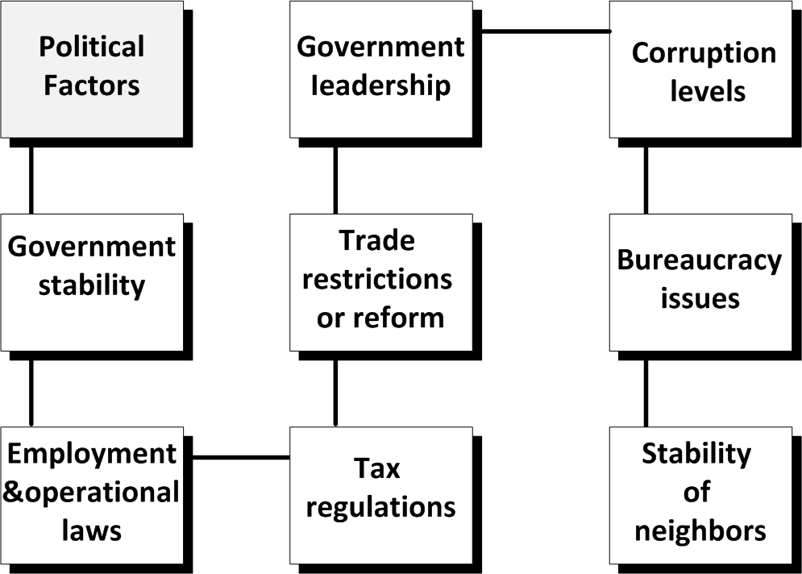
Political Factors:
Any factors in the political environment either in the home country or international arena. Examples of these could be government initiatives or changes of policy which affect the organisation.
These factors are all about how and to what degree a government intervenes in the economy or a certain industry. Basically all the influences that a government has on your business could be classified here. This can include government policy, political stability or instability, corruption, foreign trade policy, tax policy, labour law, environmental law and trade restrictions. Furthermore, the government may have a profound impact on a nation’s education system, infrastructure and health regulations. These are all factors that need to be taken into account when assessing the attractiveness of a potential market.

Slide 8
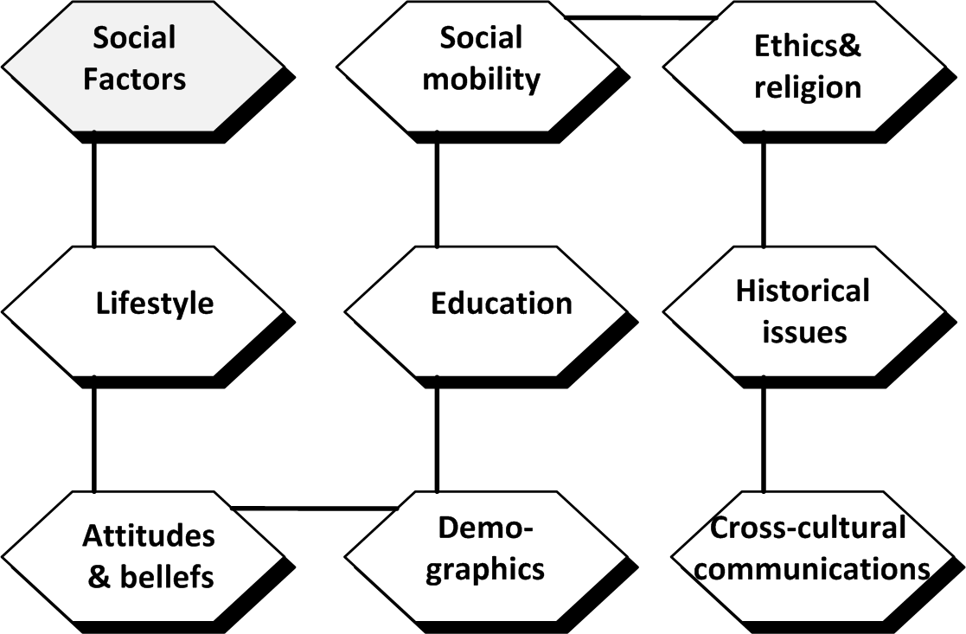
Social Factors:
This dimension of the general environment represents the demographic characteristics, norms, customs and values of the population within which the organization operates. This inlcudes population trends such as the population growth rate, age distribution, income distribution, career attitudes, safety emphasis, health consciousness, lifestyle attitudes and cultural barriers. These factors are especially important for marketers when targeting certain customers. In addition, it also says something about the local workforce and its willingness to work under certain conditions.

Slide 9
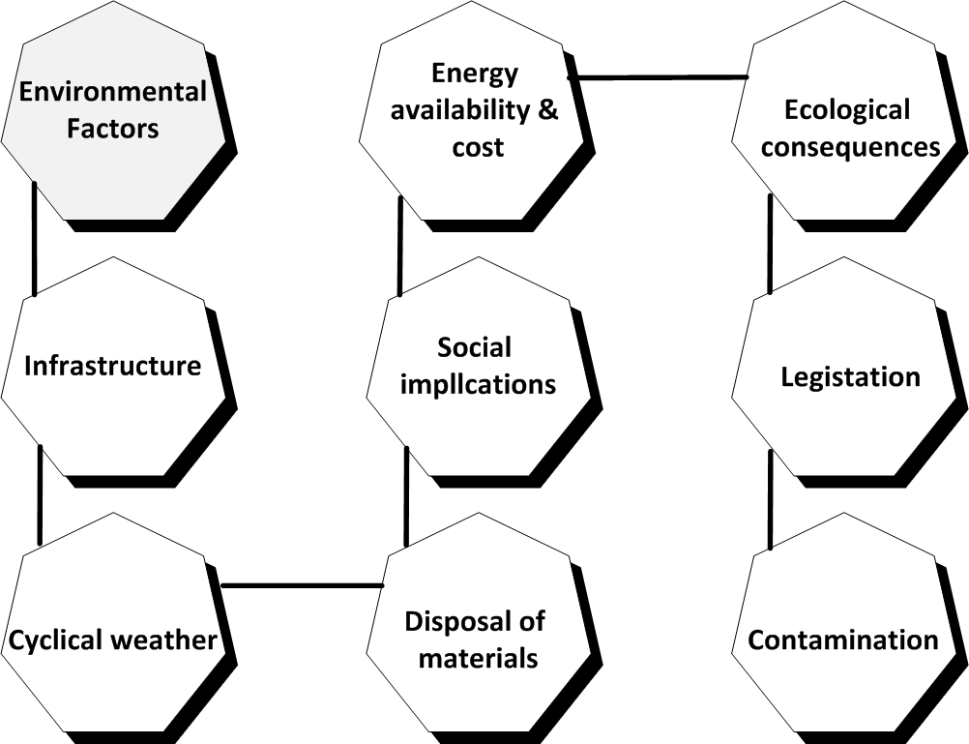
Environmental Factors:
Environmental factors have come to the forefront only relatively recently. They have become important due to the increasing scarcity of raw materials, polution targets and carbon footprint targets set by governments. These factors include ecological and environmental aspects such as weather, climate, environmental offsets and climate change which may especially affect industries such as tourism, farming, agriculture and insurance. Furthermore, growing awareness of the potential impacts of climate change is affecting how companies operate and the products they offer. This has led to many companies getting more and more involved in practices such as corprate social responsibility (CSR) and sustainability.

Slide 10
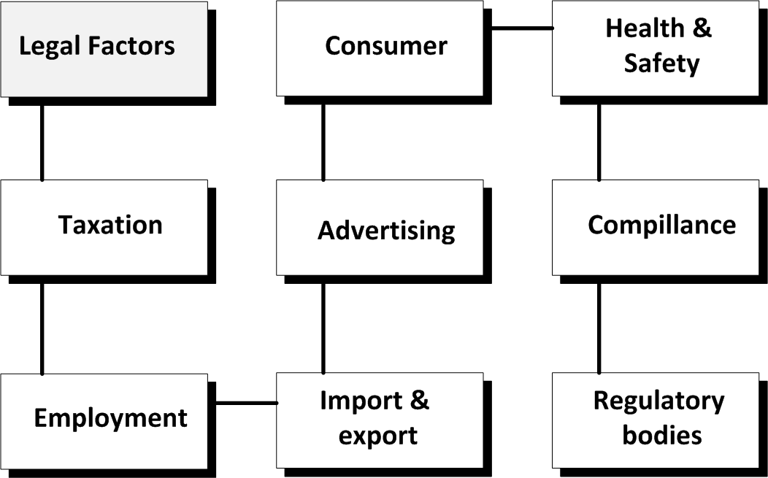
Legal Factors:
Although these factors may have some overlap with the political factors, they include more specific laws such as discrimination laws, antitrust laws, employment laws, consumer protection laws, copyright and patent laws, and health and safety laws. It is clear that companies need to know what is and what is not legal in order to trade successfully and ethically. If an organisation trades globally this becomes especially tricky since each country has its own set of rules and regulations. In addition, you want to be aware of any potential changes in legislation and the impact it may have on your business in the future. Recommended is to have a legal advisor or attorney to help you with these kind of things.

Slide 11
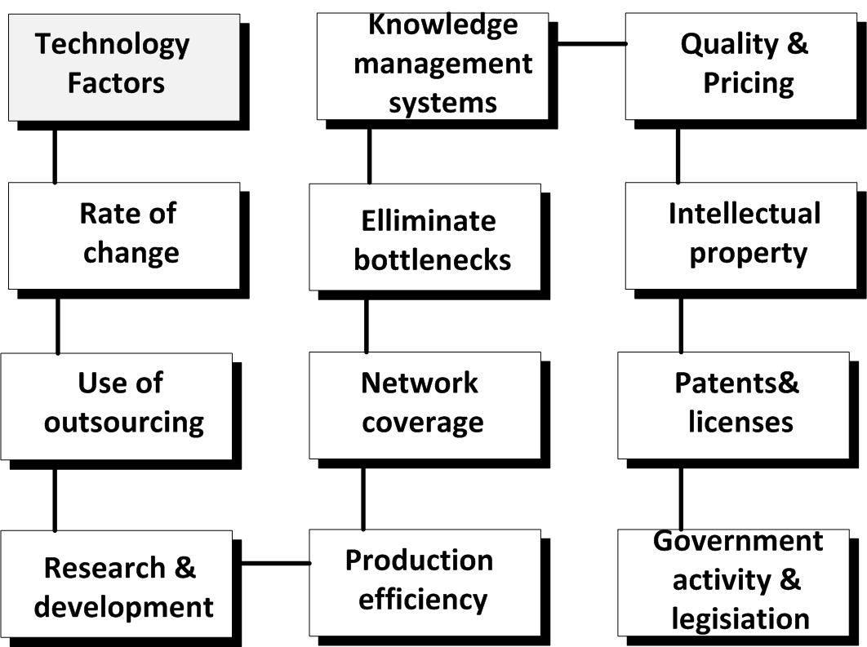
Technological Factors:
These factors pertain to innovations in technology that may affect the operations of the industry and the market favorably or unfavorably. This refers to technology incentives, the level of innovation, automation, research and development (R&D) activity, technological change and the amount of technological awareness that a market possesses. These factors may influence decisions to enter or not enter certain industries, to launch or not launch certain products or to outsource production activities abroad. By knowing what is going on technology-wise, you may be able to prevent your company from spending a lot of money on developing a technology that would become obsolete very soon due to disruptive technological changes elsewhere.

Slide 12
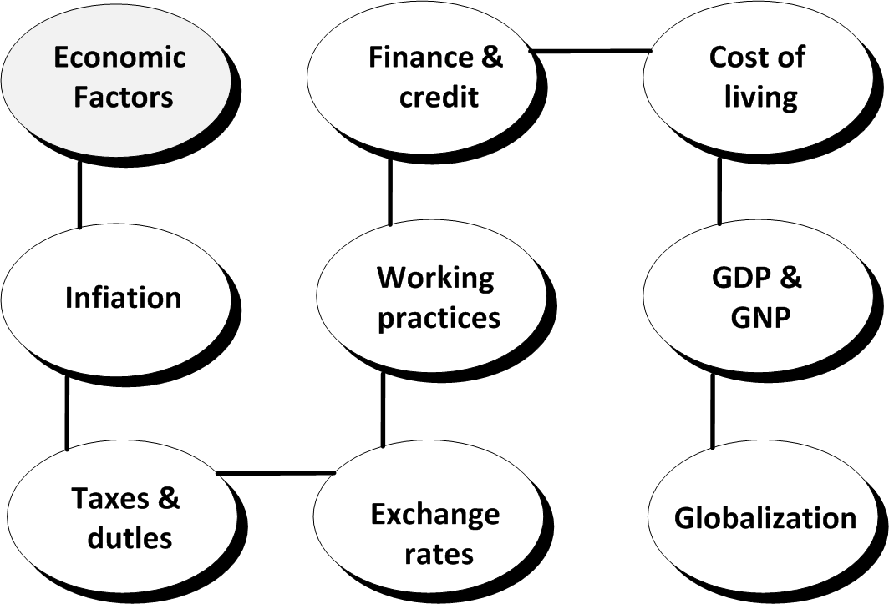
Economic Factors:
Economic factors are determinants of a certain economy’s performance. Factors include economic growth, exchange rates, inflation rates, interest rates, disposable income of consumers and unemployment rates. These factors may have a direct or indirect long term impact on a company, since it affects the purchasing power of consumers and could possibly change demand/supply models in the economy. Consequently it also affects the way companies price their products and services.

Slide 13
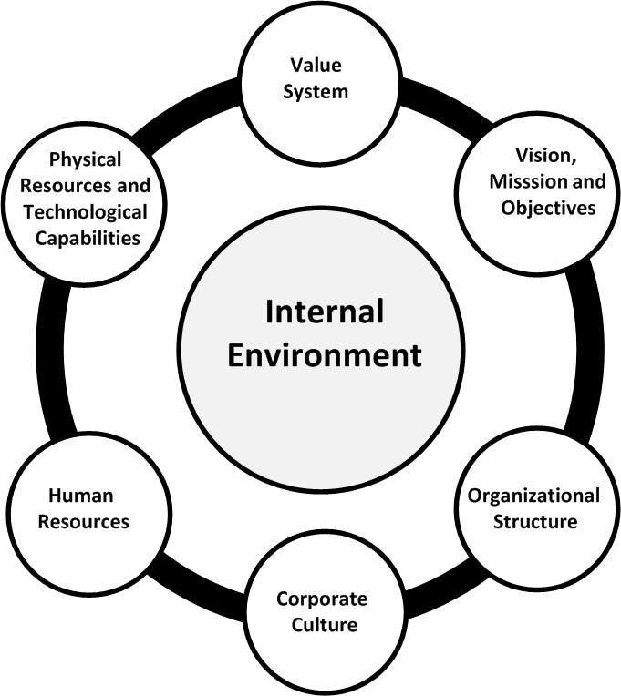
Internal business environment
The internal business environment comprises of factors within the company which impact the success and approach of operations. Unlike the external environment, the company has control over these factors. It is important to recognize potential opportunities and threats outside company operations.

Slide 14
SWOT Analysis
SWOT analysis draws the critical strengths, weaknesses, opportunities and threats (SWOT) from the strategic viewpoint. The audit contains a wealth of data of differing importance and reliability. SWOT analysis distils these data to show the critical items from the internal and external audit. The number of items is small for forceful communications, and they show where a business should focus its attention.

Slide 15
Opportunities and Threats
Managers need to identify the main threats and opportunities that their company faces. The purpose of the analysis is to make the manager anticipate important developments that can have an impact on the firm.
Opportunities:
Economic climate. Because of improved economic conditions, pet ownership is increasing in almost all segments of the population.
Demographic factor. (1) Increasing single parenthood, dual-income families and ageing will increase the trend towards convenient pet foods (from wet to dry); and (2) the aged population will grow and increasingly keep pets as company.
Market. The pet food market will follow the human market in the concern for healthy eating and pre-prepared luxury foods,
Technology. New forms of pet food that are low in fat and calories, yet highly nutritious and tasty, will soon emerge. These products will appeal strongly to many of today's pet food buyers, whose health concerns extend to their pets.

Slide 16
Threats:
• Competitive activity. A large competitor has just announced that it will introduce a new premium pet food line, backed by n huge advertising and sales promotion blitz,
• Channel pressure. Industry analysts predict that supermarket chain buyers will face more than 10,000 new grocery product introductions next year. The buyers accept only 38 per cent of these new products and give each one only five months to prove itself,
• Demographic changes. Increasing single parenthood and dual-income families (1) will encourage the trend towards pets that neeci little care (cats rather than dogs), and (2) will encourage the trend towards smaller pets who eat less.
• Politics. European Union legislation will force manufacturers to disclose the content of their pet food. This will adversely affect the attractiveness of some ingredients like kangaroo and horse meat.

Slide 17
Strengths:
• Market leader in the dry eat food market.
• Access to the group's leading world position in food technology.
• Market leader in luxury pel: foods.
• The group's excellent worldwide grocery distribution.
• Pet food market leader in several big markets, including France, Italy, Spain
and South America.

Slide 18
Weaknesses:
• Number three in the wet pet food market.
• Excessive product range with several low-volume brands.
• Most brand names are little known, and are cluttered following acquisitions.
• Relatively low advertising and promotions budget.
• Product range needs many manufacturing skills.
• Poor store presence in several large markets: Germany, UK, USA and Canada.
• Overall poor profits performance.

Slide 19
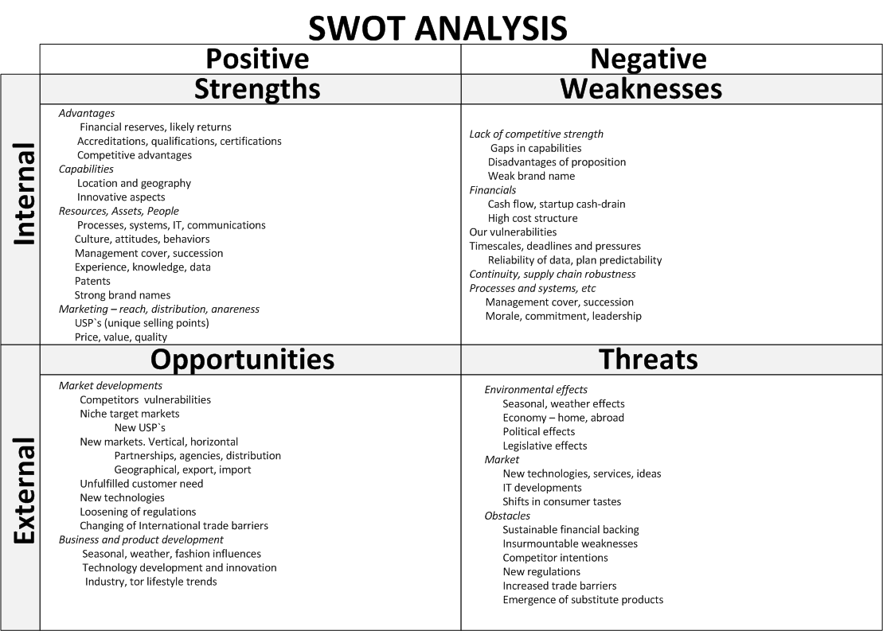

Slide 20
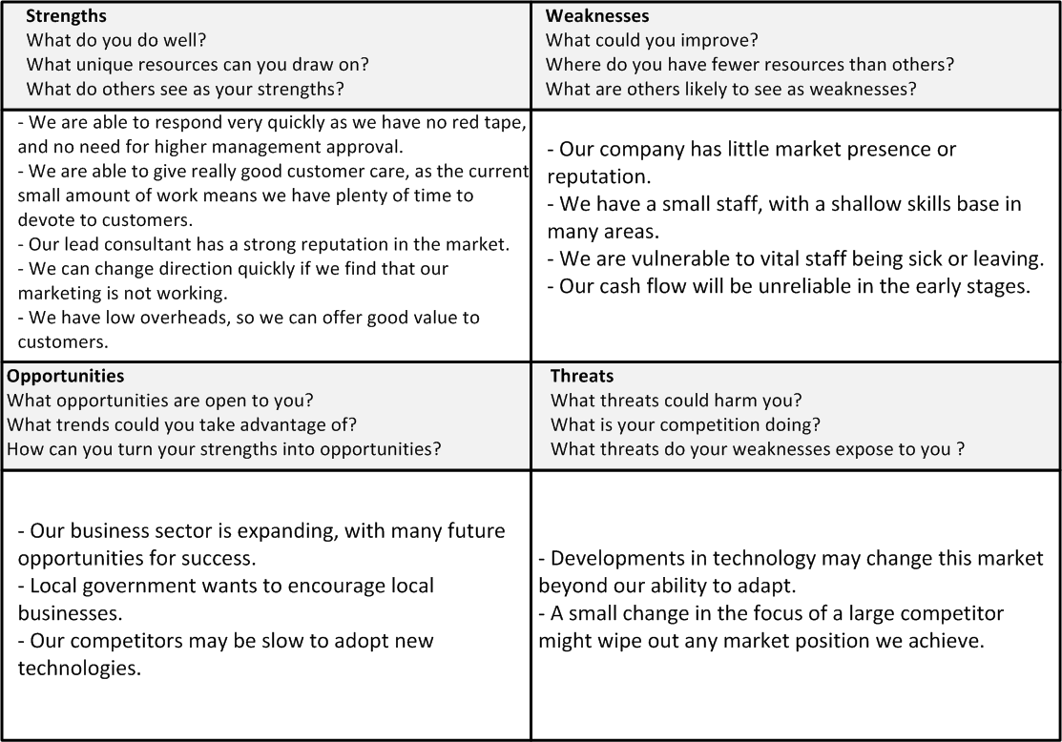
SWOT Analysis: example

Slide 21
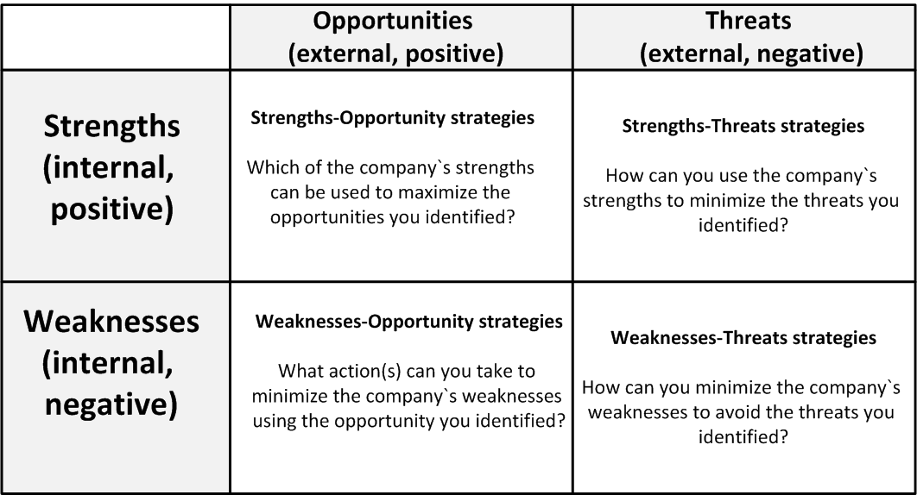
Strategy based on SWOT

Slide 22
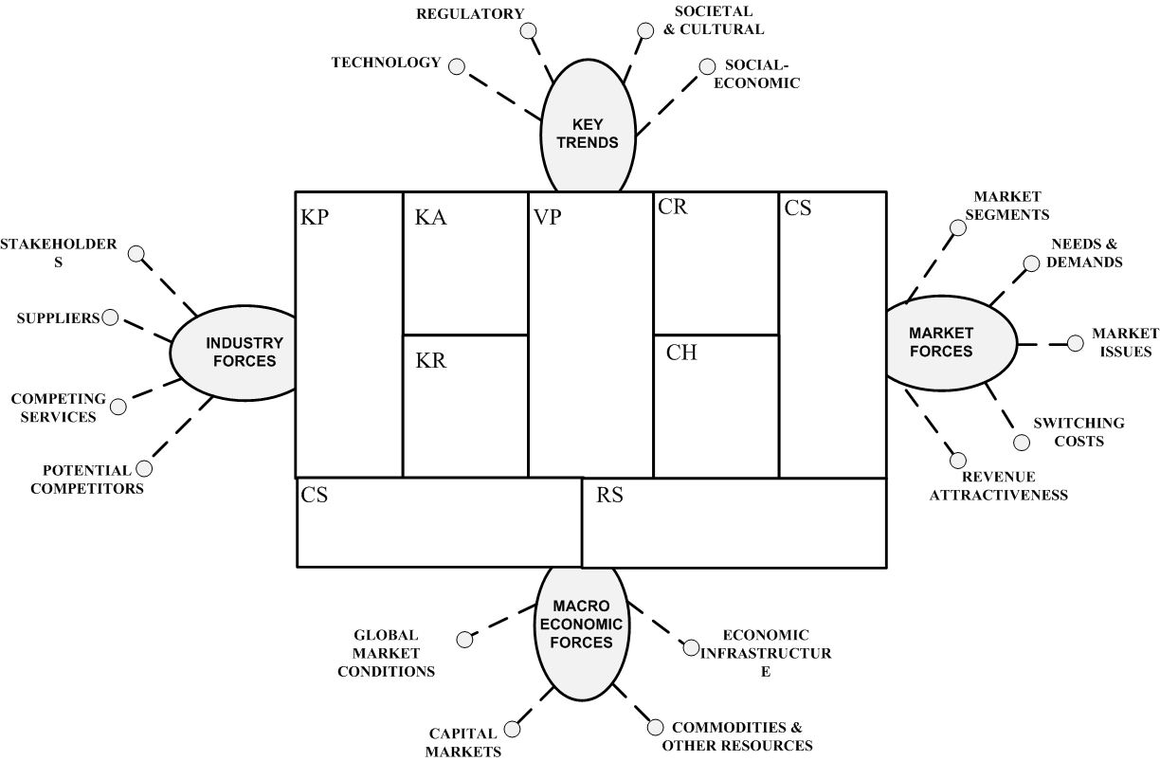
Business environment and business modelling

Slide 23
https://www.greatassignmenthelp.com/blog/five-excellent-examples-of-pestle-analysis-that-everyone-should-know/

