Slide 1
Marketing information

Slide 2
The marketing information system
A marketing information system (MIS) consists of people, equipment and procedures to gather, sort, analyze, evaluate and distribute needed, timely and accurate information to marketing decision makers.
The MIS begins and ends with marketing managers. First, it interacts with these managers to assess their information needs. Next, it develops the needed information from internal company records, marketing intelligence activities and the marketing research process. Information analysis processes the information to make it more useful. Finally, the MIS distributes information to managers in the right form at the right time to help them in marketing planning, implementation and control.

Slide 3
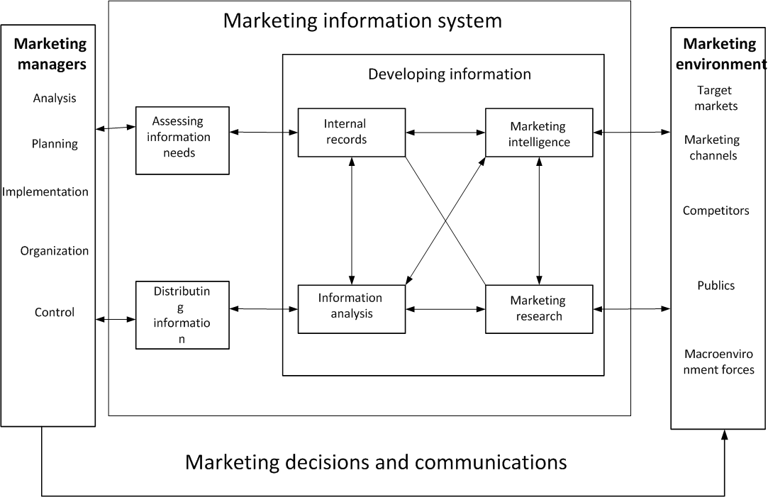
The marketing information system

Slide 4
Internal Records
Most marketing managers use internal records and reports regularly, especially for making day-to-day planning, implementation and control decisions. Internal records information consists of information gathered from sources within the company to evaluate marketing performance and to detect marketing problems and opportunities. The company's accounting department prepares financial statements and keeps detailed records of sales, orders, costs and cash flows. Manufacturing reports on production schedules, shipments and inventories. The sales force reports on reseller reactions and competitor activities. The customer service department provides information on customer satisfaction or service problems. Research studies done for one department may provide useful information for several others. Managers can use information gathered from these and other sources within the company to evaluate performance and to detect problems and opportunities.

Slide 5
Marketing Intelligence
The marketing intelligence system determines the intelligence needed, collects it by searching the environment and delivers it to marketing managers who need it. Marketing intelligence comes from many sources. Much intelligence is from the company's personnel - executives, engineers and scientists, purchasing agents and the sales force.
The company must also persuade suppliers, resellers and customers to pass along important intelligence. Some information on competitors conies from what they say about themselves in annual reports, speeches, press releases and advertisements. The company can also learn about competitors from what others say about them in business publications and at trade shows.
Companies also buy intelligence information from outside suppliers.

Slide 6
Marketing Research
Marketing research is the function linking the consumer, customer and public to the marketer through information - information used: to identify and define marketing opportunities and problems; to generate, refine and evaluate marketing actions; to monitor marketing performance; and to improve understanding of the marketing process.13 Marketing researchers specify the information needed to address marketing issues, design the method for collecting information, manage and implement the data collection process, analyze the results and communicate the findings and their implications.
Marketing researchers engage in a wide variety of activities, ranging from analyses of market potential and market shares to studies of customer satisfaction and purchase intentions. Every marketer needs research. A company can conduct marketing research in its research department or have some or all of it done outside. Although most large companies have their own marketing research departments, they often use outside firms to do special research tasks or special studies. A company with no research department will have to buy the services of research firms.

Slide 7
Market research
Market research seeks two types of data:
1) Marketers generally begin by looking at secondary data—information already collected, whether by the company or by others, that pertains to the target market.
2) With secondary data in hand, they’re prepared to collect primary data—newly collected information that addresses specific questions.

Slide 8
Secondary data can come from inside or outside the organization. Internally available data includes sales reports and other information on customers. External data can come from a number of sources. The U.S. Census Bureau, for example, posts demographic information on American households (such as age, income, education, and number of members), both for the country as a whole and for specific geographic areas.
Population data helped Wow Wee estimate the size of its potential U.S. target market. Other secondary data helped the firm assess the size of foreign markets in regions around the world, such as Europe, the Middle East, Latin America, Asia, and the Pacific Rim. This data helped position the company to sell the product in eighty-five countries, including Canada, England, France, Germany, South Africa, Australia, New Zealand, Hong Kong, and Japan.
Using secondary data that is already available (and free) is a lot easier than collecting your own information. Unfortunately, however, secondary data didn’t answer all the questions that Wow Wee was asking in this particular situation. To get these answers, the marketing team had to conduct primary research, working directly with members of their target market. First they had to decide exactly what they needed to know, then determine who to ask and what methods would be most effective in gathering the information.

Slide 9
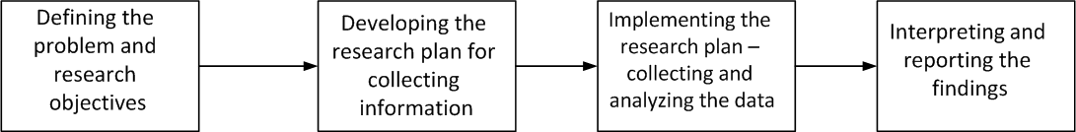
The Marketing Research Process

Slide 10
STEPS IN ACT MARKETING RESEARCH PROCESS
1. Identify and articulate the problem.
2. Identify research goals.
3. Determine the information needed to achieve the research goals.
4. Determine research design.
5. Decide on research sample (i.e., whom to call).
6. Determine content of the individual questions.
7. Construct a questionnaire.
8. Test the questionnaire,
9. Adjust the questionnaire based on the test results.
10. Conduct the interviews.
11. Write up the results of each interview.
12. Write a report.

Slide 11
Referenses

