Slide 1
Marketing characteristics of IT and software

Slide 2
Characteristics of the IT Industry
The IT industry has several characteristics that greatly affect the way the industry works and, to a certain extent, differentiates it from other industries. The main factors:
High Rate of Product Innovation and Short Product Life Cycles
Moore’s law
Modular Nature and Open Standards
Competition and Consolidation

Slide 3
High Rate of Product Innovation and Short Product Life Cycles
The high rate of product innovation is one of the IT industry’s most important characteristics, because of its implications for the whole industry. The high rate of innovation leads to very short product-life cycles, which in turn means that assemblers must constantly upgrade their production facilities and produce in new ways (instead of refining old ways) to avoid inventory deprecation. (Curry & Kenny, 1999) The high rate of product innovation also results in discontinuous change, when new technology suddenly emerges from ‘nowhere’ and in a very short time replaces the current standard; this is known as a shift of paradigms. (Moore, 1999)

Slide 4
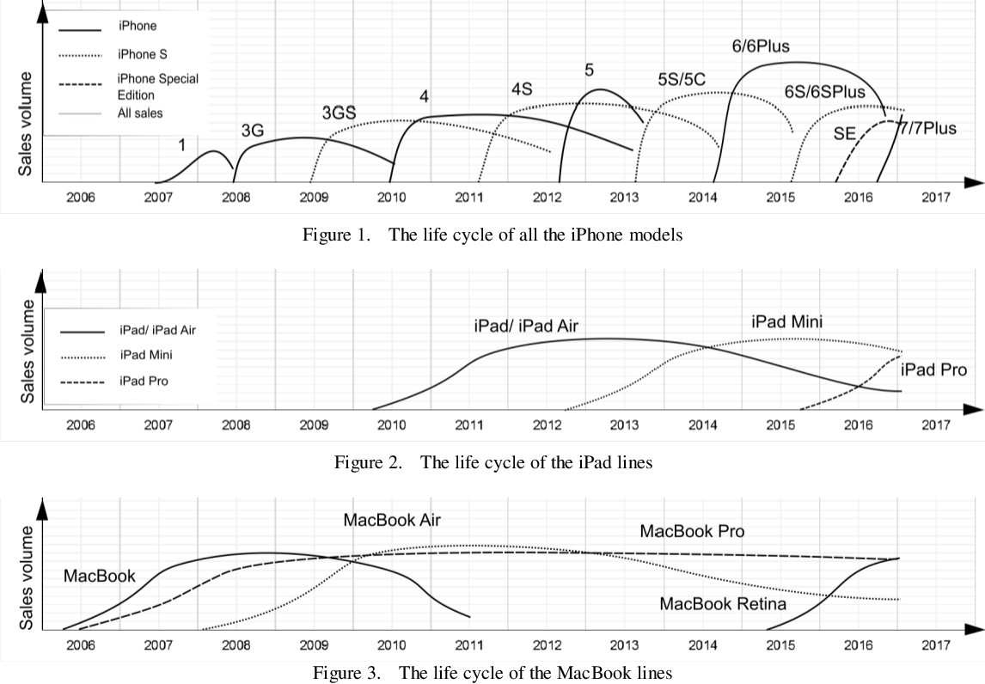

Slide 5
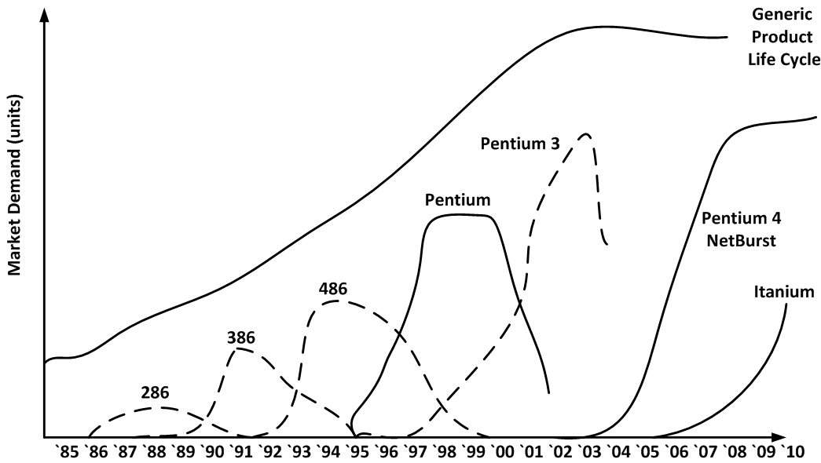
Product-Market vs. Product Life Cycle

Slide 6
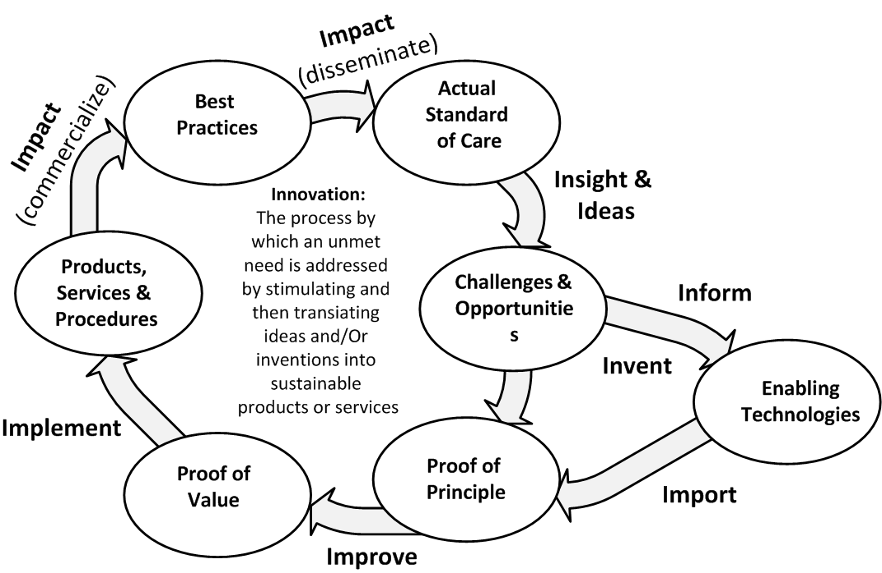

Slide 7
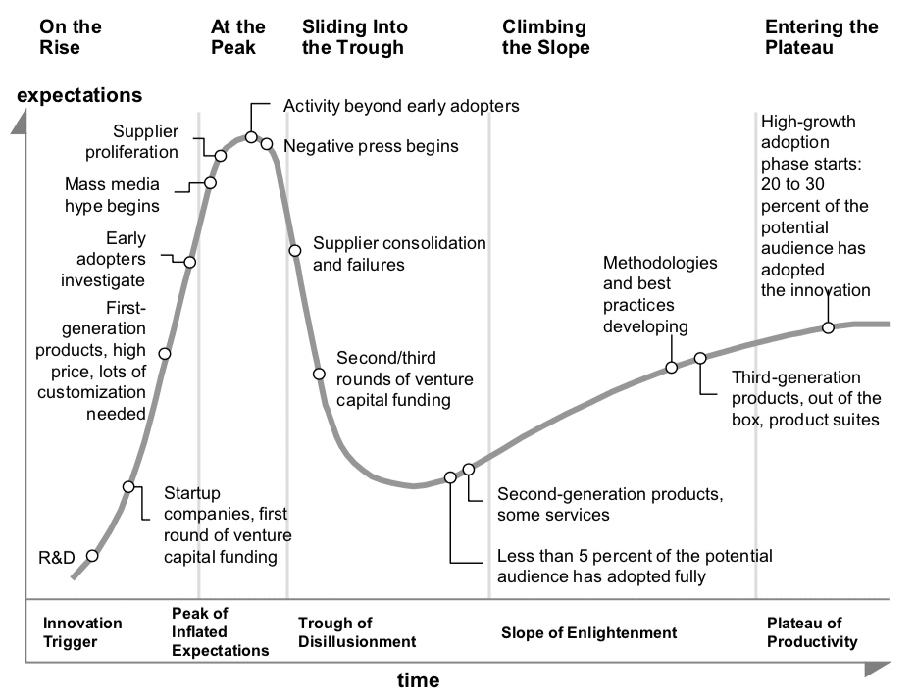

Slide 8
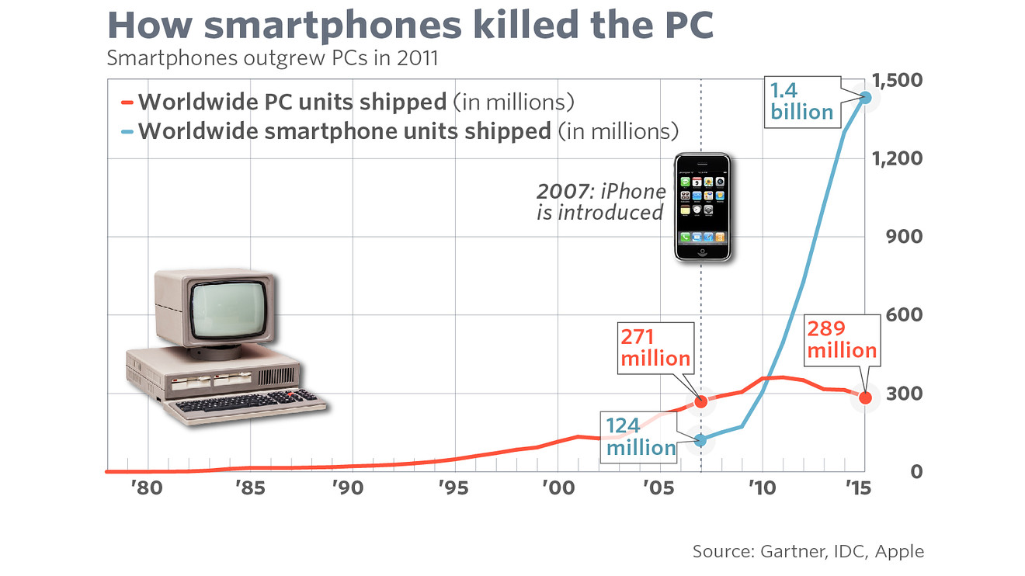

Slide 9
Moore’s law
Moore’s law, a prediction by Gordon Moore in 1965, stated that the numbers of transistors per silicon chip will double each year, while the manufacturing cost remains constant. The time was revised in 1975 to every second year, but since 1961 the actual numbers of transistors per chip have roughly doubled every 18 months. (Encyclopedia Britannica, 2004c)
However, Moore’s law does not apply to all computer products: the parts that are not part of the computer core (processor, graphic card, hard-drive etc.) such as keyboard Sales and Marketing Strategy in the IT Industry and monitors do not decrease in price as rapidly as the internal components. (Curry & Kenney, 1999)

Slide 10
Modular Nature and Open Standards
One of the fundamental features of the PC industry today is that the modular nature of PC production combined with the availability of components has led to competition on every stage of the value chain in the hardware industry (Curry & Kenney, 1999).
This modular nature has also started to spread to the software side of the industry, which also has been moving to creating products that adhere to open standards. Databases, middleware and, to some extent, operating systems are examples of software products that are starting to be considered as commodities.
This hardware and, to some extent software, commoditisation makes it harder for computer manufacturers and software companies to lock customers to their platform. As the industry is moving away from proprietary systems to open standards companies must try to find new ways to attract and keep their customers. Examples of hardware that follow open standards are graphic cards: they all follow the necessary hardware and software standards (e.g. many graphic cards follow the AGP hardware standard as well as Microsoft’s Direct-X software standard). (Healy & Shooter, 2004)

Slide 11
Modular Nature and Open Standards
"Open Standards" are standards made available to the general public and are developed (or approved) and maintained via a collaborative and consensus driven process. "Open Standards" facilitate interoperability and data exchange among different products or services and are intended for widespread adoption.
An Open Standard refers to a format or protocol that is
subject to full public assessment and use without constraints in a manner equally available to all parties;
without any components or extensions that have dependencies on formats or protocols that do not meet the definition of an Open Standard themselves;
free from legal or technical clauses that limit its utilisation by any party or in any business model;
managed and further developed independently of any single vendor in a process open to the equal participation of competitors and third parties;
available in multiple complete implementations by competing vendors, or as a complete implementation equally available to all parties.

Slide 12
Competition and Consolidation
The IT industry has until recently been characterised by a disaggregated value-chain; the term disaggregated refers to the fact that one part of the value-chain is affected by changes in another part of the value chain.
An example of this is Microsoft and Intel: if Intel decreases its price on processors, it is likely that computer sales will increase, which in turn means that Microsoft’s sales would increase, since many of the sold computers probably would have Microsoft’s operating system installed. (Curry & Kenney, 1999)
During the end of the 1990’s the IT industry entered a phase of increased consolidation, both horizontally and vertically, that looks set to continue in the next few years. Examples of the increased consolidation are HP’s acquisition of Compaq in 2002 and Microsoft’s acquisition of the enterprise resource planning-system developer Navision. (Gartner from PC Magazine, 2004) Furthermore, the industry has traditionally been characterised by horizontal competition (e.g. operating system competing against operating system and processor manufacturer against processor manufacturer). One of the consequences of the increased level of consolidation is that the competition in the industry is now both horizontal and vertical (Healy, 2004). Vertical competition means that total solutions compete against total solutions, rather than hardware against hardware and operating systems against operating systems.

Slide 13
A Focus on Applications and Total Solutions
Many IT-analysts (e.g. Carr & McHale, 2002) predict that one of HP’s corner stones, hardware, will reduce its share of the total IT-spending in the coming years, while at the same time services and software spending will increase; this is part of the trend where IT infrastructure is moving to higher levels of efficiency and off-the-shelf approaches in technology, software and some service segments. Customers are demanding higher quality, innovative software and hardware, and IT is becoming increasingly focused on solving customers’ real business problems. IT solutions are being expected to provide real business solutions with applications aimed at specific business purposes; customers are demanding total (end-to-end) solutions spanning the entire solution stack (explained in detail in section 2.2.2) from hardware infrastructure up to high-end applications, which puts pressure on IT companies to become more solutions-oriented. (HP, 2004)

Slide 14
The Industry Channel: Definitions and Participants
The Industry Channel
Waxman et al. (2003) define a channel as a sell-through relationship in which one firm, often referred to as a partner, acts as an independent selling party to an end-user, leveraging products and or services from a vendor or service provider in addition to, or as part of, their own goods and services. The partners generally earn profit by adding their own product/services to a customer solution. (Waxman et al., 2003)
Solution stack
A complete (end-to-end) IT solution can be seen as a block consisting of several bricks, and is commonly referred to as a solution stack. This concept is important because many IT related companies use this stack as a way of communicating what their products do, and how they interact with other products. The different levels of the stack combined create a complete solution; the lowest level represent the actual hardware, the next level represent the operating system that runs on the hardware and so forth; each level requires that the levels below it function accurately. (Healy & Shooter, 2004)

Slide 15
The Industry Channel: Definitions and Participants
2.2.3 Hardware Vendor
An independent hardware vendor (IHV) is a company specializing in making or selling computer hardware, usually for niche markets. A hardware vendor develops, manufactures and sells core infrastructure and hardware platforms. Apart from hardware, some of the vendors (especially IBM) are focused on offering total solutions; usually with partners (they offer hardware, software and services). Typically the term hardware vendor refers to the industry’s largest vendors, such as Dell, HP, IBM and Sun Microsystems (Sun). (Healy & Shooter, 2004)
2.2.4 Independent Software Vendor (ISV)
An independent software vendor (ISV) is a company that develops, sells and often installs and manages software applications that run on hardware vendors’ platforms. Examples of large ISVs are Oracle, SAP, BEA and Microsoft. There are a vast number of smaller ISVs in the marketplace developing a large range of applications from broad applications, used by most business companies, to applications used by niche companies in vertical industries. (Bruin & Raviart, 2004)
The ISV functions both as an enabler and gatekeeper, seen from the hardware vendor’s perspective; the ISV can actively support or block a hardware vendors attempt to sell hardware together with the ISV’s application. (Poorabia, 2004)

Slide 16
The Industry Channel: Definitions and Participants
System Integrator (SI and CSI)
A system integrator (SI) or a consultant system integrator (CSI) is a company that integrates applications and hardware from several companies to build a complete (end-to-end) solution for end customers. The SI usually leads the project and designs and builds custom solutions from concept to implementation. A true SI is often distinguished by its software and consulting capabilities. Examples of large system integrators are consulting firms such as Accenture, BearingPoint and Cap Gemini. Depending on the complexity of the solution the integration can also be done by hardware vendors or by the customer itself depending on their skills and capabilities. (Waxman et al., 2003)

Slide 17
The Industry Channel: Definitions and Participants
Distributor (VAD)
A distributor buys and sells hardware and software vendors’ products to other channel members, but normally it does not sell to end consumers. Distributors primarily sell to resellers, system integrators, ISVs or other distributors. There are two major categories of distributors: volume- (regular) and value-adding distributors (VADs). A VAD adds value to the product before they distribute them; this might be in the form of assembling a complete system or installing software. The two terms are not exclusive; a distributor can be both a VAD and volume distributor and even a reseller at the same time. (Adams & Costigan, 2004)

Slide 18
The Industry Channel: Definitions and Participants
Reseller (VAR)
A reseller works like a distributor, except that it sells primarily to end customers. There are two major categories of resellers: regular and value-adding resellers (VARs). A VAR adds value to the product in some way, much like a VAD, e.g. by installing and assembling a complete system, while the regular reseller simply sells the products without modification. The term reseller is not exclusive. (Waxman et al., 2003)

Slide 19
The Industry Channel: Definitions and Participants
ISVs and the Hardware Vendor
The ISVs form a heterogenic community with diverse needs and requirements. Carr & McHale (2002) state that the relationship between the ISV and the hardware vendor is a give and take relationship: while the ISVs extend to solution eco-systems of the vendor, the ISVs profit by association with vendors whose name has a market pull effect. As a result, it is in the vendors’ interest to help the ISVs with porting to their platforms, compatibility testing, marketing support and in some cases even help selling the ISV’s product. (Porting means that the application is made available on an additional platform.) Because of the standardisation of hardware platforms ISVs can be a lot more agnostic in terms of platform selection today than in the past. But there can still be many aspects that influence their choice of platform and preferred hardware provider. (Carr & McHale, 2002)

Slide 20
The Industry Channel: Definitions and Participants Partners’ Platform Influence
The vendor’s partners (e.g. HP’s partners) can influence the customers’ end-platform selection in several ways, hence exist several different sales scenarios, depending on if, for example, the partner influences the customer to buy the vendor’s hardware, the partners sell the hardware and so forth.
In order to understand the different sales scenarios, it is necessary to know the following terms:
• Sell through sales: the partner sells the vendor’s products
• Influenced sales: the partner influences the choice of platform, but does not sell HP products
• Leveraged (or incremental) sales: sales of the vendor’s products that would not have occurred without the influence of the partner (and in turn possibly the vendor’s effort to influence the partner) The terms do not necessarily have to be exclusive; a sale could for example be influenced as well as leveraging HP hardware.

Slide 21
Eco-system
A company’s eco-system consists of all the interconnected industry members involved in delivering a complete solution to an end customer. The eco-system in the IT industry primarily consists of vendors, independent software vendors, system integrators, value-added distributors and resellers. The members all have different roles, but they all may take part in delivering the solution to the end-customer. (Bruin Raviart, 2004)

Slide 22
Eco-system
The different kinds of industry members are interconnected in several ways. A company might have several roles: an ISV might for example also function as a VAR. Furthermore, a transaction between involved parties usually consists of one contact way from vendor to customer (i.e. if the vendor sells directly to the customer, then there is normally no need for a distributor).
Companies build eco-systems around their own offerings, often to serve a specific market. Examples of HP’s eco-systems are the ones that the company builds around its hardware platforms; they consist of partners delivering applications and other related software and services to HP’s hardware platforms. An eco-system is very much the same as a value-creating network of interdependent partners, where each partner contributes and adds value to a customer solution. Value networks will be discussed in more detail in the theoretical framework.

