Slide 1
Developing a Product

Slide 2
What is Product Development?
Product development typically refers to all of the stages involved in bringing a product from concept or idea through market release and beyond. In other words, product development incorporates a product’s entire journey.
There are many steps to this process, and it’s not the same path for every organization, but these are the most common stages through which products typically progress.
Product Development Does Not Mean Product Management
When you understand product development this way, you can see that it is not synonymous with product management, although many people mistakenly use the terms interchangeably. Indeed, product development does not refer to a single role at all.

Slide 3
The most common stages through which products typically progress
Identifying a market need—Products solve problems. Identifying a problem that needs solving (or a better way of being solved) is where this journey should begin. Conversations with potential customers, surveys, and other user research activities can inform this step.
Quantifying the opportunity—Not every problem is problematic enough to warrant a product-based solution. The pain it causes and the number of people or organizations it impacts can determine whether it’s a worthy problem to solve and if people are willing to pay for a solution (be it with money or their data).
Conceptualizing the product—Some solutions may be obvious, while others may be less intuitive. Here’s where the team puts in the effort and applies their creativity to devising how a product might serve its needs.
Validating the solution—Before too much time is spent prototyping and design, whether the proposed solution is viable should be tested. This can still happen at the conceptual level. Still, it is an early test to see whether the particular product idea is worth pursuing further or if it will be rejected or only lightly adopted by the target user.
Building the product roadmap—With a legitimate product concept in hand, product management can build out the product roadmap, identifying which themes and goals are central to develop first to solve the most significant pain points and spark adoption.
Developing a minimum viable product (MVP)—This initial version of the product needs just enough functionality to be used by customers.
Releasing the MVP to users—Experiments can be conducted to gauge interest, prioritize marketing channels and message, and begin testing the waters around price sensitivity and packaging. It also kicks off the feedback loop to bring ideas, complaints, and suggestions into the prioritization process and populate the product backlog.
Ongoing iteration based on user feedback and strategic goals—With a product in the market, enhancements, expansions, and changes will be driven by the user feedback being collected via various channels. Over time the product roadmap will evolve based on this learning and the objectives the company sets for this product. This work never ends until it’s finally time to sunset a product at the end of its lifecycle.

Slide 4
In some organizations, “product development” may be shorthand for the implementation team, comprised primarily of developers, engineers, and possibly quality assurance. But, when it comes to the house’s personnel side, it should instead view it as more of an overall process or method for bringing products to market, which involves many teams across a company, including:
Product management
Product marketing
Project management
Agile management (Scrum masters, product owners, etc.)
Architecture
Design
UI/UX
Development/Engineering
Manufacturing
Testing or QA
Shipping/Distribution
Essentially, it encompasses everyone involved from idea generation through to customer delivery. Each of these groups plays an essential role in the process, defining, designing, building, testing, or delivering the product.

Slide 5
1. Ideation
Many aspiring entrepreneurs get stuck on ideation, often because they’re waiting for a stroke of genius to reveal the perfect product they should sell. While building something fundamentally "new" can be creatively fulfilling, many of the best ideas are the result of iterating upon on an existing product. The SCAMPER model is a useful tool for quickly coming up with product ideas by asking questions about existing products. Each letter stands for a prompt:
Substitute (e.g. faux fur for fur)
Combine (e.g. a phone case and a battery pack)
Adapt (e.g. a bra with front clasps for nursing)
Modify (e.g. an electric toothbrush with a sleeker design)
Put to another use (e.g. memory-foam dog beds)
Eliminate (e.g. get rid of the middleman to sell sunglasses and pass the savings on to consumers)
Reverse/Rearrange (e.g. a duffle bag that doesn’t wrinkle your suits)
By asking these questions, you can come up with novel ways to transform existing ideas or even adapt them for a new target audience or problem.If you're still looking for your "aha!" moment, we also put together a list of sources for coming up with your own product ideas, from analyzing online marketplaces and product descriptions for inspiration to reinventing historical trends.

Slide 6
The new product development process in 6 steps
New product development is the process of bringing an original product idea to market. Although it differs by industry, it can essentially be broken down into six stages: ideation, research, planning, prototyping, sourcing, and costing. Here's how to develop your own original product idea and what to consider at each stage.
1. Ideation

Slide 7
2. Research
With your product idea in mind, you may feel inclined to leapfrog ahead to production, but that can become a misstep if you fail to validate your idea first.
Product validation ensures you’re creating a product people will pay for and that you won’t waste time, money, and effort on an idea that won't sell. There are several ways you can validate your product ideas, including:
Talking about your idea with family and friends
Sending out an online survey to get feedback
Starting a crowdfunding campaign
Asking for feedback on forums like Reddit
Researching online demand using Google Trends
Launching a “coming soon” page to gauge interest via email opt-ins or pre-orders
However you decide to go about validating your idea, it is important to get feedback from a substantial and unbiased audience as to whether they would buy your product. Be wary of overvaluing feedback from people who “definitely would buy” if you were to create your theoretical product—until money changes hands, you can’t count someone as a customer. Product validation ensures you’re creating a product people will pay for. Validation research will also inevitably involve competitive analysis. If your idea or niche has the potential to take off, there are likely competitors already operating in that space. Visiting your competitors’ website and signing up for their email list will allow you to understand how they attract customers and make sales. Asking your own potential customers what they like or dislike about your competitors will also be important in defining your own competitive advantage. The information compiled from doing product validation and market research will allow you to gauge the demand for your product and also the level of competition that exists before you start planning.

Slide 8
3. Planning
Since product development can quickly become complicated, it’s important to take the time to plan before you begin to build your prototype.
When you eventually approach manufacturers or start looking for materials, if you don’t have a concrete idea of your product's design and how it will function, it’s easy to get lost in the subsequent steps.
The best place to begin planning is with a hand-drawn sketch of what your product will look like. The sketch should be as detailed as possible, with labels explaining the various features and functions.

Slide 9
3. Planning
You don't need a professional quality drawing since you won’t be submitting it to a manufacturer at this stage. However, if you are not confident that you can produce a legible diagram that will make sense of your product, it is easy to find illustrators for hire on Dribbble, UpWork, or Minty. Try to use your diagram to create a list of the different components or materials you will need in order to bring the product to life. The list does not need to be inclusive of all potential components, but it should allow you to begin planning what you will need in order to create the product. For example, a drawing of a purse design could be accompanied by this list:
Zippers (large and small)
Silver clasps
Leather straps
Protection pouch
Embossed label
Interior wallet
Along with the components, you should also begin to consider the retail price or category your product will fall into. Will the product be an everyday item or for special occasions? Will it use premium materials or be environmentally friendly? These are all questions to consider in the planning phase since they will help guide you through not only your product development process but also your brand positioning and marketing strategy. The packaging, labels, and overall quality of your materials should be considered as well before you continue to the sourcing and costing stages. These will have an effect on how you market your product to your target customer, so it’s important to take these aspects of your product into consideration during the planning phase too.

Slide 10
4. Prototyping
The goal of the prototyping phase during product development is to create a finished product to use as a sample for mass production. It’s unlikely you will get to your finished product in a single attempt—prototyping usually involves experimenting with several versions of your product, slowly eliminating options and making improvements until you feel satisfied with a final sample.

Slide 11
4. Prototyping
Prototyping also differs significantly depending on the type of product you are developing. The least expensive and simplest cases are products you can prototype yourself, such as food recipes and some cosmetic products. This do-it-yourself prototyping can also extend to fashion, pottery, design and other verticals, if you are lucky enough to be trained in these disciplines.
However, more often than not, entrepreneurs will work with a third party to prototype their product. In the fashion and apparel industry, this usually involves working with a local seamstress (for clothing and accessories), cobbler (for shoes) or pattern maker (for clothing). These services can usually be found online by Googling local services in the industry.
Most large cities also have art, design or fashion schools where students are trained in these techniques. Administrators from these university or college programs can usually grant you access to their internal job board where you can create a request for prototyping help.
For objects like toys, household accessories, electronics, and many other hard-exterior objects, you may require a 3D rendering in order to make a prototype. Artists or engineers who are trained in computer-aided design and drafting (CAD) software can be contracted to do this, using UpWork or Freelancer. There are also user-friendly online tools such as SketchUp, Tinkercad and Vectary, for founders who want to learn how to create 3D models for themselves.

Slide 12
To get a 3D design turned into a physical model, makers used to have to get molds made for each part. Molds are typically expensive and involve set-up fees for things like tools and dies that are used to cut and shape pieces of plastic and other hard materials.
Luckily, with the innovation of 3D printing, designs can be turned into physical samples at a much lower cost with a quicker turnaround time.
Chris Little, the founder of Wintersmiths, prototyped his line of barware using Quickparts and explains that he was able to do so on a budget and within a few days' time. Alex Commons of Bulat Kitchen recommends 3D Hubs, which he used to prototype a knife, paying around $30 per 3D-printed model.

Slide 13
5. Sourcing
Once you have a product prototype you’re satisfied with, it's time to start gathering the materials and securing the partners needed for production. This is also referred to as building your supply chain: the vendors, activities, and resources needed to create a product and get it into a customer's hands.
While this phase will mainly involve looking for manufacturing-related services, you may also factor storage, shipping, and warehousing into your choice.
In Shoe Dog, a memoir by Nike founder Phil Knight, the importance of diversifying your supply chain is a theme emphasized throughout the story. Finding multiple suppliers for the different materials you will need, as well as different potential manufacturers, will allow you to compare costs. It also has an added benefit of creating a backup option if one of your suppliers or manufacturers doesn’t work out. Sourcing several options is an important part of safeguarding your business for the long term.
During product development, each journey to a finished product is different.
When looking for suppliers, there are plenty of resources both online and in person. While it may seem old fashioned, many business owners choose to attend trade shows dedicated to sourcing. Trade shows like Magic in Las Vegas provide the opportunity to meet hundreds of vendors at once—to see, touch, and discuss materials and build a personal relationship with suppliers, which can be valuable when it comes time to negotiate prices.
During the sourcing phase, you will inevitably come across the decision of whether to produce your product locally or overseas. It is a good idea to compare the two options, as they each have their own advantages and disadvantages.
The most commonly used sourcing platform for overseas production is Alibaba. Alibaba is marketplace for Chinese suppliers and factories, where you can browse listings for finished goods or raw materials. A popular way of using Alibaba to find a manufacturer is to look for listings with similar products to your own and then contact the factory to see if they can produce your specific design.

Slide 14
6. Costing
After research, planning, prototyping, and sourcing is done, you should have a clearer picture of what it will cost to produce your product. Costing is the process of taking all of the information gathered thus far and adding up what your cost of goods sold (COGS) will be, so you can determine a retail price and gross margin.
Begin by creating a spreadsheet with each additional cost broken out as a separate line item. This should include all of your raw materials, factory setup costs, manufacturing costs, and shipping costs. It is important to factor in shipping, import fees, and any duties you will need to pay in order to get your final product into the customer's hands, as these fees can have a significant impact on your COGS, depending on where you are producing the product.
If you were able to secure multiple quotes for different materials or manufacturers during the sourcing phase, you can include different columns for each line item that compare the cost. Another option is to create a second version of the spreadsheet, so you can compare local production versus overseas production.
Once you have your total COGS calculated, you can come up with a retail price for your product and subtract the COGS from that price to get your potential gross margin, or profit, on each unit sold.

Slide 15
Why New Products Fail
Lack of differentiating advantage
Poor marketing plan
Poor timing
Target market too small
Poor product quality
No access to market

Slide 16
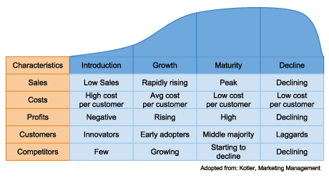
The Product Life Cycle

Slide 17
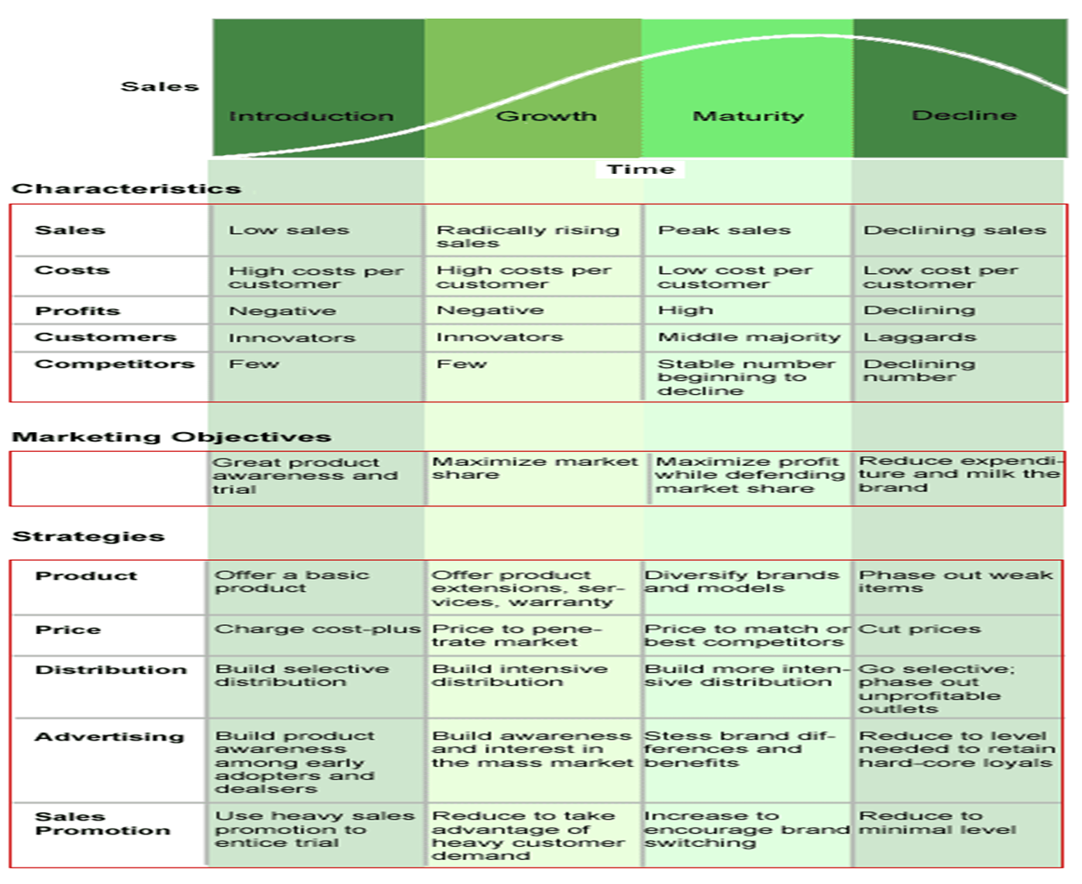

Slide 18
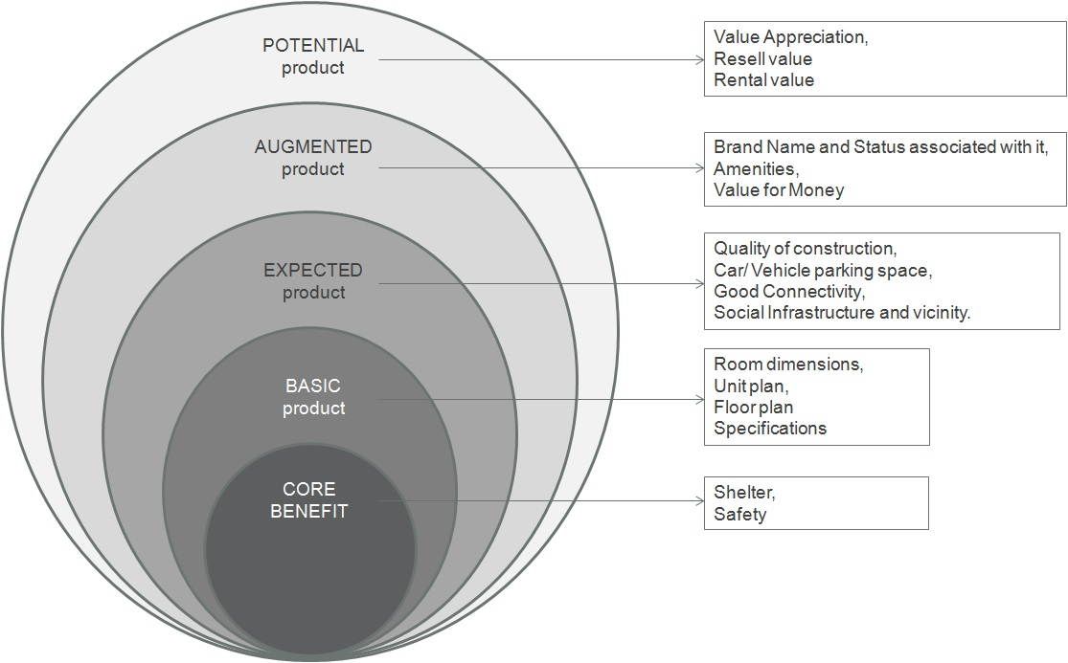

Slide 19
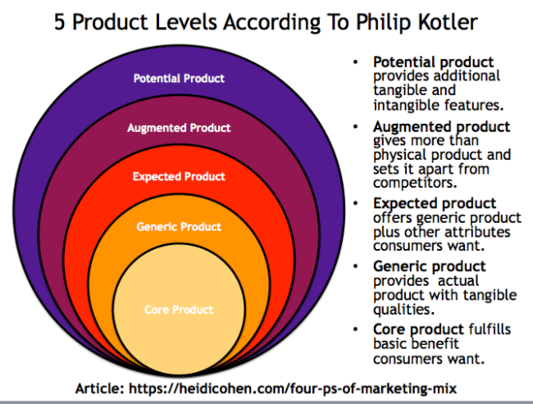

Slide 20
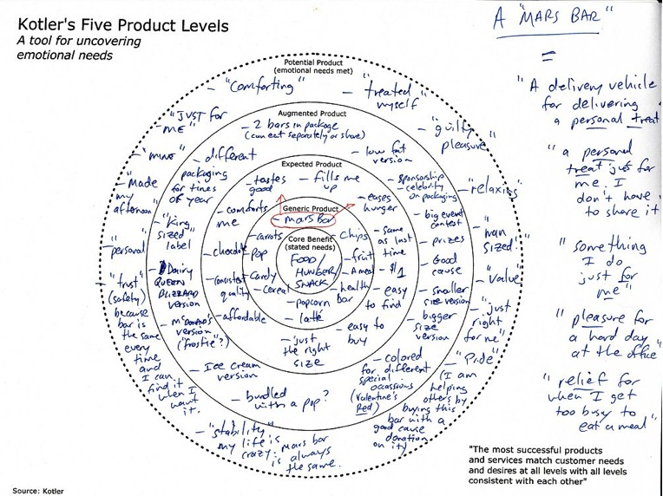

Slide 21
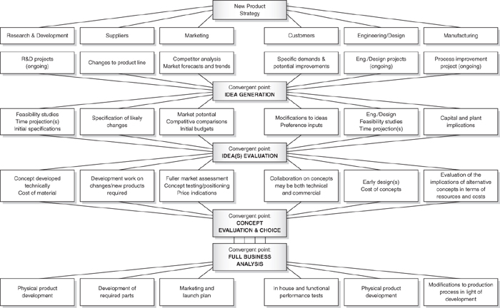

Slide 22
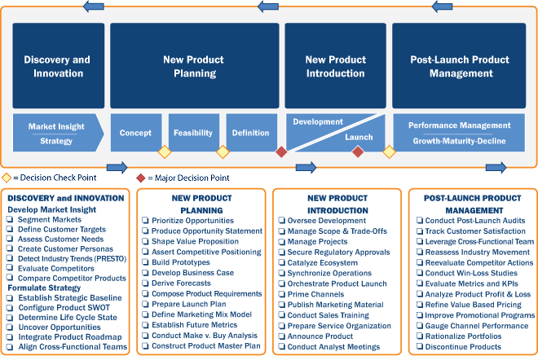

Slide 23
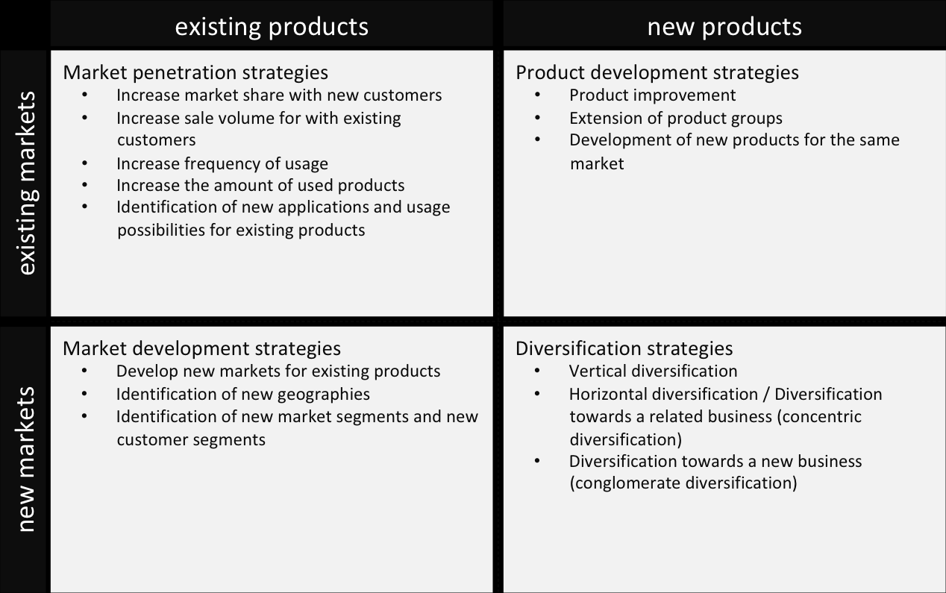

Slide 24
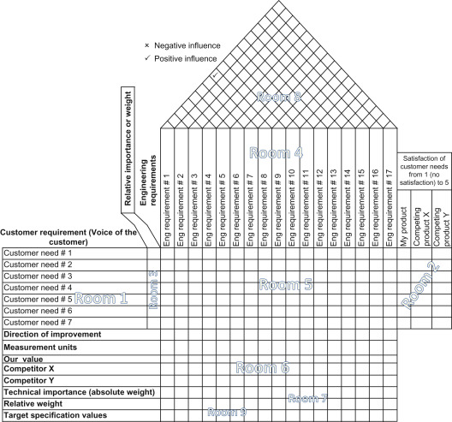

Slide 25
