Slide 1
Mission, vision, strategy goals

Slide 2
A mission statement
A mission statement is a short statement of why an organization exists, what its overall goal is, identifying the goal of its operations: what kind of product or service it provides, its primary customers or market, and its geographical region of operation. It may include a short statement of such fundamental matters as the organization's values or philosophies, a business's main competitive advantages, or a desired future state—the "vision".
A mission is not simply a description of an organization by an external party, but an expression, made by its leaders, of their desires and intent for the organization. The purpose of a mission statement is to communicate the organisation's purpose and direction to its employees, customers, vendors, and other stakeholders. A mission statement also creates a sense of identity for its employees. Organizations normally do not change their mission statements over time, since they define their continuous, ongoing purpose and focus.
According to Chris Bart, professor of strategy and governance at McMaster University, a commercial mission statement consists of three essential components:
Key market: the target audience
Contribution: the product or service
Distinction: what makes the product unique or why the audience should buy it over another
Bart estimates that in practice, only about ten percent of mission statements say something meaningfull. For this reason, they are widely regarded with contempt.

Slide 3
A mission statement: examples
1. Microsoft: Our mission is to empower every person and every organization on the planet to achieve more.
2. Nordstrom: To give customers the most compelling shopping experience possible.
3. Southwest Airlines: The mission of Southwest Airlines is dedication to the highest quality of customer service delivered with a sense of warmth, friendliness, individual pride, and company spirit.
4. Squarespace: Squarespace empowers people with creative ideas to succeed.
5. Uber: We ignite opportunity by setting the world in motion.
6. Google: To organize the world's information and make it universally accessible and useful.
7. Kickstarter: To help bring creative projects to life.
8. Tesla: To accelerate the world’s transition to sustainable energy.
9. The Coca-Cola Company: To refresh the world in mind, body and spirit. To inspire moments of optimism and happiness through our brands and actions.
10. Caterpillar: To enable economic growth through infrastructure and energy development, and to provide solutions that support communities and protect the planet.
11. Whole Foods Market: To nourish people and the planet. We're a purpose-driven company that aims to set the standards of excellence for food retailers. Quality is a state of mind at Whole Foods Market.
12. American Red Cross: The American Red Cross prevents and alleviates human suffering in the face of emergencies by mobilizing the power of volunteers and the generosity of donors.
13. Life is Good: To spread the power of optimism.
14. TED: Spread ideas.
15. Starbucks: To inspire and nurture the human spirit – one person, one cup and one neighborhood at a time.
16. LinkedIn: The mission of LinkedIn is simple: connect the world’s professionals to make them more productive and successful.
17. Wawa: Fulfilling Lives, Every Day.
18. Spotify: Our mission is to unlock the potential of human creativity — by giving a million creative artists the opportunity to live off their art and billions of fans the opportunity to enjoy and be inspired by it.

Slide 4
WHAT IS A MISSION STATEMENT?
A company mission statement sets the immediate course for that business. It focuses on the company’s current goals. It lets customers, employees, and the general public know what a company is about, how it will reach its objectives, and what motivates the company to do what it is doing. It lets people know what the company offers, and why they are different from the other companies out there who do exactly the same thing. It gives a business a chance to show how it is unique, even if at first glance, it doesn’t appear to be. With 30.2 million small businesses in the U.S., which makes up 99.9 percent of the companies in this country, there is a lot of industry competition. Standing out from the crowd and finding a way to run a successful business is imperative when there is this kind of competition. That’s how a mission statement can help. Since they are such an important tool for a company, a business mission statement requires a lot of thought and effort. They aren’t hastily jotted down in a few minutes — they may take weeks of meetings and dozens of drafts before one is accepted. It’s an important process that is worth the time. And as time goes on and goals are met or changed, it’s critical to revisit that mission statement and see if it still applies or if it can be tweaked to make it a more effective tool for the company. If it is changed, it should always tie in to the values that the company holds dear. Having a concise, updated mission statement is crucial for businesses who want to continue to thrive. It can also clearly spell out what the company’s values are. That can be valuable because businesses can attract or lose business based on their values and how well they adhere to them. Consumers are more sophisticated and place a higher emphasis on transparency than prior generations did. A carefully drafted mission statement can reach these conscious consumers.

Slide 5


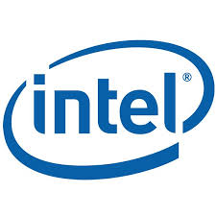





“To enable people and businesses throughout the world to realize their full potential.”
“To organize the world’s information and make it universally accessible and useful.”
“Utilize the power of Moore’s Law to bring smart, connected devices to every person on earth.”
“To move the web forward and give web designers and developers the best tools and services in the world.”
“Shape the future of the Internet by creating unprecedented value and opportunity for our customers, employees, investors, and ecosystem partners.”
“To be the catalyst in communities of customers, contributors, and partners creating better technology the open source way.”
“To improve its customers’ financial lives so profoundly, they couldn’t imagine going back to the old way.”
“Improving people’s lives through meaningful innovation.”
https://alessiobresciani.com/foresight-strategy/51-mission-statement-examples-from-the-worlds-best-companies/

Slide 6
What is a mission statement?
Your mission statement drives the company. It is what you do/the core of the business, and from it come the objectives and finally, what it takes to reach those objectives. It also shapes your company’s culture.
Mission statement questions look like:
What do we do?
Whom do we serve?
How do we serve them?
This trickle-down effect of a mission statement confirms its value at any company. Just by its definition, you can quickly see how a solid mission motivates a team to advance toward a common goal, because they started at the same place and they are working together to reach the same end-goal.
On the other hand, a weak mission — or no mission at all — can have the opposite effect. Picture this: silos, miscommunications, flailing, feeling unmotivated. And, imagine what that does to a company. Scary, right?

Slide 7
A mission statement: algorithm
Step 1: Interview Leadership
First, interview leadership about what they believe your company’s purpose is. Ask questions like:
What prominent challenges does our company solve? Why are we in business?
When you first applied, why did you want to work for us?
Who are our customers, and what do they value most?
What kind of image do we want to convey to the outside world as a company?
How do we use our products and services to reach our goals?
What do you think our organization’s purpose is?
What do you like about working for our company?
What differentiates us from our competitors?
What underlying philosophies and principles shaped your responses to the previous questions?

Slide 8
A mission statement: algorithm
Step 2: Identify Common Themes from Your Interviews
Next, review the common themes that emerged during your conversations, distilling them into paragraphs. You’ll want to set aside several hours to do this, or even an entire day. It’s important that you carve out the necessary time to spend on this process since crafting a mission statement is critical to identifying the motivations behind your business. When developing ideas, keep the following in mind:
Your mission statement should be attainable. Your company should be working toward it already and it should be possible to achieve.
Ensure your mission statement is clear so everyone can understand it.
The best mission statements are inspiring for management and staff.
It should set your company apart from others and be unique to you.
Your mission statement needs to be credible and inspire buy-in from all your major stakeholders.
Once you have these paragraphs written, rewrite each to be more succinct. Eliminate as many unnecessary sentences as you can. Once you have each paragraph distilled down to three sentences, challenge yourself to combine these sentences into a single thought that encapsulates your theme. Do this with every theme you’ve discovered during your interviews and you’ll end up with several options for a mission statement to present to leadership.

Slide 9
A mission statement: algorithm
Step 3: Present to Leadership
Once you have identified a few options for your mission statement, present them to leadership and get feedback. Be prepared to hear a lot of conflicting opinions — this is all part of the process! Mission statements don’t evolve in a vacuum, and it will take time to iterate on your ideas.

Slide 10
What is a vision statement?
Your vision statement gives the company direction. It is the future of the business, which then provides the purpose.
The vision statement is about what you want to become. It’s aspirational.
Vision statement questions look like:
What are our hopes and dreams?
What problem are we solving for the greater good?
Who and what are we inspiring to change?
The vision statement promotes growth, both internally and externally. A strong vision helps teams focus on what matters the most for their company. It also invites innovation. A purpose-driven company envisions success as a whole, because they know what success means for their company.
On the flip side, a lack of vision is a road to nowhere for a business. Imagine this: stagnation, outdated processes, moving without purpose, feeling uninspired. Can a company even survive without a clear vision? You know the answer to that one.

Slide 11
WHAT IS A VISION STATEMENT?
The vision statement can be considered an end game or ultimate goal for a company. It’s where they want to end up.
It serves as a source of inspiration for what that company wants for itself in the upcoming years. As such, vision statements are often lofty and may even seem far-fetched to some. That’s okay, because dreams do become reality with enough hard work.
And while vision statements may seem incredibly simple, they can be excruciatingly hard to write. That’s in part because of how simple they are. It’s not easy to boil all your hopes and dreams for your company into one short sentence.
Some businesses choose to skip vision statements, sometimes only having a mission statement instead. But because they can be powerful guiding principles when hard decisions have to be made, they are handy to have and to refer back to whenever you’re questioning a decision.
To help understand what a vision statement definition is, think about retirement planning. When companies offer their employees retirement savings seminars so they can learn about their investing options, often the financial experts hand out retirement planning books.
These workbooks ask employees questions about what they would like their retirement to be like. They ask what their goals are, and where they envision themselves at retirement time. What would they like to be doing if money weren’t an option?
Based on those answers, those booklets help employees determine how much money they might need to fund their dream. It motivates those employees to make the leap and sign up for a proper retirement savings plan like 401k. It convinces them to take action to make those dreams come true.
A company vision statement is a lot like that retirement booklet. It requires forward thinking and the ability to dream up the kind of future you’d like to see for your company.

Slide 12
DIFFERENCE BETWEEN MISSION AND VISION
Mission and vision statements are sometimes confused with each other or used interchangeably, but these are two separate, but equally important, statements.
While a mission statement can be a great tool for a company to let people know what they are about and to govern their present actions and aspirations, the vision definition is more of a long-term plan.
It should inspire the future path of the company. It may even touch on the industry as a whole and what company leaders envision for that as well, and what role the company may play in that future. But one of the most important differences between these types of statements is the scope of time they are encompassing. Remember:
The difference between mission and vision is the scope of time involved. Mission statements deal with the present, while vision statements are based on where you want to be years, even decades, from now.

Slide 13



Mission: To accelerate the world’s transition to sustainable energy.
Vision: To create the most compelling car company of the 21st century by driving the world’s transition to electric vehicles.
Why it works: What better word than “accelerate” in a mission to serve as the driving force behind what Tesla does. While boldly stating “best in the century” reflects loftier dreams in the vision.
Mission: We strive to offer our customers the lowest possible prices, the best available selection, and the utmost convenience.
Vision: To be Earth’s most customer-centric company, where customers can find and discover anything they might want to buy online.
Why it works: Amazon’s mission is cut-and-dry about what they offer to customers. The vision takes the offerings farther, saying their company will offer “anything” customers want.
Mission: Utilize the power of Moore’s Law to bring smart, connected devices to every person on earth.
Vision: If it is smart and connected, it is best with Intel.
Why it works: Intel “brings smart, connected devices” to everyone in their mission. Their vision uses more boastful language, illustrating great confidence in the future of their solutions.
Mission: Shape the future of the Internet by creating unprecedented value and opportunity for our customers, employees, investors, and ecosystem partners.
Vision: Changing the way we work, live, play, and learn.
Why it works: Cisco decided on a blended mission and vision statement. Language like “shape the future” is more vision-oriented, but the mission talks about the people they serve.
https://www.clearvoice.com/blog/difference-between-mission-vision-statement-examples/

Slide 14
core value
Your core company values shape your company culture and impact your business strategy. They help you create a purpose, improve team cohesion, and create a sense of commitment in the workplace.

Slide 15
Company Values: Definition and Principles
In essence, your company values are the beliefs, philosophies, and principles that drive your business. They impact the employee experience you deliver as well as the relationship you develop with your customers, partners, and shareholders.
Your company values are your company's DNA and they help you differentiate your business from the competition. That's why you can't make any important business decisions without having them in mind.
However, having company values doesn't mean having a polished communication plan around nice values and principles.
You have to truly honor your company values in everything you do and set the right example for your employees. It's the only way you can build trust in the workplace. Don't ask your employees to follow the company values you've set for your business if you don't follow and integrate them into your daily work in the first place.

Slide 16
Company Values: Definition and Principles
1. Your company values help your employees make the right decisions
Having a clear set of values helps your employees understand what you stand for. Your company values also give them guidance for their work and a sense of security.
As a result, your employees are more likely to make the right decisions — the decisions that help them achieve the company's vision and goals. And that's because they understand the company's mission statement, share the values that you stand for, and believe in your brand.
What's more, having a set of well-defined company values provides a moral direction to guide employees in difficult times. In a volatile environment of rapid technological, environmental, and societal changes, it’s a much-needed constant.
But to help your employees make the right decisions, you need to set the right company values, the ones that reflect what you stand for. That's why Simon Sinek explains in his book "Start With Why" that you need to communicate with your employees why your company exists, what your mission statement is, and what beliefs you stand for.
2. They help you improve your employee communications
Employee communication plays an extremely important role in building a better company culture, improving employee satisfaction, and increasing employee engagement.
The thing is, when employers don't have clear company values, their communications with their employees are usually inconsistent and unclear. This often leads to confusion in the workplace.

Slide 17
Company Values: Definition and Principles
3. They have a direct impact on employee motivation and engagement
When your employee communication is built around your core company values, it helps boost employee motivation and engagement.
Indeed, if you explain your core values to your employees and the reasons why you stand for these specific values, they will have a better understanding of the company goals and will work harder to achieve them.
Engaged employees are the ones that have clear guidance for achieving their personal goals as well as the company's goals. They have a good understanding of what is expected from them and how to achieve the business goals.
But most importantly, engaged employees are the ones that share your company values and strongly believe in them. If you want your employees to feel more engaged, you need to define your company values and communicate them properly.

Slide 18
Company Values: Definition and Principles
4. They help your clients understand what your company stands for
Besides helping your employees to live by your company values, it is extremely important to make sure that your clients understand what your core values are.
Indeed, your company values help you clarify the identity of the brand and educate your clients about what the company stands for.
Having a set of specific and unique core values can be a highly competitive advantage.
Think about it: if you manage to build a relationship with your clients based on the values you share, you're most likely going to strengthen this relationship because it is built on common beliefs and principles.
5. They help you attract and retain top talent
Company values are extremely important when it comes to talent attraction and retention.
ions going on on social media about the companies they are interested in, and they pay particular attention to company reviews.
That's because they don't want to choose the "wrong" company and the same goes for you as an employer — you want to hire the "right" talent.
Check out this short video where Simon Sinek explains why setting strong company values is essential when it comes to attracting top talentBesides interviewing candidates about their skills and experience, you're going to ask them questions about their values to make sure that they fit your company culture.
If you don't check whether the candidates are a cultural fit during the interview process, you may end up seeing your employee turnover rates drastically increase in the next few months!

Slide 19
Company Values: Definition and Principles
6. They help you attract customers that share the same values
In addition to your customers, potential new clients also care about what your company stands for. When a company finds out that your values are similar to theirs, you could have a much bigger chance of being chosen over someone else. For example, if one of your main company values is accountability, you can attract new customers who appreciate accountability and transparency from their vendors. For that reason, it is important to understand who your leads are and what their values are.
7. They make your marketing and internal comms teams' lives easier
To align their messages, your marketing and internal communications teams need to have a great understanding of your company values. To be credible, your internal and external communications have to be consistent. Companies that haven't set clear company values usually struggle with their communications strategies. Furthermore, marketing teams that know what the company stands for are much more successful in attracting new qualified leads that convert.
Indeed, you need to make sure that you share the right message with the right audience. If your messages include values that resonate with your target audience's values, you're much more likely to catch their attention. It's all about delivering authentic messages and building trust with your leads.

Slide 20
Words to shape company core value
Integrity
Boldness
Honesty
Fairness
Trustworthiness
Accountability
Learning
Customer Experience
Passion
Balance
Fun
Discipline
Humility
Ownership
Result oriented
Constant Improvement
Leadership
Hard work
Diversity
Employee Development
Innovation
Quality
Teamwork
Simplicity
Collaboration and Partnership
Idealism
Courage
Unselfishness
Self-Discipline
Self-Respect

Slide 21
Company Values: examples
Microsoft’s core values are “innovation, trustworthy computing, diversity and inclusion, corporate social responsibility, AI”
Apple core values include “inclusion and diversity, education, accessibility, environment, supplier responsibility and privacy.”
Tesla’s core values comprise “doing the best, taking risks, respect, constant learning, and environmental consciousness.”
Amazon core values include “customer obsession, ownership, invent and simplify, are right, a lot, hire and develop the best, insist on the highest standards, think big, bias for action, frugality, vocally self-critical, earn trust of others, dive deep, have backbone, disagree and commit, and deliver results.”

Slide 22
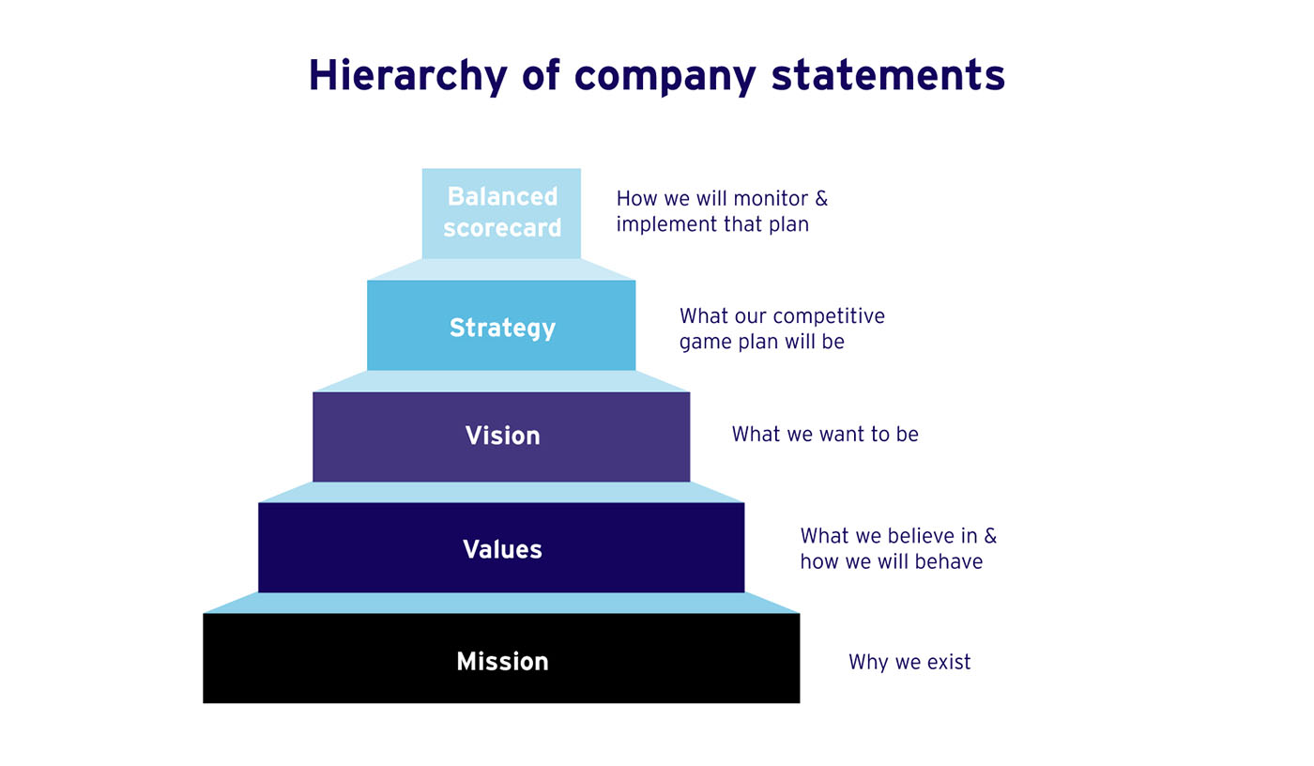

Slide 23
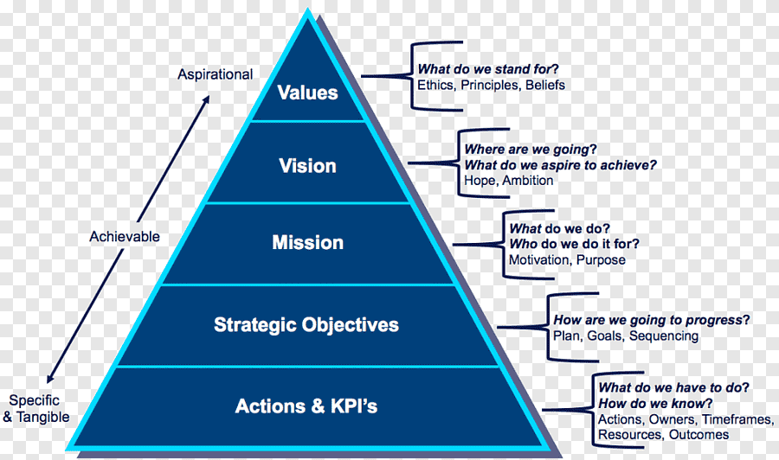

Slide 24
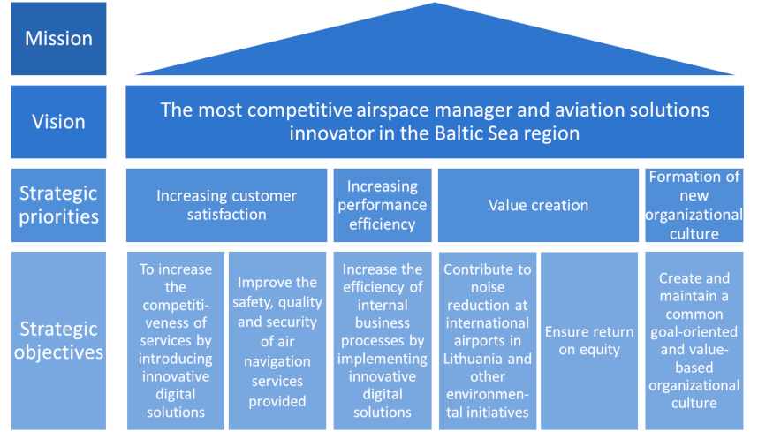

Slide 25
What is a strategic goal?
Strategic goals are visions for your business that have quantifiable or qualitative results. This means that achieving the goal must be something you can measure and track, using data like increased numbers, financial figures or improved productivity rates. There are many different types of examples for strategic planning goals and objectives that can be useful. Which goals you choose to work toward depends on what will be a greater benefit to you and your company.
Some businesses prefer to write detailed strategic plans for short or long-term goals, while others do not have specific approaches besides using a basic structure. Some strategic plans have simple goals, strategies, objectives and tactics, while others are more complicated and involved multiple layers. How the strategic goals are created depends on what level of accountability you are aiming for, what timeframe you want to complete them in and what the organization’s culture is. No matter which way you choose, creating the plan and committing to it is the most important part of setting strategic goals.

Slide 26
Why strategic goals are important
Setting strategic goals can have a significant impact on the success and productivity of your team. Strategic goals influence how and where a team’s energy and resources are used. They also provide the team with concrete objectives which will keep them focused and motivated.
Here are some examples of the benefits of strategic goals:
Defining priorities
Guiding resource allocation
Directing the creation and maintenance of budgets
Influencing the formation of teams
Providing focus and motivation for employees
Informing the objectives of the marketing, public relations and human resources departments
Providing comprehensive data used to measure a team’s results

Slide 27
Strategic goals examples
There are several specific types of strategic goals. Which approach you use depends entirely on the individual needs and objectives of your team. The progress your team makes toward the goals you choose to implement should be simple to track, easy to record and have recognizable results. Here are some examples of strategic goal plans to consider before setting goals for your team:
Objectives goals
Objectives are measurable and quantifiable targets, which inform when goals will be met and by how much. Progress toward objectives must be regularly recorded. If the objectives are not measurable, they are simply task lists. Factors that objectives measure include targeted performance, baseline performance and date that the objective will be achieved by.
Objectives are an important example of strategic goals that are created to promote success, as they are the foundation for planning. An example is to improve client satisfaction from 80% to 90% by the end of the year. That result would be easily measured and reported.
More examples of objectives goals include:
Increasing shareholder value by the next quarter
Lowering production costs by the next year
Balancing the company budget before January 1
Maintaining the current profit margins for six months
Securing five new client deals by the end of the year

Slide 28
Theme goals
A strategic theme goal is usually comprised of one to three words that are used to organize operational and strategic plans. Companies that have strategic themes may have an average of four to six different ones. Theme goals focus on uniting a team by choosing a simple idea that everyone on the team can understand and support. Because this type of goal is usually quite general, the individual tasks needed to reach the goal will need to be effectively communicated in order for the goal to be achieved. Here are some examples of theme goals:
Customer service first
Excel
Optimize opportunities
Improve and increase
Grow
Goal statements
Goals statements are broader concepts that interpret the vision statement of the organization into something that is more time-sensitive and meaningful. When used in conjunction with strategic themes, goal statements translate a vision into a strategic plan. Goal statements typically take the focus of an entire company and make it actionable for an individual team.
Some examples of goal statements are:
Increase team productivity
Increase web traffic
Improve customer relations
Increase community outreach
Innovate new solutions

Slide 29
Goal statements
Goals statements are broader concepts that interpret the vision statement of the organization into something that is more time-sensitive and meaningful. When used in conjunction with strategic themes, goal statements translate a vision into a strategic plan. Goal statements typically take the focus of an entire company and make it actionable for an individual team.
Some examples of goal statements are:
Increase team productivity
Increase web traffic
Improve customer relations
Increase community outreach
Innovate new solutions

Slide 30
Business process goals
There are many strategic goals you can use for business processes. A company may want to improve its web traffic and create monthly and quarterly goals it wants to hit each month. The company may want to increase the number of publications it has or is in by the end of the year.
A business can also measure vendor performance or restructure its organization. These are all strategic goal examples that are easy to set and monitor over the year. A company can set a goal to increase the value of its projects and manage its growth. Maybe the company wants to decrease overall costs and figure out a way to lower production costs. There are different ways to do this so the company can track whether its goals and plans are working or not.
Some examples of business process goals are:
Increase number of quality control employees by 10%
Record 5,000 volunteer hours by next quarter
Decrease unit costs before production begins for the holiday season
Complete and introduce new product development software
Settle all vendor accounts by the end of the calendar year
Setting strategic goals for your team is a smart way to change aspects of the company in a positive way. When a company has set goals, everyone can work as a team toward a common objective. Having goals that are weekly, monthly, quarterly and yearly are also important so you can see if the team is on track to meet each goal and adjust accordingly if not. Do some research, assess your team members and decide which strategic goals will the most beneficial for you and your team.

Slide 31
Customer interaction goals
When thinking about strategic goals and plans, it’s important to have goals for customers when you work in an industry that interacts with them often. A common goal is to improve the rate of customer satisfaction, which is important for customer retention.
Social media is a huge market and vital to most businesses, so setting goals to improve your social media statistics is common. You may have a goal of getting X amount of followers on Y platform by a certain date. You could also work on improving your likes per post by the end of the month. Content calendars can also be created so the company has a goal of producing better content.
Focusing on the happiness of existing customers is also important for a business—many businesses have a goal of improving the number of return customers that they have. They know these are just as important as new customers because they have a higher chance of sticking around and buying more products each time.
More customer interaction goals are:
Improve customer complaint response time
Decrease number of faulty/malfunctioning products
Improve net promoter score
Launch two new social media campaigns
Implement customer loyalty program

Slide 32
Growth goals
If the business is doing well at the current location, it might aim to open several new locations across the state or the country. This is a big goal, so having set tactics and strategies with objectives is essential to make sure all deadlines are met and all tasks are checked off the list. One goal may be to figure out which locations are the best choice for opening up new stores.
The company may even want to go international, which will have its own set of tasks to follow to make sure all international regulations are complied with. Other goals related to this may be having a certain percentage of sales in local stores and a certain goal for sales in international stores. A business can also track how many exported products are made and shipped out.
Here are some more examples of growth goals:
Acquire two new companies with more $500,000 in revenue
Open three new international locations
Hire 18 more employees to the production department
Increase brand value

Slide 33
Communication goals
There are a variety of strategic goal examples that will improve communication in your business. This includes increasing internal communications so everyone shares information better as a team and accomplishes more. There might be more in-person and online team updates that you want to happen so the team is more informed of what is happening on a daily basis. A company might want more reporting tools used or created so it is easier to see the progress the team is making. A weekly newsletter can go out each week internally to update all teams on what the others are up to.
If your team needs to work on communication skills, there are a number of tasks that can aid in that goal. Surveys can be sent out each month to make sure you are meeting the needs of everyone on the team. The company may want to start a reward and performance review system.
Other examples of communication goals include:
Increase employee satisfaction ratings
Simplify instruction materials
Streamline the new employee training process
Maintain a positive company culture
Prioritize team projects over individual tasks

