Slide 1
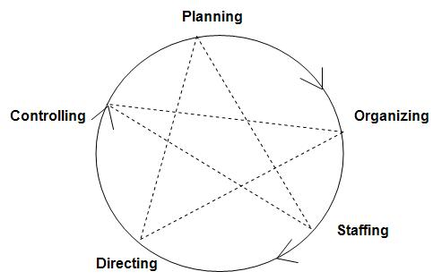
MANAGEMENT FUNCTIONS or PROCESS OF MANAGEMENT
planning,
organizing,
staffing,
directing,
coordinating
controlling.

Slide 2
Planning
Planning is the most fundamental and the most pervasive of all management functions. If people working in groups have to perform effectively, they should know in advance what is to be done, what activities they have to perform in order to do what is to be done, and when it is to be done. Planning is concerned with 'what', 'how, and 'when' of performance. It is deciding in the present about the future objectives and the courses of action for their achievement. It thus involves:
determination of long and short-range objectives;
development of strategies and courses of actions to be followed for the achievement of these objectives;
formulation of policies, procedures, and rules, etc., for the implementation of strategies, and plans.

Slide 3
Organizing :
Organizing involves identification of activities required for the achievement of enterprise objectives and implementation of plans; grouping of activities into jobs; assignment of these jobs and activities to departments and individuals; delegation of responsibility and authority for performance, and provision for vertical and horizontal coordination of activities. Every manager has to decide what activities have to be undertaken in his department or section for the achievement of the goals entrusted to him. Having identified the activities, he has to group identical or similar activities in order to make jobs, assign these jobs or groups of activities to his subordinates, delegate authority to them so as to enable them to make decisions and initiate action for undertaking these activities, and provide for coordination between himself and his subordinates, and among his subordinates. Organizing thus involves the following sub-functions :

Slide 4
Organizing
Identification of activities required for the achievement of objectives and implementation of plans.
Grouping the activities so as to create self-contained jobs.
Assignment of jobs to employees.
Delegation of authority so as to enable them to perform their jobs and to command the resources needed for their performance.
Establishment of a network of coordinating relationships.
Organizing process results in a structure of the organization. It comprises organizational positions, accompanying tasks and responsibilities, and a network of roles and authority-responsibility relationships.
Organizing is Organizing is thus the basic process of combining and integrating human, physical and financial resources in productive interrelationships for the achievement of enterprise objectives. It aims at combining employees and interrelated tasks in an orderly manner so that organizational work is performed in a coordinated manner, and all efforts and activities pull together in the direction of organizational goals.

Slide 5
Staffing :
Staffing is a continuous and vital function of management. After the objectives have been determined, strategies, policies, programmes, procedures and rules formulated for their achievement, activities for the implementation of strategies, policies, programmes, etc. identified and grouped into jobs, the next logical step in the management process is to procure suitable personnel for manning the jobs. Since the efficiency and effectiveness of an organization significantly depends on the quality of its personnel and since it is one of the primary functions of management to achieve qualified and trained people to fill various positions, staffing has been recognized as a distinct function of management. It comprises several subfunctions :
Manpower planning involving determination of the number and the kind of personnel required.
Recruitment for attracting adequate number of potential employees to seek jobs in the enterprise.
Selection of the most suitable persons for the jobs under consideration.
Placement, induction and orientation.
Transfers, promotions, termination and layoff.
Training and development of employees.

Slide 6
Staffing
As the importance of human factor in organizational effectiveness is being increasingly recognized, staffing is gaining acceptance as a distinct function of management. It need hardly any emphasize that no organization can ever be better than its people, and managers must perform the staffing function with as much concern as any other function.

Slide 7
Directing
Directing : Directing is the function of leading the employees to perform efficiently, and contribute their optimum to the achievement of organizational objectives. Jobs assigned to subordinates have to be explained and clarified, they have to be provided guidance in job performance and they are to be motivated to contribute their optimum performance with zeal and enthusiasm. The function of directing thus involves the following sub-functions :
Communication
Motivation
Leadership

Slide 8
Coordination :
Coordinating is the function of establishing such relationships among various parts of the organization that they all together pull in the direction of organizational objectives. It is thus the process of tying together all the organizational decisions, operations, activities and efforts so as to achieve unity of action for the accomplishment of organizational objectives.
The significance of the coordinating process has been aptly highlighted by Mary Parker Follet. The manager, in her view, should ensure that he has an organization "with all its parts coordinated, so moving together in their closely knit and adjusting activities, so linking, interlocking and interrelation, that they make a working unit, which is not a congeries of separate pieces, but what I have called a functional whole or integrative unity". Coordination, as a management function, involves the following sub-functions:
Clear definition of authority-responsibility relationships
Unity of direction
Unity of command
Effective communication
Effective leadership

Slide 9
Controlling :
Controlling is the function of ensuring that the divisional, departmental, sectional and individual performances are consistent with the predetermined objectives and goals. Deviations from objectives and plans have to be identified and investigated, and correction action taken. Deviations from plans and objectives provide feedback to managers, and all other management processes including planning, organizing, staffing, directing and coordinating are continuously reviewed and modified, where necessary. Controlling implies that objectives, goals and standards of performance exist and are known to employees and their superiors. It also implies a flexible and dynamic organization which will permit changes in objectives, plans, programmes, strategies, policies, organizational design, staffing policies and practices, leadership style, communication system, etc., for it is not uncommon that employees failure to achieve predetermined standards is due to defects or shortcomings in any one or more of the above dimensions of management. Thus, controlling involves the following process :
Measurement of performance against predetermined goals.
Identification of deviations from these goals.
Corrective action to rectify deviations.
It may be pointed out that although management functions have been discussed in a particular sequence-planning, organizing, staffing, directing, coordinating and controlling – they are not performed in a sequential order. Management is an integral process and it is difficult to put its functions neatly in separate boxes. Management functions tend to coalesce, and it sometimes becomes difficult to separate one from the other. For example, when a production manager is discussing work problems with one of his subordinates, it is difficult to say whether he is guiding, developing or communicating, or doing all these things simultaneously. Moreover, managers often perform more than one function simultaneously.

Slide 10
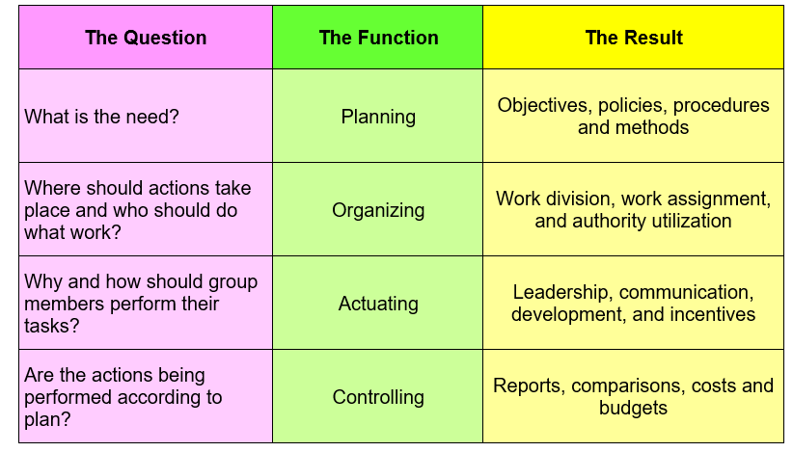
MANAGEMENT FUNCTIONS : summary

