Slide 1
Management functions: planning and organising

Slide 2
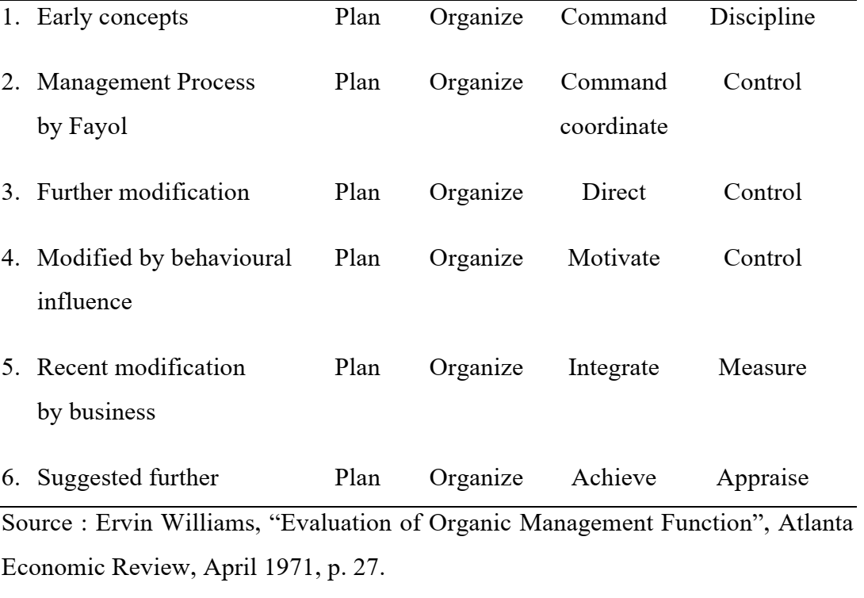
Evolution of Management Functions

Slide 3
Planning
The planning function is the primary activity of management. Planning is the process of establishing goals and a suitable course of action for achieving those goals. Planning implies that managers think through their goals and actions in advance and that their actions are based on some method, plan, or logic rather than on a....... Plans give the organization its objectives and set up the best procedures for reaching them. The organizing, leading and controlling functions all derived from the planning function.

Slide 4
Definition of Planning
Planning is the process of deciding in advance what is to be done, who is to do it, how it is to be done and when it is to be done. It is the process of determining a course of action, so as to achieve the desired results. It helps to bridge the gap from where we are, to where we want to go. It makes it possible for things to occur which would not otherwise happen. Planning is a higher order mental process requiring the use of intellectual faculties, imagination, foresight and sound judgment.
According to Koontz, O'Donnell and Weihrich, "Planning is an intellectually demanding process; it requires the conscious determination of courses of action and the basing of decisions on purpose, knowledge and considered estimates".

Slide 5
Definition of Planning
Planning is a process which involves anticipation of future course of events and deciding the best course of action. It is a process of thinking before doing. To plan is to produce a scheme for future action; to bring about specified results, at specified cost, in a specified period of time. It is deliberate attempt to influence, exploit, bring about, and control the nature, direction, extent, speed and effects of change. It may even attempt deliberately to create change, remembering always that change (like decision) in any one sector will in the same way affect other sectors. Planning is a deliberate and conscious effort done to formulate the design and orderly sequence actions through which it is expected to reach the objectives. Planning is a systematic attempt to decide a particular course of action for the future, it leads to determination of objectives of the group activity and the steps necessary to achieve them. Thus, it can be said that planning is the selecting and relating of facts and the making and using of assumptions regarding the future in the visualization and formulation of proposed activities believed necessary to achieve desired results.

Slide 6
Definition of Planning
Planning is thus deciding in advance the future state of business of an enterprise, and the means of attaining it. Its elements are :
1.What will be done – what are the objectives of business in the short and in the long run?
2. What resources will be required – This involves estimation of the available and potential resources, estimation of resources required for the achievement of objectives, and filling the gap between the two, if any.
3. How it will be done – This involves two things : (i) determination of tasks, activities, projects, programmes, etc., required for the attainment of objectives, and (ii) formulation of strategies, policies, procedures, methods, standard and budgets for the above purpose.
4. Who will do it – It involves assignment of responsibilities to various managers relating to contributions they are expected to make for the attainment of enterprise objectives. This is preceded by the breaking down of the total enterprise objectives into segmental objectives, resulting into divisional, departmental, sectional and individual objectives.
5. When it will be done – It involves determination of the timing and sequence, if any, for the performance of various activities and execution of various projects and their parts.

Slide 7
NATURE AND SCOPE OF PLANNING
The nature of planning can be understood by focusing on its following
aspects :
Planning is a Continuous Process
Planning deals with the future, and future, by its very nature, is uncertain. Although the planner bases his plans on an informed and intelligent estimate of the future, the future events may not turnout to be exactly as predicted. This aspect of planning makes it a continuous process. Plans tend to be a statement of future intentions relating to objectives and means of their attainment. They do not acquire finality because revisions are needed to be made in them in response to changes taking place in the internal as well as external environment of enterprise. Planning should, therefore, be a continuous process and hence no plan is final, it is always subject to a revision.

Slide 8
2. Planning concerns all Managers
It is the responsibility of every manager to set his goals and operating plans. In doing so, he formulates his goals and plans within the framework of the goals and plans of his superior. Thus, planning is not the responsibility of the top management or the staff of planning department only; all those who are responsible for the achievement of results, have an obligation to plan into the future. However, managers at higher levels, being responsible for a relatively larger unit of the enterprise, devote a larger part of their time to planning, and the time span of their plans also tends to be longer than that of managers at lower levels. It shows that planning acquires greater importance and tends to the longer in the future at higher than at lower management levels.

Slide 9
3. Plans are arranged in a Hierarchy
Plans are first set for the entire organization called the corporate plan. The corporate plan provides the framework for the formulation of divisional departmental and sectional goals. Each of these organizational components sets its plans laying down the programmes, projects, budgets, resource requirements, etc. The plans of each lower component are aggregated into the plans of successively higher component until the corporate plan integrates all component plans into a composite whole. For example, in the production department, each shop superintendent sets his plans, which are successively integrated into the general foremen's, works manager's and production manager's plans. All departmental plans are then integrated in the corporate plan. Thus, there is a hierarchy of plans comprising the corporate plan, divisional/department plans, ectional plans and individual manger's unit plans.

Slide 10
4. Planning Commits an Organization into the Future
Planning commits an organization into the future, as past, present and future is tied in a chain. An organization’s objectives, strategies, policies and operating plans affect its future effectiveness, as decisions made and activities undertaken in the present continue to have their impact into the future. Some of the plans affect the near future, while others affect it in the long run. For example, plans for product diversification or production capacity affect a company long into the future, and are not easily reversible, whereas plans relating to the layout of its office locations can be changed with relatively less difficulty in the future. This focuses on the need for better and more careful planning.

Slide 11
5. Planning is Antithesis of States Quo
Planning is undertaken with the conscious purpose of attaining a position for the company that would not be accomplished otherwise. Planning, therefore, implies change in organizational objectives, policies, products, marketing strategies and so forth. However, planning itself is affected by unforeseen environmental changes. It, therefore, needs examination and re-examination, continual reconsideration of the future, constant searching for more effective methods and improved results. Planning is thus an all pervasive, continuous and dynamic process. It imposes on all executives a responsibility to estimate and anticipate the future, prepare the organization to cope with its challenges as well as take advantage of the opportunities created by it, while at the same time, influence tomorrow's events by today's pre-emptive decisions and actions.

Slide 12
IMPORTANCE OF PLANNING
While planning does not guarantee success in organizational objectives, there is evidence that companies that engaged in formal planning consistently performed better than those with none or limited formal planning and improved their own performance over a period of time. It is very rare for an organization to succeed solely by luck or circumstances. Some of the reasons as to why planning is considered a vital managerial function are given below :

Slide 13
Planning is essential in modern business : The growing complexity of the modern business with rapid technological changes, dynamic changes in the consumer preferences and growing tough competition necessities orderly operations, not only in the current environment but also in the future environment. Since planning takes a future outlook, it takes into account the possible future developments.
Planning affects performance : A number of empirical studies provide evidence of organizational success being a function of formal planning, the success being measured by such factors as return on investment, sales volume, growth in earnings per share and so on. An investigation of firms in various industrial products as machinery, steel, oil, chemicals and drugs revealed that companies that engaged in formal planning consistently performed better than those with no formal planning.

Slide 14
Planning puts focus on objectives : The effectiveness of formal planning is primarily based upon clarity of objectives. Objectives provide a direction and all planning decisions are directed towards achievement of these objectives. Plans continuously reinforce the importance of these objectives by focusing on them. This ensures maximum utility of managerial time and efforts.
Planning anticipates problems and uncertainties : A significant aspect of any formal planning process in collection of relevant information for the purpose of forecasting the future as accurately as possible. This would minimize the chances of haphazard decisions. Since the future needs of the organization are anticipated in advance, the proper acquisition and allocation of resources can be planned, thus minimizing wastage and ensuring optimal utility of these resources.

Slide 15
Planning is necessary to facilitate control : Controlling involves the continual analysis and measurement of actual operations against the established standards. These standards are set in the light of objectives to by achieved. Periodic reviews of operations can determine whether the plans are being implemented correctly. Well developed plans can aid the process of control in two ways. First, the planning process establishes a system of advance warning of possible deviations from the expected performance. Second contribution of planning to the control process is that it provides quantitative data which would make it easier to compare the actual performance in quantitative terms, not only with the expectations of the organization but also with the industry statistics or market forecasts.

Slide 16
Planning helps in the process of decision making : Since planning specifies the actions and steps to be taken in order to accomplish organizational objectives, it serves as a basis for decision-making about future activities. It also helps managers to make routine decisions about current activities since the objectives, plans, policies, schedules and so on are clearly laid down.

Slide 17
BASIC PRINCIPLES OF PLANNING
The important principles of planning are as follows:
Principle of contribution to objective : The purpose of plans and their components is to develop and facilitate the realization of organizational aims and objectives. Long-range plans should be interwoven with medium-range plans which, in turn, should be meshed with short-range ones in order to accomplish organizational objectives more effectively and economically.
2. Principle of limiting factors : Planning must take the limiting factors (manpower, money, machines, materials, and management) into account by concentrating on them when developing alternative plans, strategies, policies, procedures and standards.
3. Principle of pervasiveness of planning : Planning is found at all levels of management. Strategic planning or long-range planning is related to top management, while intermediate and short-range planning is the concern of middle and operative management respectively.

Slide 18
Principle of navigational change : This principle requires that managers should periodically check on events and redraw plans to maintain a course towards a desired goal. It is the duty of the navigator to check constantly, whether his ship is following the right direction in the vast ocean to reach the distinction as scheduled. In the same way, a manager should check his plans to ensure that these are processing as required. He should change the direction of his plans if he faces unexpected events. It is useful if plans contain an element of flexibility. It is the responsibility of the manager, to adapt and change the direction of plans, to meet the challenge of constantly changing environment that could not be foreseen.

Slide 19
Principle of flexibility : Flexibility should be built into organizational plans. Possibility of error in forecasting and decisionmaking and future uncertainties is the two common factors which call for flexibility in managerial planning. The principal of flexibility states the management should be able to change an existing plan because of changes in environment, without due cost or delay, so that activities keep moving towards established goals. Thus, an unexpected slump in demand for a product will require change in sales plan as well ass production plan. Change in these plans can be introduced, only when these possess the characteristics of flexibility. Adapting plans to suit future uncertainties or changing environment is easier if flexibility is an important consideration while planning.

Slide 20
ATEGORIES AND LEVELS OF PLANNING
Planning can be classified on different bases which are discussed below :
Strategic and Functional Planning : In strategic or corporate planning, the top management determines the general objectives of the enterprise and the steps necessary to accomplish them in the light of resources currently available and likely to be available in the future. Functional planning, on the other hand, is planning that covers functional areas like production, marketing, finance and purchasing.
Long-range and short-range planning : Long-range planning sets long-term goals of the enterprise and then proceeds to formulate specific plans for attaining these goals. It involves an attempt to anticipate, analyze and make decisions about basic problems and issues which have significance reaching well beyond the present operating horizon of the enterprise. Short-range planning, on the other hand, is concerned with the determination of short-term activities to accomplish long-term with the determination of shortterm activities to accomplish long-term objectives. Short range planning relates to a relatively short period and has to be consistent with the long-range plans. Operational plans are generally related to short periods.

Slide 21
Adhoc and Standing Planning : Adhoc planning committees may be constituted for certain specific matters, as for instance, for project planning. But standing plans are designed to be used over and over again. They include organizational structure, standard procedures, standard methods etc.
4. Administrative and Operational Planning : Administrative planning is done by the middle level management which provides the foundation for operative plans. Operative planning, on the other hand, is done by the lower level mangers to put the administrative plans into action.
5. Physical Planning : It is concerned with the physical location and arrangement of building and equipment.

Slide 22
Formal and Informal Planning : Various types of planning discussed above are of formal nature. They are carried on systematically by the management. They specify in black and white the specific goals and the steps to achieve them. They also facilitate the installation of internal control systems. Informal planning, on the other hand, is mere thinking by some individuals which may become the basis of formal planning in future.

Slide 23
LEVELS OF PLANNING
In management theory it is usual to consider that there are three basic level of planning, though in practice there may be more than three levels of management and to an extent there will be some overlapping of planning operations. The three level of planning are as under :
Top Level Planning : Also known as overall or strategic planning, top level planning is done by the top management, i.e. board of directors or governing body. It encompasses the long-range objectives and policies of organization and is concerned with corporate results rather than sectional objective. Top level planning is entirely long-range and is inextricably linked with long-term objectives. It might be called the 'what' of planning.

Slide 24
Second Level Planning : Also known as tactical planning, it is done by middle level mangers or department heads. It is concerned with 'how' of planning. It deals with deployment of resources to the best advantage. It is concerned mainly, but not exclusively, with longrange planning, but its nature is such that the time spans are usually shorter than those of strategic planning. This is because its attentions are usually devoted to the step by step attainment of the organization’s main objectives. It is, in fact, oriented to functions and departments rather than to the organization as a whole.
Third Level Planning : Also known as operational or activity planning, it is the concern of department managers and supervisors. It is confined to putting into effect the tactical or departmental plans. It is usually for short-term and may be revised quite often to be in tune with the tactical planning.

Slide 25
ESSENTIAL STEPS IN PLANNING
Planning is a process which embraces a number of steps to be taken. It is an intellectual exercise and a conscious determination of courses of action. Therefore, it requires a serious thought on numerous factors necessary to be considered in making plans. Facts are collected and analyzed and the best out of all is chosen and adopted. The planning process, valid for one organization and for one plan, may not be valid for all other organizations or all types of plans, because various factors that go into planning process may differ from organization to organization or plan to plan. For example, planning process for a large organization may not be the same as for a small organization. The steps generally involved in planning are as follows :

Slide 26
Establishing Verifiable Goals or Set of Goals to be Achieved :
The first step in planning is to determine the enterprise objectives. These are most often set by upper level or top managers, usually after a number of possible objectives have been carefully considered. There are many types of objectives managers may select: a desired sales volume or growth rate, the development of a new product or service, or even a more abstract goal such as becoming more active in the community. The type of goal selected will depend on number of factors: the basic mission of the organization, the values its managers hold, and the actual and potential ability of the organization.

Slide 27
Establishing Planning Premises : The second step in planning is to establish planning premises, i.e. certain assumptions about the future on the basis of which the plan will be intimately formulated. Planning premises are vital to the success of planning as they supply economic conditions, production costs and prices, probable competitive behaviour, capital and material availability, governmental control and so on.

Slide 28
Deciding the planning period : Once upper-level managers have selected the basic long-term goals and the planning premises, the next task is to decide the period of the plan. Business varies considerably in their planning periods. In some instances plans are made for a year only while in others they span decades. In each case, however, there is always some logic in selecting a particular time range for planning. Companies generally base their period on a future that can reasonably be anticipated. Other factors which influence the choice of a period are as follows: : (a) lead time in development and commercialization of a new product; (b) time required to recover capital investments or the pay back period; and (c) length of commitments already made.

Slide 29
Findings Alternative Courses of Action : The fourth step is planning is to search for and examining alternative courses of action. For instance, technical know-how may be secured by engaging a foreign technician or by training staff abroad. Similarly, products may be sold directly to the consumer by the company's salesmen or through exclusive agencies. There is seldom a plan for which reasonable alternatives do not exit, and quite often an alternative that is not obvious proves to be the best.
Evaluating and Selecting a Course of Action : Having sought alternative courses, the fifth step is to evaluate them in the light of the premises and goals and to select the best course or courses of action. This is done with the help of quantitative techniques and operations research.

Slide 30
Developing Derivative plans : Once the plan has been formulated, its broad goals must be translated into day-to-day operations of the organization. Middle and lower-level managers must draw up the appropriate plans, programmes and budgets for their sub-units. These are described as derivative plans. In developing these derivative plans, lower-level managers take steps similar to those taken by upper-level managers – selecting realistic goals, assessing their sub-units particular strength and weaknesses and analyzing those parts of the environment that can affect them.

Slide 31
Measuring and Controlling the Progress :Obviously, it is foolish to let a plan run its course without monitoring its progress. Hence the process of controlling is a critical part of any plan. Managers need to check the progress of their plans so that they can (a) take whatever remedial action is necessary to make the plan work, or (b) change the original plan if it is unrealistic.

Slide 32
Management functions: Organizing

Slide 33
Organizing
After managers develop objectives and plans to achieve the objectives, they must design and develop an organization that will be able to accomplish the objectives. Thus the purpose of the organizing function is to create a structure of task and authority relationships that serves this purpose. Organizing is the process of arranging and allocating work, authority, and resources among an organization’s members so they can achieve the organization’s goals.
Stoner defines “organizing as the process of engaging two or more people in working together in a structured way to achieve a specific goal or set of goals.
The organizing function takes the tasks identified during planning and assigns them to individuals and groups within the organization so that objectives set by planning can be achieved. Organizing, then, can be thought of turning plans into actions. Organizing function can be viewed as a bridge connecting the conceptual idea developed in creating and planning to the specific means for accomplishing these ideas.
The organizing function also provides on organizational structure that enables the organization to function effectively. Managers must match an organization’s structure to its goals and resources, a process called organizational design.

Slide 34
Organizing
Organizing thus involves the following subfunctions:
(a) Identification of activities required for the achievement of objectives and implementation of plans.
(b) Grouping the activities so as to create self-contained jobs.
(c) Assignment of jobs to employees.
(d) Delegation of authority so as to enable them to perform their jobs and to command the resources needed for their performance.
(e) Establishment of a network of coordinating relationships.

Slide 35
Organizing process results in a structure of the organization. It comprises
organizational positions, accompanying tasks and responsibilities, and a
network of roles and authority-responsibility relationships.
Organizing is thus the basic process of combining and integrating human,
physical and financial resources in productive interrelationships for the
achievement of enterprise objectives. It aims at combining employees and
interrelated tasks in an orderly manner so that organizational work is
performed in a coordinated manner, and all efforts and activities pull
together in the direction of organizational goals.

Slide 36
MEANING AND CHARACTERISTICS OF ORGANISATION
The term 'organization' connotes different meanings to different people. Many writers have attempted to state the nature, characteristics and principles of organization in their own may. For instance, to the sociologists organization means a study of the interactions of the people, classes, or the hierarchy of an enterprise; to the psychologists organization means an attempt to explain, predict and influence behaviour of individuals in an enterprise; to a top level executive it may mean the weaving together the functional components in the best possible combination so that an enterprise can achieve its goals. The word 'organization' is also used widely to connote a group of people and the structure of relationships.

Slide 37
characteristics of an organization :
1. It is a group of individuals which may be large or small.
2. The group in the organization works under the executive leadership.
3. It is a machine or mechanism of management.
4. It has some directing authority or power which controls the concerted efforts of the group.
5. The division of labour, power and responsibilities are deliberately planned.
6. It implies a structure of duties and responsibilities.
7. It is established for accomplishment of common objectives
8. It is a functional concept.

Slide 38
Sound organization brings about the following advantages :
1. Facilitates attainment of the objectives of the enterprise.
2. Facilitates optimum use of resources and new technological development.
3. Facilitates growth and diversification.
4. Stimulates creativity and innovation.
5. Facilities effective communication.
6. Encourages better relations between the labour and the management.
7. Increase employee satisfaction and decreases employee turnover.

Slide 39
NATURE OF ORGANISATION
The term 'organization' is used in two different senses. In the first sense it is used to denote the process of organizing. In the second sense, it is used to denote the results of that process, namely, the organizational structure. So, the nature of organization can be viewed in two ways :
(a) Organization as a process; and
(b) Organization as a structure or framework of relationship.

Slide 40
Organization as a process : As a process, organization is an executive function. It becomes a managerial function involving the following activities :
Determining activities necessary for the accomplishment of the business objective.
Grouping of interrelated activities.
Assigning duties to persons with requisite competence,
Delegating authority, and
Coordinating the efforts of different persons and groups.

