Slide 1
Organizational Structure

Slide 2
Organizational Structure: essence
An organization is a social unit of individuals that is designed and managed to achieve collective goals. As such organizations are open systems that are greatly affected by the environment they operate in. Every organization has its own typical management structure that defines and governs the relationships between the various employees, the tasks that they perform, and the roles, responsibilities and authority provided to carry out different tasks.
An organization that is well structured achieves effective coordination, as the structure delineates formal communication channels, and describes how separate actions of individuals are linked together.
Organizational structure defines the manner in which the roles, power, authority, and responsibilities are assigned and governed, and depicts how information flows between the different levels of hierarchy in an organization.
The structure an organization designs depends greatly on its objectives and the strategy it adopts in achieving those objectives.

Slide 3
organizational chart
An organizational chart is a diagram that visually conveys a company's internal structure by detailing the roles, responsibilities, and relationships between individuals within an entity. Organizational charts either broadly depict an enterprise company-wide or drill down to a specific department or unit.

Slide 4
Types of Organizational Structure
Functional Organizational Structure
Product-Based Divisional Structure
Market-Based Divisional Structure
Geographical Divisional Structure
Process-Based Structure
Matrix Structure
Circular Structure
Flat Structure
Network Structure

Slide 5
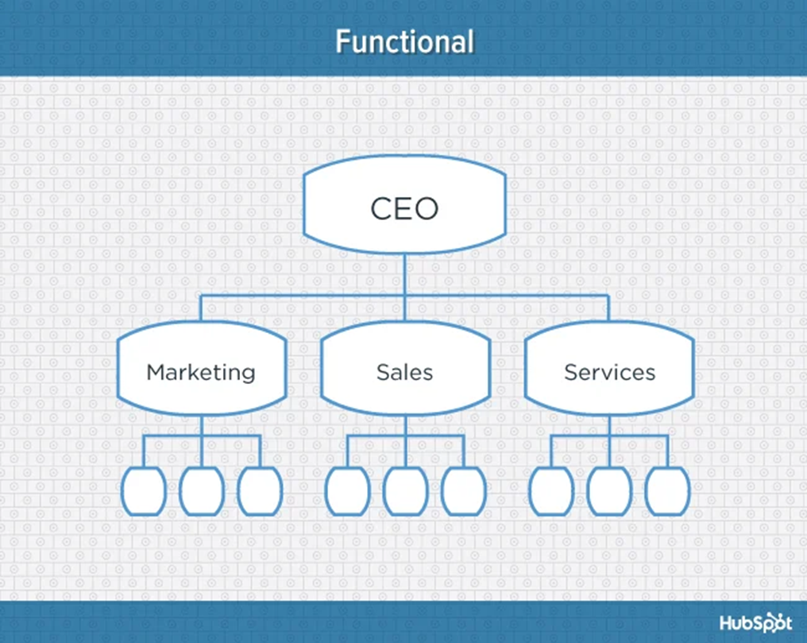
1. Functional Organizational Structure
One of the most common types of organizational structures, the functional structure departmentalizes an organization based on common job functions.
An organization with a functional org structure, for instance, would group all of the marketers together in one department, group all of the salespeople together in a separate department, and group all of the customer service people together in a third department.
The functional structure allows for a high degree of specialization for employees, and is easily scalable should the organization grow. Also this structure is mechanistic in nature -- which has the potential to inhibit an employee's growth -- putting staff in skill-based departments can still allow them to delve deep into their field and find out what they're good at.
Disadvantages
Functional structure also has the potential to create barriers between different functions -- and it can be inefficient if the organization has a variety of different products or target markets. The barriers created between departments can also limit peoples' knowledge of and communication with other departments, especially those that depend on other departments to succeed.

Slide 6
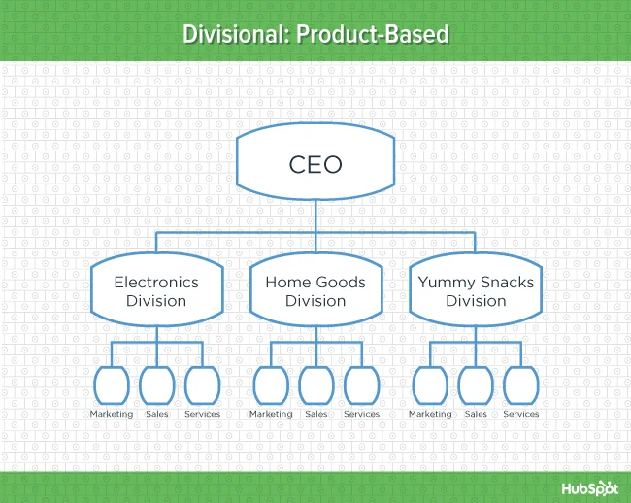
2. Product-Based Divisional Structure
A divisional organizational structure is comprised of multiple, smaller functional structures (i.e. each division within a divisional structure can have its own marketing team, its own sales team, and so on). In this case -- a product-based divisional structure -- each division within the organization is dedicated to a particular product line.
This type of structure is ideal for organizations with multiple products and can help shorten product development cycles. This allows small businesses to go to market with new offerings fast.
Disadvantages
It can be difficult to scale under a product-based divisional structure, and the organization could end up with duplicate resources as different divisions strive to develop new offerings.

Slide 7
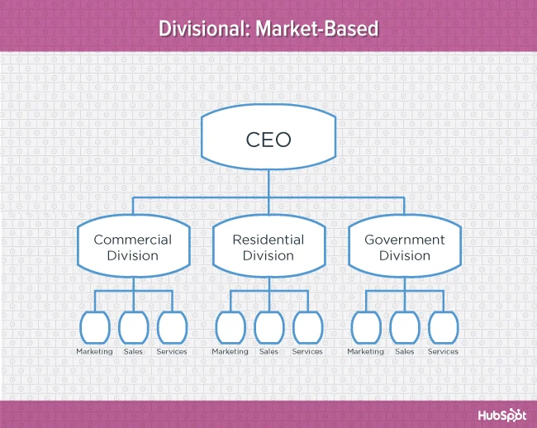
3. Market-Based Divisional Structure
Another variety of the divisional organizational structure is the market-based structure, wherein the divisions of an organization are based around markets, industries, or customer types.
The market-based structure is ideal for an organization that has products or services that are unique to specific market segments, and is particularly effective if that organization has advanced knowledge of those segments. This organizational structure also keeps the business constantly aware of demand changes among its different audience segments.
Disadvantages
Too much autonomy within each market-based team can lead to divisions developing systems that are incompatible with one another. Divisions might also end up inadvertently duplicating activities that other divisions are already handling.

Slide 8
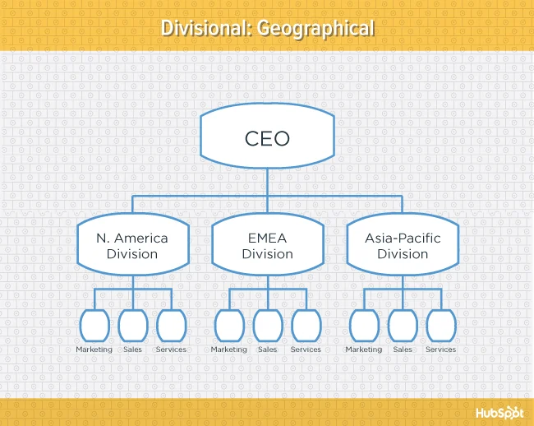
4. Geographical Divisional Structure
The geographical organizational structure establishes its divisions based on -- you guessed it -- geography. More specifically, the divisions of a geographical structure can include territories, regions, or districts.
This type of structure is best-suited to organizations that need to be near sources of supply and/or customers (e.g. for deliveries or for on-site support). It also brings together many forms of business expertise, allowing each geographical division to make decisions from more diverse points of view.
Disadvantages
The main downside of a geographical org structure: It can be easy for decision- making to become decentralized, as geographic divisions (which can be hundreds, if not thousands of miles away from corporate headquarters) often have a great deal of autonomy. And when you have more than one marketing department -- one for each region -- you run the risk of creating campaigns that compete with (and weaken) other divisions across your digital channels.

Slide 9
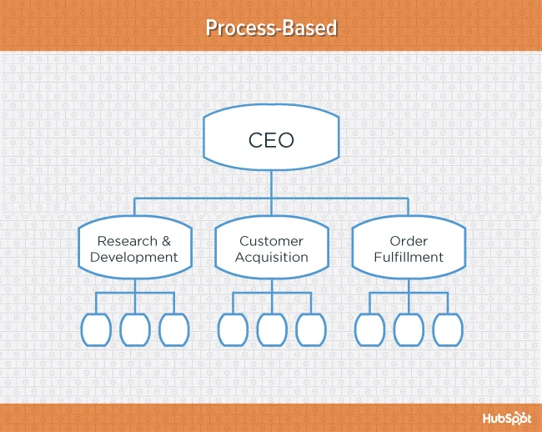
5. Process-Based Structure
Process-based organizational structures are designed around the end-to-end flow of different processes, such as "Research & Development," "Customer Acquisition," and "Order Fulfillment." Unlike a strictly functional structure, a process-based structure considers not only the activities employees perform, but also how those different activities interact with one another.
In order to fully understand the diagram below, you need to look at it from left to right: The customer acquisition process can't start until you have a fully developed product to sell. By the same token, the order fulfillment process can't start until customers have been acquired and there are product orders to fill.
Process-based organizational structure is ideal for improving the speed and efficiency of a business, and is best-suited for those in rapidly changing industries, as it is easily adaptable.
Disadvantages
Similar to a few other structures on this list, process-based structure can erect barriers between the different process groups. This leads to problems communicating and handing off work to other teams and employees.

Slide 10
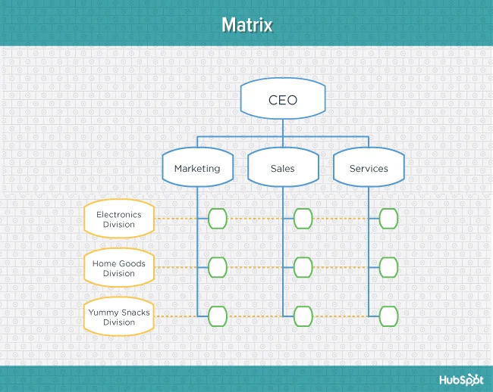
6. Matrix Structure
Unlike the other structures we've looked at so far, a matrix organizational structure doesn't follow the traditional, hierarchical model. Instead, all employees (represented by the green boxes) have dual reporting relationships. Typically, there is a functional reporting line (shown in blue) as well as a product- based reporting line (shown in yellow).
When looking at a matrix structure org chart, solid lines represent strong, direct-reporting relationships, whereas dotted lines indicate that the relationship is secondary, or not as strong. In our example below, it's clear that functional reporting takes precedence over product-based reporting.
The main appeal of the matrix structure is that it can provide both flexibility and more balanced decision-making (as there are two chains of command instead of just one). Having a single project overseen by more than one business line also creates opportunities for these business lines to share resources and communicate more openly with each other -- things they might not otherwise be able to do regularly.
Disadvantages
The primary pitfall of the matrix organizational structure? Complexity. The more layers of approval employees have to go through, the more confused they can be about who they're supposed to answer to. This confusion can ultimately cause frustration over who has authority over which decisions and products -- and who's responsible for those decisions when things go wrong.

Slide 11
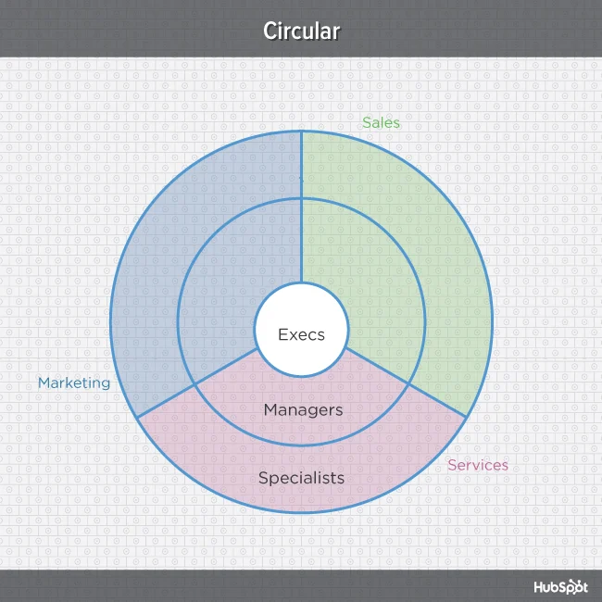
7. Circular Structure
While it might appear drastically different from the other organizational structures highlighted in this section, the circular structure still relies on hierarchy, with higher-level employees occupying the inner rings of the circle and lower-level employees occupying the outer rings.
That being said, the leaders or executives in a circular organization aren't seen as sitting atop the organization, sending directives down the chain of command. Instead, they're at the center of the organization, spreading their vision outward.
From an ideological perspective, a circular structure is meant to promote communication and the free flow of information between different parts of the organization. Whereas a traditional structure shows different departments or divisions as occupying individual, semi-autonomous branches, the circular structure depicts all divisions as being part of the same whole.
Disadvantages
From a practical perspective, the circular structure can be confusing, especially for new employees. Unlike with a more traditional, top-down structure, a circular structure can make it difficult for employees to figure out who they report to and how they're meant to fit into the organization.

Slide 12
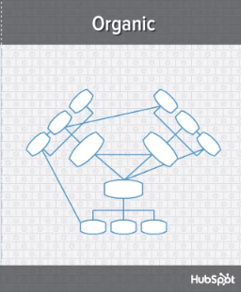
8. Flat Structure
While a more traditional organizational structure might look more like a pyramid -- with multiple tiers of supervisors, managers and directors between staff and leadership, the flat structure limits the levels of management so all staff are only a few steps away from leadership. It also might not always take the form or a pyramid, or any shape for that matter. As we mentioned earlier, It's also a form of the "Organic Structure" we noted above.
This structure is probably one of the most detailed, It's also thought that employees can be more productive in an environment where there's less hierarchy-related pressures. This structure might also make staff feel like the managers they do have are more like equals or team members rather than intimidating superiors.
Disadvantages
If there's a time when teams in a flat organization disagree on something, such as a project, it can be hard to get aligned and back on track without executive decisions from a leader or manager. Because of how complicated the structure's design is, it can be tricky to determine which manager an employee should go to if they need approval or an executive decision for something. So if you do choose to have a flat organization, you should have a clearly marked tier of management or path that employers can refer to when they run into these scenarios.

Slide 13
9. Network Structure
A network structure is often created when one company works with another to share resources -- or if your company has multiple locations with different functions and leadership. You might also use this structure to explain your company workflows if much of your staffing or services is outsourced to freelancers or multiple other businesses.
The structure looks nearly the same as the Divisional Structure, shown above. However, instead of offices, it might list outsourced services or satellite locations outside of the office.
If your company doesn't do everything under one roof, this is a great way to show employees or stakeholders how outsourcing of off-site processes work. For example, if an employee needs help from a web developer for a blogging project and the company's web developers are outsourced, the could look at this type of chart and know which office or which person to contact outside of their own work location.
Disadvantages
The shape of the chart can vary based on how many companies or locations you're working with. If it's not kept simple and clear, there may be a lot of confusion if multiple offices or freelancers do similar things. If you do outsource or have multiple office locations, make sure your org chart clearly states where each specific role and job function lies so someone can easily understand your basic company processes.

