Slide 1
Government law information sources

Slide 2
Primary Sources
Legal sources can be divided into primary and secondary sources. Primary sources are authoritative records of the law made by law making authorities. Secondary sources pertain to the law, but are not authoritative records of the law (i.e. they are not official texts).

Slide 3
Primary Sources
Primary materials are the statements of the law itself. Primary materials include acts of parliament, subordinate legislation and reputed decisions of courts and tribunals (Makri 2008). The primary frequently consists of two categories of material: legislation (the law made by the legislature or parliament), and the decisions of the Courts of Laws: case or judge made law. There is sometimes a third category of primary material; codes, principles and standards of practice, possibly approved by bodies outside the legislature, parliament or Courts which are recognized as guides to practice.
The most common forms of primary legislation are acts of parliament also known collectively as the statutes. In their draft form, before they have been approved by parliament and received the royal assent, Acts are known as Bills of parliament. There are two types of Acts of Parliament; public general acts containing matters of public policy and which are of general application, and local and personal acts (sometimes referred to as private acts). These latter give special powers to organizations or individuals, such as local authorities or public corporations. On the other hand by-laws are secondary legislation made by a local or public authority under powers given by an Act of parliament.

Slide 4
Secondary Sources
Important secondary sources for lawyers include: textbooks, legal journals (which include a variety of both practical and academic articles) and commentary materials (which summarise the law related to particular legal areas). Generally they include all types of legal literature that are formal records of law such as encyclopedia, digests, cases, textbooks, formats, dictionaries, indexes and bibliographies. law text books are a very useful starting point when trying to understand the meaning and effect of major primary sources in an area of law. There are several categories of text books, ranging from practitioners' books which provide a very detailed treatment of a subject and are usually read selectively and used more like a reference work to student text books which are less concerned with detail but more with describing the general principles of law.
There are also casebooks, which reprint or summarise key cases and other law material on a topic. However, Makri (2008) and Todd (2007) note that some law publishers are starting to provide texts in electronic format. Butterworth has launched books on screen in which selected paper texts have been placed on CD along with electronic versions or related legislation and case law. Users are able to search for information quickly, annotate the text with personal notes and create bookmarks making it possible to return quickly on another occasion to a particular part of the text.

Slide 5
Secondary Sources
Another example of secondary sources of legal information includes periodicals. To find commentary in law periodicals, it is best to use one of the periodical indexing services now available. The best are in electronic format. Legal journals index established in September 1986, is the pre-eminent index in the English jurisdiction. It indexes over 400 journals and is available in CD and Internet versions. Clinch (2000) notes that there are other secondary sources of legal information such as judgments, newspapers, Internet and others. A wide variety of other electronic legal resources are also available to lawyers, often for specialized purposes. The current extent of digital access to legal resources is vast.
Some sources for example in United States law -- including court opinions, legislative enactments and administrative agency actions -- are available from LexisNexis and Westlaw, and other vendors and free public Web sites provide access to resources as well (Todd 2007 ; Makri 2008).

Slide 6
Accessing Legal Information
Access to and usage of information has been one of the essential developments in our century. Means of access to legal information refers to the ways, means or methods used to access or acquire the right legal information from the available sources. These include the telephone; e-mails; faxes; visiting the library, personally; reading public notice-boards; listening to radio broadcasts; etc. The means of accessibility to information is a powerful procedural measure that needs to be instituted in an information system for quality control. For instance, if the information system institutes personal visits to the resource center as the only means to access information, this can have a detrimental effect on the quality of information accessed. A Lawyer may decide to use a third party to access the information because of distance - which may affect the quality of access because of misinterpretation by the third party. If only the telephone is used, what measures are there to minimize noise? The type and quality of the means used to access information have a direct bearing on the quality of information. For a lawyer and any other person, the issue of speed, distance of location, noise and costs incurred in the use of the means, are crucial matters. Just as users put trust in the sources of legal information, the means used to access the legal information from those sources should be trusted. A trusted means or channel should facilitate accurate, timely and less costly access to legal information. Needful to point out that good administration by legal information providers is prudent if the means are to be used effectively. The principle of good administration is an important element in granting access to legal information.

Slide 7
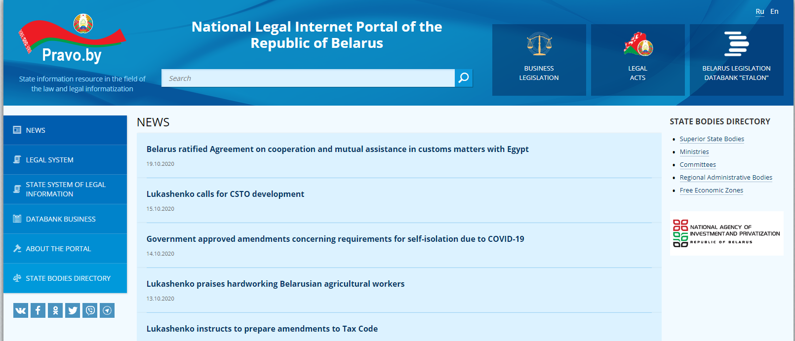
National legal Internet portal of the Republic of Belarus

Slide 8
Belarus Legislation Databank
The Belarus Legislation Databank "ETALON" is a full-text search system containing legal acts issued by the President, Parliament, Government, National Bank, ministries, Constitutional Court, Supreme Court, Supreme Economic Court, and international treaties.

Slide 9
List of Legal Acts of the Republic of Belarus
Constitution of the Republic of Belarus
Codes of the Republic of Belarus
Laws of the Republic of Belarus
Decrees of the President of the Republic of Belarus
Edicts of the President of the Republic of Belarus
Resolutions of the Council of Ministers of the Republic of Belarus
Legal Acts of the Republican Bodies of State Administration
Legal Acts of Local Administration Bodies
Directives of the President of the Republic of Belarus

Slide 10
Business laws and legislations
Business laws and legislations are the laws governing companies. They include those regulations associated with intellectual property, employment, insurance, business entity formation, and other matters. Because it can be difficult to keep track of all the business laws that apply to your industry, you may want to retain the services of an experienced business attorney.
The regulations you must follow depend on the type of business you have and how large it is, as well as where you do business. If you cross county or state lines in the course of doing business, you could be subject to additional laws and regulations.

Slide 11
General range of legislation applies to businesses
A wide range of legislation applies to businesses, including but not limited to rules associated with:
What activities are illegal or constitute misconduct
Financial and operational codes
Special licenses and permits
Liquor licenses
State and local building codes
Federal taxes
Bankruptcy
Environmental laws
Employment
Safety and health standards for the workplace
To attract new businesses, states provide technical assistance to help new companies comply with the pertinent laws.

Slide 12
Regulatory Laws
These types of laws, issued by federal, state, and local governments, govern how businesses must operate. Certain industries, particularly those affected by environmental laws and building codes, must comply with even more regulations. Major federal environmental regulations are typically enforced by the Environmental Protection Agency (EPA) and include:
The Clean Air Act, which regulates air emissions
The Comprehensive Environmental Response, Compensation, and Liability Act (CERCLA) governs the mitigation of hazardous waste sites.
The Endangered Species Act protects both plants and animals that are endangered or at risk of endangerment.
The Occupational Safety and Health Act (OSHA) addresses workplace safety and environmental issues.
Employment Laws

Slide 13
Labor laws
Labor laws govern the rights and responsibilities of employees in the workplace. These include:
Wage garnishment rules
Minimum wage regulations
Worker protection rules
Child labor laws
Some sections of OSHA
Employee insurance and benefit programs
Immigration and employment
The Fair Labor Standards Act, which governs overtime, child labor, minimum wage, and record-keeping.
Federal Equal Employment Opportunity laws prevent employers from discriminating based on religion, race, sex, or national origin, require equal pay for women and men, and provides protection for people with disabilities.
The Family and Medical Leave Act, which provides time off if an employee or immediate family member is dealing with a medical condition
Workers' compensation insurance
At-will work doctrines

Slide 14
Miscellaneous Business Laws
Other laws that may impact the operation of your business include those regarding:
Taxation
Reporting finances to investors and to the government
Truth in advertising and marketing
Telemarketing sales
Sales tax collection
International sales laws
Data security
Healthcare privacy
Intellectual property
Bankruptcy

Slide 15
Belorussian Business Legislation strucured by pravo.by
Constitution of the Republic of Belarus
General Issues of Economic Activities
Registration of Economic Entities
Taxation
Financial Issues and Currency Regulation
Privatization
External Economic Activity
Investment Activity
Customs Regulation
Free Economic Zones
Settlement of Economic Disputes

Slide 16
The main legal codes of the Republic of Belarus concerning business
legal code - a code of laws adopted by a state or nation; that means "a code of laws"
Civil Code of the Republic of Belarus.
Tax Code of the Republic of Belarus.
Banking Code of the Republic of Belarus.
Economic Procedural Code of the Republic of Belarus.

Slide 17
References
https://www.upcounsel.com/business-laws-and-legislations
Pravo.by

