Slide 1
business and organizations
Modul 1.4

Slide 2
Definition of entrepreneurship
the activity of setting up a business or businesses, taking on financial risks in the hope of profit.
Entrepreneurship is the creation or extraction of value. With this definition, entrepreneurship is viewed as change, which may include other values than simply economic ones.
More narrow definitions have described entrepreneurship as the process of designing, launching and running a new business, which is often initially a small business, or as the "capacity and willingness to develop, organize and manage a business venture along with any of its risks to make a profit." The people who create these businesses are often referred to as entrepreneurs. While definitions of entrepreneurship typically focus on the launching and running of businesses, due to the high risks involved in launching a start-up, a significant proportion of start-up businesses have to close due to "lack of funding, bad business decisions, government policies, an economic crisis, lack of market demand, or a combination of all of these."
A somewhat broader definition of the term is sometimes used, especially in the field of economics. In this usage, an entrepreneur is an entity which has the ability to find and act upon opportunities to translate inventions or technologies into products and services: "The entrepreneur is able to recognize the commercial potential of the invention and organize the capital, talent, and other resources that turn an invention into a commercially viable innovation."[8] In this sense, the term "entrepreneurship" also captures innovative activities on the part of established firms, in addition to similar activities on the part of new businesses. Yet, the definition is still narrow in the sense that it still focuses on the creation of economic (commercial) value.

Slide 3
Elements of entrepreneurship
Entrepreneurship is an act of being an entrepreneur, or "the owner or manager of a business enterprise who, by risk and initiative, attempts to make profits". Entrepreneurs act as managers and oversee the launch and growth of an enterprise. Entrepreneurship is the process by which either an individual or a team identifies a business opportunity and acquires and deploys the necessary resources required for its exploitation. Early-19th-century French economist Jean-Baptiste Say provided a broad definition of entrepreneurship, saying that it "shifts economic resources out of an area of lower and into an area of higher productivity and greater yield". Entrepreneurs create something new, something different—they change or transmute values. Regardless of the firm size, big or small, they can partake in entrepreneurship opportunities. The opportunity to become an entrepreneur requires four criteria. First, there must be opportunities or situations to recombine resources to generate profit. Second, entrepreneurship requires differences between people, such as preferential access to certain individuals or the ability to recognize information about opportunities. Third, taking on risk is a necessity. Fourth, the entrepreneurial process requires the organization of people and resources.
The entrepreneur is a factor in and the study of entrepreneurship reaches back to the work of Richard Cantillon and Adam Smith in the late 17th and early 18th centuries. However, entrepreneurship was largely ignored theoretically until the late 19th and early 20th centuries and empirically until a profound resurgence in business and economics since the late 1970s. In the 20th century, the understanding of entrepreneurship owes much to the work of economist Joseph Schumpeter in the 1930s and other Austrian economists such as Carl Menger, Ludwig von Mises and Friedrich von Hayek. According to Schumpeter, an entrepreneur is a person who is willing and able to convert a new idea or invention into a successful innovation. Entrepreneurship employs what Schumpeter called "the gale of creative destruction" to replace in whole or in part inferior innovations across markets and industries, simultaneously creating new products including new business models. In this way, creative destruction is largely responsible for the dynamism of industries and long-run economic growth. The supposition that entrepreneurship leads to economic growth is an interpretation of the residual in endogenous growth theory and as such is hotly debated in academic economics. An alternative description posited by Israel Kirzner suggests that the majority of innovations may be much more incremental improvements such as the replacement of paper with plastic in the making of drinking straws.

Slide 4
Elements of entrepreneurship
The exploitation of entrepreneurial opportunities may include:
Developing a business plan
Hiring the human resources
Acquiring financial and material resources
Providing leadership
Being responsible for both the venture's success or failure
Risk aversion

Slide 5
Elements of entrepreneurship
Economist Joseph Schumpeter (1883–1950) saw the role of the entrepreneur in the economy as "creative destruction" – launching innovations that simultaneously destroy old industries while ushering in new industries and approaches. For Schumpeter, the changes and "dynamic disequilibrium brought on by the innovating entrepreneur [were] the norm of a healthy economy". While entrepreneurship is often associated with new, small, for-profit start-ups, entrepreneurial behavior can be seen in small-, medium- and large-sized firms, new and established firms and in for-profit and not-for-profit organizations, including voluntary-sector groups, charitable organizations and government.
Entrepreneurship may operate within an entrepreneurship ecosystem which often includes:
Government programs and services that promote entrepreneurship and support entrepreneurs and start-ups
Non-governmental organizations such as small-business associations and organizations that offer advice and mentoring to entrepreneurs (e.g. through entrepreneurship centers or websites)
Small-business advocacy organizations that lobby governments for increased support for entrepreneurship programs and more small business-friendly laws and regulations
Entrepreneurship resources and facilities (e.g. business incubators and seed accelerators)
Entrepreneurship education and training programs offered by schools, colleges and universities
Financing (e.g. bank loans, venture capital financing, angel investing and government and private foundation grants).
In the 2000s, usage of the term "entrepreneurship" expanded to include how and why some individuals (or teams) identify opportunities, evaluate them as viable, and then decide to exploit them. The term has also been used to discuss how people might use these opportunities to develop new products or services, launch new firms or industries, and create wealth. The entrepreneurial process is uncertain because opportunities can only be identified after they have been exploited.
Entrepreneurs exhibit positive biases towards finding new possibilities and seeing unmet market needs, and a tendency towards risk-taking that makes them more likely to exploit business opportunities.

Slide 6
Definition of business
What Is a Business?
A business is defined as an organization or enterprising entity engaged in commercial, industrial, or professional activities. Businesses can be for-profit entities or they can be non-profit organizations that operate to fulfill a charitable mission or further a social cause.
The term "business" also refers to the organized efforts and activities of individuals to produce and sell goods and services for profit. Businesses range in scale from a sole proprietorship to an international corporation. Several lines of theory are engaged with understanding business administration including organizational behavior, organization theory, and strategic management.

Slide 7
Understanding a Business
Generally, a business begins with a business concept (the idea) and a name. Depending on the nature of the business, extensive market research may be necessary to determine whether turning the idea into a business is feasible and if the business can deliver value to consumers. The business name can be one of the most valuable assets of a firm; careful consideration should thus be given when choosing it. Businesses operating under fictitious names must be registered with the state.
Businesses most often form after the development of a business plan, which is a formal document detailing a business's goals and objectives, and its strategies of how it will achieve the goals and objectives. Business plans are almost essential when borrowing capital to begin operations.
It is also important to determine the legal structure of the business. Depending on the type of business, it may need to secure permits, adhere to registration requirements, and obtain licenses to legally operate. In many countries, corporations are considered to be juridical persons, meaning that the business can own property, take on debt, and be sued in court.

Slide 8
UNDERSTANDING BUSINESS DEFINITION
It is a strategic process by which firms and businesses select positions in their industry.
The more unique the positions selected and occupied, the greater is likely to be the competitive advantage enjoyed by the firm.
Management is a creative process that can impact the prospects for success of firms and businesses.
One of the outcomes of successful business definition is that a firm will focus on the things to do and likewise avoid the things that should not be done.

Slide 9
UNDERSTANDING BUSINESS DEFINITION
Businesses are started by entrepreneurs who see a need, recognize the opportunity, and go into business to meet that need
Business and people need each other – there are many stakeholders – we depend on businesses for products and services, but also for employment
Buy inputs – raw materials, labour, machinery and equipment, and land
Produce outputs – goods and services
Focus on efficient use of resources
Generate profit/surplus

Slide 10
Who are the business stakeholders
Anyone who has an interest in the success of a business
Customers
Managers
Employees
Owners
Local Community/ Environment
Suppliers
Government
Creditors

Slide 11
Business Sizes
Business sizes range from small owner-operated companies, such as family restaurants, to multinational conglomerates such as General Electric. Larger businesses may issue corporate stock to finance operations. In this case, the company is publicly traded and has reporting and operating restrictions. Alternatively, smaller businesses may operate more independently of regulators.

Slide 12
Business Structures
Many businesses organize themselves around some sort of hierarchy or bureaucracy, where positions in a company have established roles and responsibilities. The most common structures include sole proprietorships, partnerships, corporations, and limited liability companies (LLC), with sole proprietorships being the most prevalent.
A sole proprietorship, as its name suggests, is a business owned and operated by a single natural person. There is no legal separation between the business and the owner; the tax and legal liabilities of the business are thus that of the owner.
A partnership is a business relationship between two or more people who join to conduct business. Each partner contributes resources and money to the business and shares in the profits and losses of the business. The shared profits and losses are recorded on each partner's tax return.
A corporation is a business in which a group of people acts together as a single entity; most commonly, owners of a corporation are shareholders who exchange consideration for the corporation's common stock. Incorporating a business releases owners of the financial liability of business obligations; however, a corporation has unfavorable taxation rules for the owners of the business.
For this reason, a relatively new (first available in Wyoming in 1977 and other states in the 1990s) business structure, a limited liability company (LLC), is available; this structure combines the pass-through taxation benefits of a partnership with the limited-liability benefits of a corporation.

Slide 13
Relationship between small business and entrepreneurship
The term "entrepreneur" is often conflated with the term "small business" or used interchangeably with this term. While most entrepreneurial ventures start out as a small business, not all small businesses are entrepreneurial in the strict sense of the term. Many small businesses are sole proprietor operations consisting solely of the owner—or they have a small number of employees—and many of these small businesses offer an existing product, process or service and they do not aim at growth. In contrast, entrepreneurial ventures offer an innovative product, process or service and the entrepreneur typically aims to scale up the company by adding employees, seeking international sales and so on, a process which is financed by venture capital and angel investments. In this way, the term "entrepreneur" may be more closely associated with the term "startup". Successful entrepreneurs have the ability to lead a business in a positive direction by proper planning, to adapt to changing environments and understand their own strengths and weakness.

Slide 14
Who is a Manager?
A manager, on the other hand, is not an owner of an enterprise. Instead, he is the one that is responsible for the management and administration of a group of people or a department of the organization. His day to day job is to manage his employees and ensure the organization runs smoothly.
A manager must possess some of the same qualities as an entrepreneur, like leadership, accountability, decisiveness etc. He must also be a good manager of people. So qualities such as warmth and empathy are also very important in a manager.

Slide 15
Difference between Entrepreneur and Manager
The key difference between an entrepreneur and a manager is their standing in the company. An entrepreneur is a visionary that converts an idea into a business. He is the owner of the business, so he bears all the financial and other risks. A manager, on the other hand, is an employee, he works for a salary. So he does not have to bear any risks.
The focus of an entrepreneur lies in starting the business and later expanding the business. A manager will focus on the daily smooth functioning of the business.
For an entrepreneur the key motivation is achievements. But for the managers, the motivation comes from the power that comes with their position.
The reward for all the efforts of an entrepreneur is the profit he earns from the enterprise. The manager is an employee, so his remuneration is the salary he draws from the company.
The entrepreneur can be informal and casual in his role. However, a manager’s approach to every problem is very formal.
The entrepreneur by nature is a risk taker. His has to take calculated risks to drive the company further. A manager, on the other hand, is risk-averse. His job is to maintain the status quo of the company. So he cannot afford risks.

Slide 16
Entrepreneurship development and trends of nowadays
In the past, entrepreneurs were the few people who took risks to start their own business. Sometimes they were successful; sometimes they weren't. In the 21st century, the definition of an entrepreneur has expanded to include people who create their own Internet-based businesses, home-based companies, and even freelance workers, who are predicted to compose more than 40 percent of the workforce by 2020, according to a report by Intuit and Emergent Research. Still, the basic idea of entrepreneurship hasn't changed dramatically since the Industrial Age dawned in the 1800s. A person has an idea for a product or service that will fill a specific niche in a market. They gather the financing necessary to produce the product or offer the service, and depending on whether it's an e-company or one that requires a physical location, the company launches as soon as it has all resources and systems in place. While the rate of failure of new businesses is traditionally high (more than 50 percent fail after five years, according to the U.S. Census Bureau), with the advent of e-companies, which often require much less upfront capital, a growing number of people are willing to take the risk. Some entrepreneurs become business owners because they're looking to escape corporate life, and their goal is simply to earn enough money to live comfortably and retire. Other entrepreneurs seek to grow their companies over the years and become wealthy.
The most important ingredient to business owners is independence: They have the freedom and ability to make their own decisions, set their own working hours, and not have to answer to anyone else. Entrepreneurships first started in the United States as colonies became cities and settlers needed to purchase goods to keep them clothed and fed. Retail store owners were the first entrepreneurs and were the most prevalent for many years. In the Industrial Age of the 1800s, entrepreneurs launched manufacturing facilities that employed local workers.

Slide 17
Entrepreneurship development and trends of nowadays
It was in the 1900s that a new type of entrepreneur, the consultant, first emerged, hired by manufacturers to survey their methods and make recommendations for improving efficiency. As the economy in the late 20th century and early 21st century has transitioned from one based on manufacturing to one of service-based companies, manufacturing companies downsized, laying off thousands of employees, who then had to either begin new careers or start their own businesses, as many did. The dawn of the Internet age has also resulted in the onslaught of e-business owners, who are able to start home-based businesses, making goods and selling them online for minimal start-up costs. In addition, many companies in the 21st century are recognizing the financial benefits of hiring more independent contractors or freelance employees. These workers don't receive costly health insurance benefits, and often start work with the skills necessary and so need minimal training. They also use their own home offices, and companies don't have to invest in equipment or lose valuable office space. In the 2010s, entrepreneurships consist of a mixture of traditional businesses, e-businesses, home-based businesses, consultants, and freelance workers.

Slide 18
concept of organization
Many definitions are possible, but most of these include the characteristics of people, goals and structures. People are social beings and, by and large, tend to cooperate in interdependent relationships to achieve common aims. Originally people formed simple family and tribal structures. Today we have evolved into a complex society characterised by large, formal and increasingly global structures.
An organization is an entity – such as a company, an institution, or an association – comprising one or more people and having a particular purpose.
The word is derived from the Greek word organon, which means tool or instrument, musical instrument, and organ.,

Slide 19
Types of organization
There are a variety of legal types of organizations, including corporations, governments, non-governmental organizations, political organizations, international organizations, armed forces, charities, not-for-profit corporations, partnerships, cooperatives, and educational institutions etc. A hybrid organization is a body that operates in both the public sector and the private sector simultaneously, fulfilling public duties and developing commercial market activities. A voluntary association is an organization consisting of volunteers. Such organizations may be able to operate without legal formalities, depending on jurisdiction, including informal clubs or coordinating bodies with a goal in mind which they may express in the form of an manifesto, mision statement, or in an informal manner reflected in what they do because remember every action done by an organization both legal and illegal reflects a goal in mind. Organizations may also operate secretly or illegally in the case of secret societies, criminal organizations and resistance movements. And in some cases may have obstacles from other organizations (ex: MLK's organization) but what makes an organization an organization is not the paperwork that makes it official but to be an organization there must be four things:
A goal in mind
A leader or committee making the decision
action involved
communication and members.
But what makes an organization recognized by the government is either filling out Incorporation (business) or recognition in the form of either societal pressure (ex: Advocacy group), causing concerns (ex: Resistance movement) or being considered the spokesperson of a group of people subject to negotiation (ex: the Polisario Front being recognized as the sole representative of the Sahawri people and forming a partially recognized state.)

Slide 20
Article 132. Enterprise (Civil code)
1. An enterprise as an object of rights shall be deemed to be a property complex used to effectuate entrepreneurial activity.
Within an enterprise as a property complex shall be all types of property intended for its activity, including land plots, permanent constructions (buildings, structures), unfinished permanent constructions prepared for preservation, isolated premises, car parking lots, equipment, tools, raw material, products, rights of demand, debts, and also rights to designation which individualize the enterprise, its products, works and services (firm name, trademarks, service marks), and other exclusive rights, unless otherwise provided by the legislation or contract.
2. An enterprise as a whole or part thereof may be the object of a purchase-sale, pledge, lease, and other transactions connected with the establishment, change, and termination of rights to a thing.

Slide 21
Intrapreneurship
Intrapreneurship is actually a clever combination of two words. It is the combination of ‘intra’ meaning within the company or corporate and ‘preneur’. Essentially an intrapreneur is a person who works within the company but has taken on an individual project by himself. So an intrapreneur is responsible for turning an idea or vision into a successful finished product.
So an intrapreneurship is basically a combination of entrepreneurship and management skills. The key difference is that in an intrapreneurship the intrapreneur is not the lone risk taker, but he is an employee of the firm.
But he still requires to have all the skill and knowledge of an entrepreneur, even some assertive risk-taking.
In recent years everyone with the skills and ability of an entrepreneur chooses to start their own business. This left a dearth of talent in management.
So with the evolution of intrapreneurship, the manager was made the head of the business unit and asked to run it like an entrepreneur. This helped in bridging the gap.

Slide 22
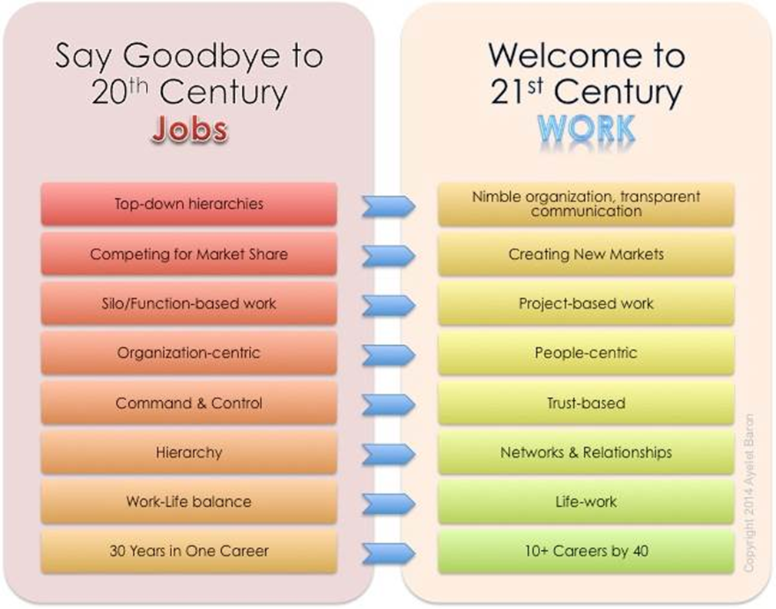

Slide 23
E-business definition and essence
E-business is short for “electronic business.” As an overarching term, it refers to any method of utilizing digital information and communication technologies to support or streamline business processes – from preparation to implementation. However, it can also refer more specifically to the business processes of online stores or other internet-based companies.
These two slightly different interpretations of the term have led to a problem: a widely accepted, precise definition of e-business does not yet exist. As a result, it’s interpreted broadly, and is commonly misunderstood – mainly in relation to e-commerce. Although there is some overlap, e-commerce refers to trading products and services online, and so is strictly only speaking of one aspect of e-business.

Slide 24
E-business definition and essence
Online Business or e-business is any kind of business or commercial transaction that includes sharing information across the internet. Commerce constitutes the exchange of products and services between businesses, groups and individuals and can be seen as one of the essential activities of any business. Electronic commerce focuses on the use of ICT to enable the external activities and relationships of the business with individuals, groups and other businesses, while e-business refers to business with help of the internet. Electronic business differ from electronic commerce as it does not only deal with online transactions of selling and buying of a product and/or service but also enables to conduct business processes (inbound/outbound logistics, manufacturing & operations, marketing and sales, customer service) within the value chain through internal or external networks. The term "e-business" was coined by IBM's marketing and Internet team in 1996.

Slide 25
E-business definition and essence
Electronic business can take place between a very large number of market participants; it can be between business and consumer, private individuals, public administrations or any other organizations such as NGOs. These various market participants can be divided into three main groups: 1) Business (B) 2) Consumer (C) 3) Administration (A) All of them can be either buyer or service provider within the market. There are nine possible combinations for electronic business relationships. B2C and B2B belong to e-commerce, while A2B and A2A belong to e-government sector that is also a part of electronic business.

Slide 26
Features of an Intrapreneurship
Promotes innovation or creativity in the intrapreneur. It also forces him to take more risks and responsibilities. This is an important step in developing future talents and leaders.
These intrapreneurship projects do not require a capital contribution from the intrapreneur. The organizations fund the projects themselves. And usually, there is a profit sharing agreement with the manager.
It also helps cultivate entrepreneurial skills and culture in a corporate setting. This merging of cultures is beneficial to both,
In an intrapreneurial project, the chances of failure are fairly lesser than a start-up. This is because the financing of the project is by large organizations.
Another feature is that it enriches life on the intrapreneur. He receives training to hone his managerial skills and techniques and also enhances his knowledge about business.
Intrapreneurship results in wealth creation. The organization earns a healthy return on their investment, and the intrapreneur also earns wealth (part of the profits)
Also, it helps in portfolio diversification for the organization.

Slide 27
Intrapreneur vs Entrepreneur
Intrapreneur
He is an employee of the organisation that is put completely in charge of a business division or a particular product
Intrapreneur uses the capital and the resources of his employer, i.e. the organization where he works
While an intrapreneur is given responsibility and authority to run his division, he is not completely independent.
An intrapreneur begins his work in an already existing organization. He only sets up his new division.
Entrepreneur
However, an entrepreneur has to come up with the capital himself and use his own resources.
An entrepreneur has to set up his entire business from the ground up.
An entrepreneur is completely independent of all his business decisions.
He is an independent individual who owns and runs his business single handly
An entrepreneur has to set up his entire business from the ground up.

