Slide 1
MODULE 3
3.4 organization of financial planning in organizations.
Business-plan

Slide 2
Financial planning
Financial planning is the process of scientifically substantiating the movement of financial resources and related financial relationships.
The purpose of drawing up financial plans is to develop and substantiate financial targets and an action program aimed at forming and maintaining an effective financial mechanism of the organization.

Slide 3
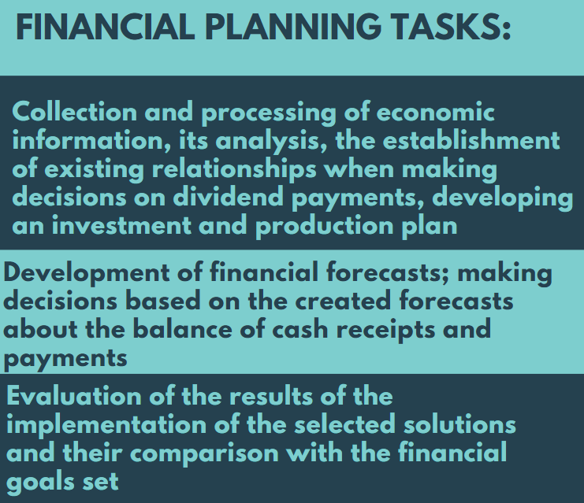
Financial planning

Slide 4
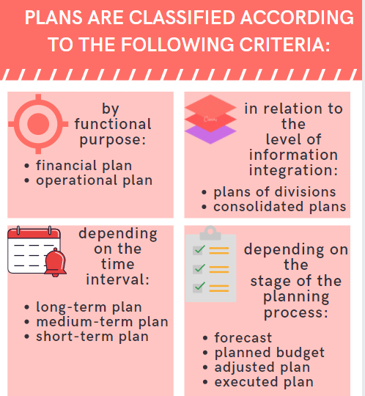
Financial
planning

Slide 5
Financial planning
The main types of plans are operational and financial plans.
Operational plans are summary plans and plans brought to the attention of structural units, reflecting certain aspects of financial and economic activities (production volumes, sales, purchases, costs in general and by elements).
Operational plans usually include:
a sales plan,
a procurement plan,
a production plan,
an inventory plan,
material and payroll plans,
general and general production costs,
an implementation plan, and
an investment plan.

Slide 6
Financial planning
Financial plans are general plans that accumulate information from operational plans and provide interconnection of data on financial flows and results at the level of an organization (department).
The examples of financial plans :
cash flow plan,
income and expense plan,
balance sheet of assets and liabilities,
credit plan,
plans of cash receipts and payments.

Slide 7
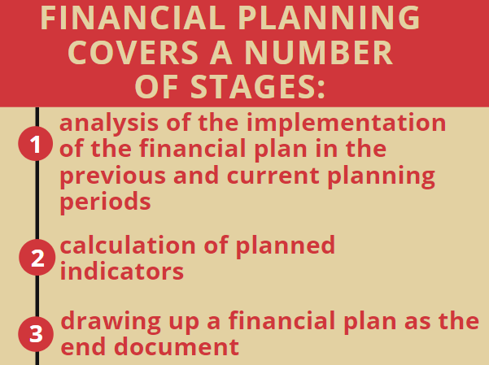
Financial planning

Slide 8
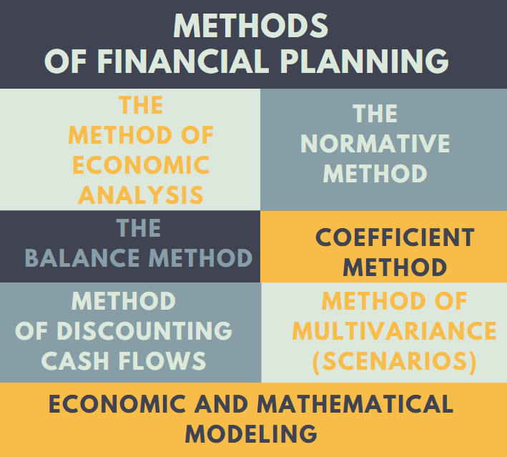
Financial planning methods

Slide 9
Financial planning methods
Economic analysis is based on a comparison of reporting and planning data
in order to identify deviations, analyze them and organize corrective management measures to eliminate negative deviations. Moreover, economic
analysis makes it possible to understand the main trends and patterns and identify the internal reserves of the enterprise.
The use of this method in control is possible when managerial accounting at the organization is established, which, in contrast to accounting
(tax) accounting allows manager to get operational information.
Economic analysis involves the processing of a large amount of primary data, for this reason, companies use modern software packages designed for a comprehensive assessment of the financial condition of an organization.

Slide 10
Financial planning methods
The normative method of financial planning is considered in two aspects:
external and internal.
The external environment sets certain norms and standards for business entities. So, there are legally approved standards (tax rates, depreciation rates, rates of deductions to the reserve fund, etc.).
Organisations are also developing internal regulations. To ensure uninterrupted production and sale of products, norms and standards are calculated
for raw materials and materials, work in progress, finished products.
Establishment of requirements for working capital using the regulatory method, on the one hand, allows prevent downtime in production, and on the other hand, helps to maintain minimum balances in warehouses, which frees up part of the company's financial resources.

Slide 11
Financial planning methods
The balance method is based on determining the balance between needs of an organization on the one hand, and available and attracted financial resources on the other.
The organization draws up a balance sheet that shows the main directions and volumes of resource use, on the one hand, and the volume and sources of the necessary resources - from another.
The balance sheet method is used in business planning in the preparation of the forecast balance sheet, in addition, the basics of the balance sheet method are applied in the preparation plan of receipts and payments, plan of income and expenses, payment calendar.

Slide 12
Financial planning methods
The coefficient method is used to adjust the baseline values. So, having calculated the need for working capital (for example, using the standard method), the organization can correct it using the derived coefficient, and not calculate it all over again. It follows from this that this method is applicable only if there is
real calculation of the need for working capital.

Slide 13
Financial planning methods
The method of discounting cash flows is applied when assessing efficiency
investment projects.
The method is based on bringing future cash flows to the present time by discounting them. Discounting cash flows is based on the use of the discount rate, the value of which is built on subjective assessment (project risk assessment): the riskier the project, the higher discount rate. The weighted average cost of capital, the interest rate on the loan, etc. can be used as the discount rate.

Slide 14
Financial planning methods
The method of multivariance (scenarios) consists in choosing a benchmark, calculating its probable value (which corresponds to the most probable scenario)
and assessing its deviations from the mean (i.e. developing pessimistic and optimistic scenarios).
The weighted average cost of capital (WACC), net present value (NPV), return on equity (ROE), return on assets (ROA), etc. can be used as a benchmark.
analysis of deviations, the sensitivity indicator is calculated (the elasticity of the indicator change is determined). This method is also called the planning decision optimization method.

Slide 15
Financial planning methods
The essence of economic and mathematical modeling is to build a model,
which describes the relationship between indicators and factors, in other words, the economic and mathematical model that describes the economic process.
The model is built according to functional or correlation connection. The main difficulty faced when calculating the model, this is the study period. Too short period does not show the desired patterns, at the same time, economic patterns are unstable, and over a long period they are distorted. Since the process of building a model very time consuming, it is also done with application packages.
There are also alternative models of financial planning:
a linear programming model,
an econometric model,
a system of algebraic equations, etc.

Slide 16
Strategic financial planning
Strategic financial planning determines the most important indicators, proportions and rates of expanded reproduction, it is the main form of achieving the goals of the company.
Strategic planning includes the development of the financial strategy of the organisation and the forecasting of financial activities. The development of a financial strategy is a special area of ​​financial planning, since, as an integral part of the overall strategy for the economic development of the company, it must be consistent with the goals and directions formulated by the general strategy. The formation of the strategic goals of the financial activities of the company is the next stage of strategic planning. The system of the company's strategic goals should be formed clearly and concisely, reflecting each of the goals in specific indicators - standards.

Slide 17
The business-plan section "Forecasting financial and economic activities"
The business-plan section "Forecasting financial and economic activities" contains financial indicators that support all the information in other sections, i.e. in essence, the rationale for the entire business plan is provided here. Most investors require that part of the capital be formed from their own funds. In this regard, the section indicates what the organisation has.

Slide 18
The business-plan section "Forecasting financial and economic activities"
The section includes the following tables:
Sales profit calculation table. It reflects the annually generated profit or loss. The distribution of profits shows the amount of profit that is used to pay dividends, wages, replenishment of working capital, support the social sphere and other current payments of a mandatory nature.
A table for calculating taxes, fees and payments, which takes into account all subsequent changes in tax legislation. With preferential taxation, the grounds for its application are given.
Table for calculating the cash flow of the organisation.
The table of the project balance sheet of the organisation.

Slide 19
The business-plan section "Indicators of project’s efficiency"
When preparing the section of business plan “Indicators of project’s efficiency” a comprehensive system of indicators is used, including the main financial indicators of the organisation, as well as indicators characterizing the financial condition and solvency of the enterprise:
volume of production;
cost of goods sold;
profit from product sales;
net profit;

Slide 20
The business-plan section "Indicators of project’s efficiency"
the amount of overdue accounts payable and receivable at the end of the corresponding planning period, its share in the total amount, respectively, of accounts payable or receivable;
stocks of finished products at the end of the planning period to the average monthly volume of industrial production;
the level of profitability of products sold;
the level of profitability of sales;
current liquidity ratio;
coefficient of provision with own circulating assets;
the ratio of financial liabilities with assets.

Slide 21
The business-plan section "Indicators of project’s efficiency"
The essence of the section of business plan “Investment plan and sources of financing” is development a complete strategy for achieving the set goals and objectives, as well as the expected results of investments.
In practice, this document is also called an investment (strategic) project, a strategic investment plan or a business plan. These concepts practically coincide, since in all cases we are talking about planning investments in the enterprise, the expected results of the investment and the specific timing of their achievement. However, there are some differences between an investment and a business plan: a business plan is a specific study of a newly created or ready-made business, a description of investments, a full estimate of the estimated costs, participants in the process and a description of the expected time frame for achieving results. The investment plan largely coincides with it in structure, but it is a long-term investment planning both in one and in several types of business at once.

Slide 22
The business-plan section "Indicators of project’s efficiency"
Investment analysis is the most important final part of the business plan. In the investment analysis, methods for evaluating the effectiveness of projects, developed for calculating the main indicators of the economic efficiency of investment, are applied.
There are a lot of indicators of project’s efficiency. The most widely used are:
payback period - РВ, months;
net discounted (present) income – NPV;
profitability index - PI;
internal rate of return - IRR, %

Slide 23
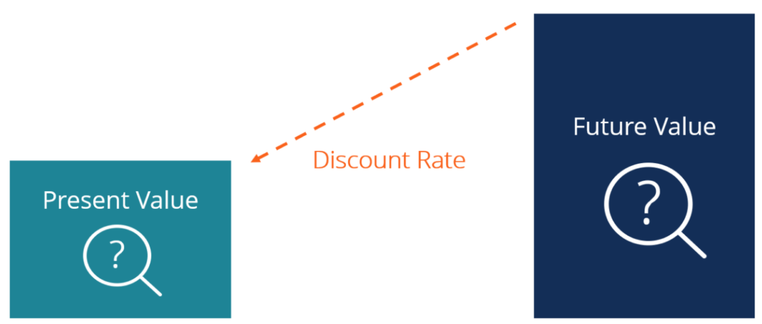
The business-plan section "Indicators of project’s efficiency"
To calculate all these indicators economists use ‘discounting’ and ‘discounting rate’.
Discounting is the process of determining the present value of a payment or a stream of payments that is to be received in the future. Given the time value of money, a dollar is worth more today than it would be worth tomorrow. Discounting is the primary factor used in pricing a stream of tomorrow's cash flows.

Slide 24
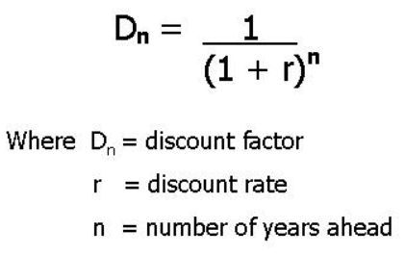
The business-plan section "Indicators of project’s efficiency"
A discount rate r is the rate of return used to discount future cash flows back to their present value. If you have estimated r, you can calculate discount factor D:

Slide 25
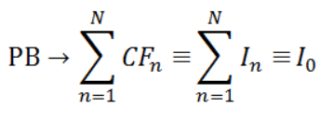
The business-plan section "Indicators of project’s efficiency"
The payback period of the project is time, when the amount of revenues generated by the project will cover the investment amount:
Where:
CF_{n} forecast – net cash flow (net receipts) in the n period,
I_{n} – initial investment in the n period.

Slide 26
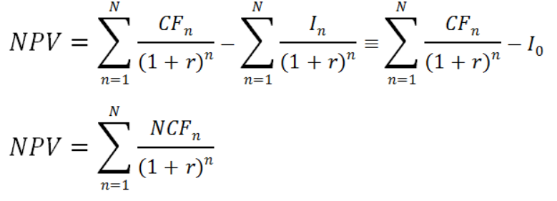
The business-plan section "Indicators of project’s efficiency"
Net present value is the amount of income that represents the estimate of the present value of future income. The net present value is the present value of future income, adjusted for the discount rate, less the present value of the initial (total) investment. Calculated by the formula:
Where:
CF_{n} – net discounted cash flow in the n period,
I_{n} – investment in the n period (or total investment),
r – discount rate,
NCF – net cash flow (NCF), is used in the alternative NPV calculation formula.

Slide 27
The business-plan section "Indicators of project’s efficiency"
The value of NPV must be positive :
I. NPV > 0 – shows how much the value of the invested capital will increase;
II. NPV = 0 – the project will not bring any profit or loss;
III. NPV < 0 – shows losses as a result of the project.

Slide 28
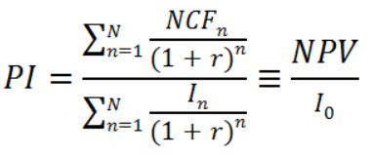
The business-plan section "Indicators of project’s efficiency"
Profitability index is the ratio of the adjusted income to the amount of invested capital.
Profitability index is calculated using the following formula:
Where:
CF_{n} – net discounted cash flow in the n period,
I_{n} – initial investment in the n period (or total investment),
r – discount rate,
NPV net discounted (present) income.
At values PI > 1 it is considered that this investment is effective.

Slide 29
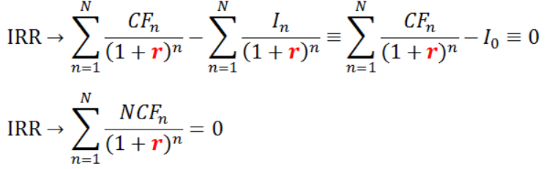
The business-plan section "Indicators of project’s efficiency"
The discount rate at which the total present value of income from investments is equal to the value of these investments. IRR is calculated as the discount rate at which NPV = 0.
IRR defines the maximum cost of the attracted capital, at which the investments in the project remain profitable:
when NPV > 0, in this case IRR > r;
when NPV < 0, in this case IRR is not defined;
when NPV = 0, in this case IRR = r.

