Slide 1
Function point method overview

Slide 2
What is Function Point Analysis?
In simple words, FPA is a technique used to measure software requirements based on the different functions that the requirement can be split into. Each function is assigned with some points based on the FPA rules and then these points are summarized using the FPA formula. The final figure shows the total man-hours required to achieve the complete requirement.

Slide 3
Function Point Analysis (FPA) is a sizing measure of clear business significance. First made public by Allan Albrecht of IBM in 1979, the FPA technique quantifies the functions contained within software in terms that are meaningful to the software users. The measure relates directly to the business requirements that the software is intended to address. It can therefore be readily applied across a wide range of development environments and throughout the life of a development project, from early requirements definition to full operational use. Other business measures, such as the productivity of the development process and the cost per unit to support the software, can also be readily derived.The function point measure itself is derived in a number of stages. Using a standardized set of basic criteria, each of the business functions is a numeric index according to its type and complexity. These indices are totaled to give an initial measure of size which is then normalized by incorporating a number of factors relating to the software as a whole. The end result is a single number called the Function Point index which measures the size and complexity of the software product.

Slide 4
Components of Function Point Analysis
Based on the interaction of the system components internally and with external users, applications, etc they are categorized into five types:
External Inputs (EI): This is the process of capturing inputs from users like control information or business information and store it as internal/external logic database files.
External Outputs (EO): This is the process of sending out data to external users or systems. The data might be directly grabbed from database files or might undergo some system-level processing.
Inquiries (EQ): This process includes both input and output components. The data is then processed to extract relevant information from internal/external database files.
Internal Logic File (ILF): This is the set of data present within the system. The majority of the data will be interrelated and are captured via the inputs received from the external sources.
External Logic File (ELF): This is the set of data from external resources or external applications. The majority of the data from the external resource is used by the system for reference purposes.

Slide 5
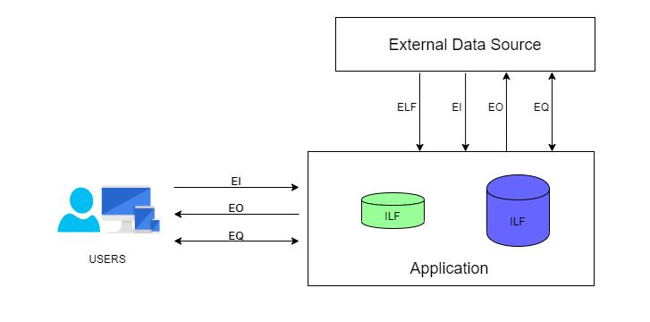

Slide 6
Below are some abbreviations which need to be understood to know the logic in-depth:
Data Element Type (DET): This can be defined as a single, unique, non-repetitive data field.
Record Element Type (RET): This can be defined as a group of DETs. In a more generic way, we can call this a table of data fields.
File Type Referenced (FTR): This can be defined as a file type referenced by a transaction (Input/Output/Inquiry). This can be either an Internal logic file or an external interface file.

Slide 7
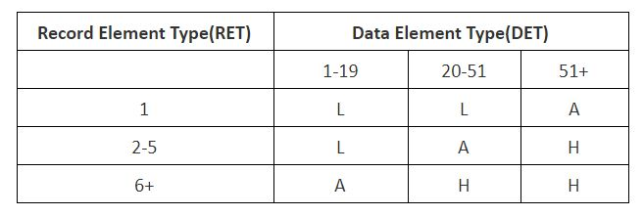
Based on the number of DETs and RETs, all the five components of FPA are classified into High, Average and Low complexity based on the below table.
For Internal Logical Files

Slide 8
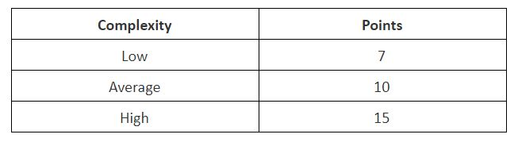
And based on the complexity, the FPA points are calculated

Slide 9
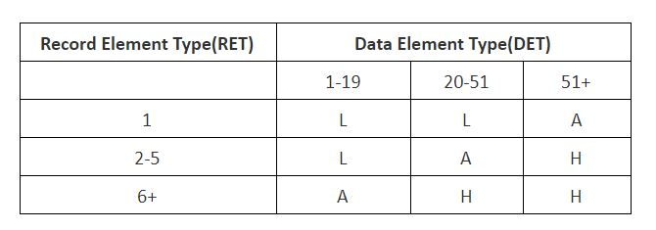
For External Logical Files

Slide 10
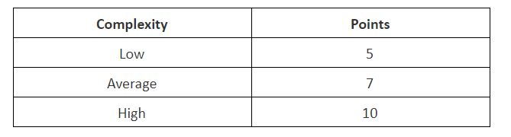
And based on the complexity, the FPA points are calculated

Slide 11
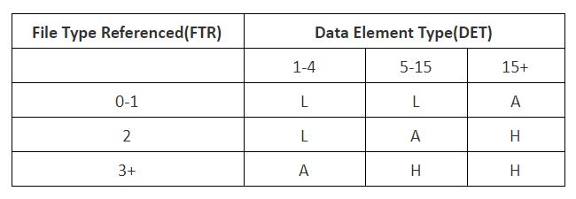
For External Input Transactions
As the External input is a Transactional type, the complexity is judged based on FTR instead of RET.

Slide 12
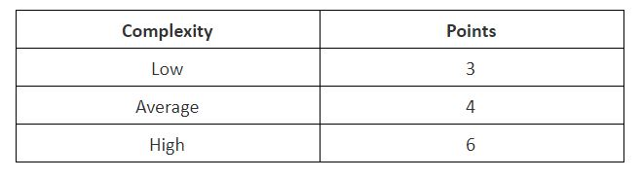
And based on the complexity, the FPA points are calculated

Slide 13
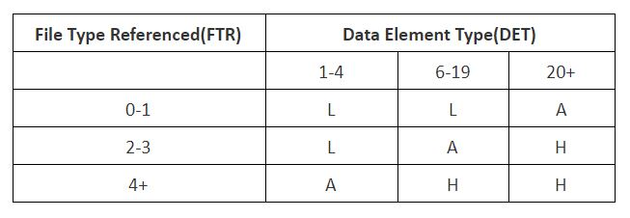
For External Output Transactions
As External Output is a Transactional type the complexity is judged based on FTR instead of RET.

Slide 14
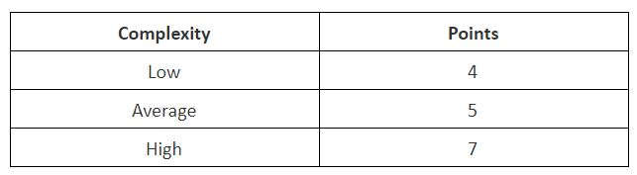
And based on the complexity, the FPA points are calculated

Slide 15
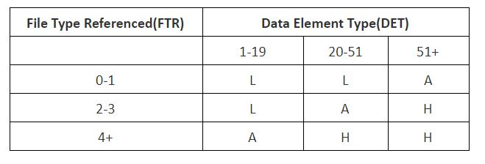
For Inquiries
As Inquiries is a Transactional type the complexity is judged based on FTR instead of RET.

Slide 16
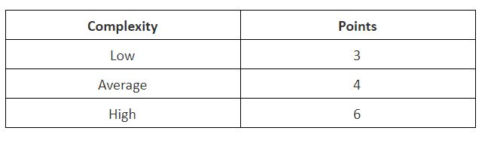
And based on the complexity, the FPA points are calculated

Slide 17
As we now have the reference chart to find the complexity of each variety of functions discovered in the system and that we also have the Points that should be assigned based on the complexity of each component. We can now look into the calculation.

Slide 18
Steps to Count the Function Points
1. Type of count: The very first step of this process is to determine the type of function count. There are 3 types of function point (FP) count.
Development Project FP Count: This measures the functions that are directly involved in the development of the final system. This would include all the phases of the project from requirements gathering to the first installation.
Enhancement Project FP Count: This measures the functions involved in the modifications brought in the system. That is the changes made to the system after production.
Application FP count: This measures the functions involved in the final deliverable excluding the effort of already existing functions that may have existed.
2. Scope and Boundary of the Count: In the second step, the scope and boundary of the functions are identified. Boundary indicates the border between the application being measured and the external applications. Scope can be decided with the help of data screens, reports, and files.

Slide 19
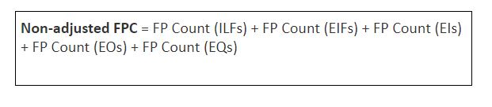
Steps to Count the Function Points
3. Unadjusted Function Point Count: This is the main step of this process where all the function points produced from the above FPA components (External Inputs, External Output, Internal Logic files, External Logic files, Inquiries) are added together and labeled as unadjusted function point count.
4. Value Adjustment Factor: In this step the value adjustment factor is determined. VAF contains 14 General system characteristics(GSC) of the system or application that defines the types of application characteristics and is rated on a scale of 0 to 5. The sum of all the 14 GSC rates are calculated to give out a mathematical value and is labeled as Total Degree Influence(TDI). TDI is used in the calculation of VAF and its value may vary from 0 to 35.

Slide 20
Below are the 14 GSCs listed and the mathematical formula for calculating the VAF.
Data communications
Distributed data processing
Performance
Heavily used configuration
Transaction rate
On-Line data entry
End-user efficiency
On-Line update
Complex processing
Reusability
Installation ease
Operational ease
Facilitate change
Multiple sites

Slide 21
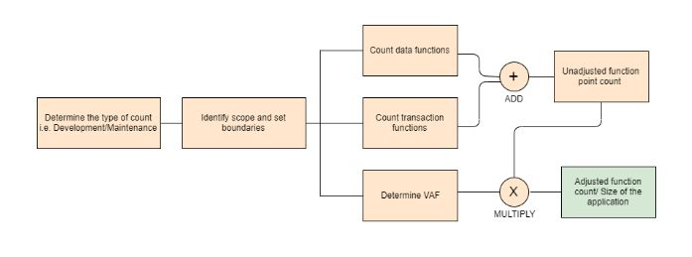
Once the unadjusted function point and value adjustment factor is calculated, the Adjusted Functional point count is found out using the two values. This is done with the help of the following formula.

Slide 22
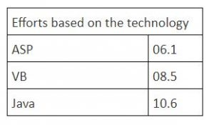
The Adjusted FPC is then multiplied with a numeric value, which is the effort based on the technology. Some of the examples are below.

Slide 23
If the technology selected for a particular requirement is Java, then the formula to calculate the final hours are as follows:
FPC = (Non-adjusted FPC*VAF) * 10.6
This will give the total hours of effort required to achieve the requirement under analysis.

Slide 24
Merits of Function Point Analysis
FPA measures the size of the solution instead of the size of the problem
It helps in estimating overall project costs, schedule, and effort
It is independent of technology/programming language
It helps in the estimation of testing projects
FPA gives clarity in contract negotiations as it provides a method of easier communication with business groups

